Slide 1
Psychic powers?

Slide 2
Topic: Psychic illusions Reading: Blackmore (1992), Psychic Experiences: Psychic Illusions, Skeptical Inquirer 16, 367-376. Group 5: Shu Min, Yan Ling (Presenter), Yi Mou

Slide 3
Outline
Introduction to psychic and illusion
5 types of illusion:
- Connections
- Control
- Pattern and randomness
- Forms
- Memory
Conclusion

Slide 4
Psychic
A psychic is a person who claims to use extrasensory perception (ESP) to identify information hidden from normal senses
Related to the human soul and mind
Examples: telepathy, déjà vu
People believe in psychic phenomena because they have psychic experience
Misinterpreted perception of the senses
Examples: Visual (optical) illusion, auditory illusion
Illusion

Slide 5
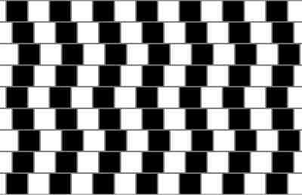
The rows of black and white squares are parallel.

Slide 6
There are only white circles in the intersection

Slide 7
Psychic experiences are comparable to visual illusions

Slide 8
Visual illusions are caused by a mismatch of what the eyes see and what the brain intercepts.
In the case of psychic experiences, it may be due to the illusion that a cause is operating and an explanation is required when in fact none is.

Slide 9
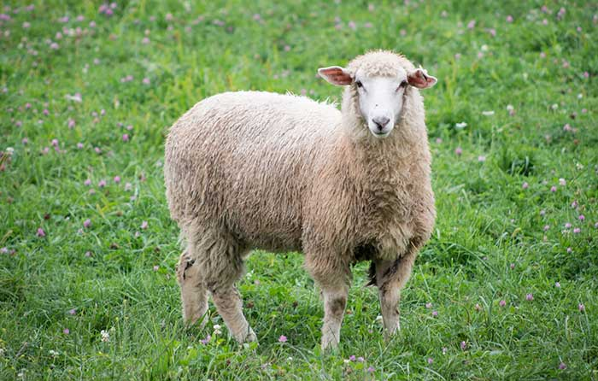
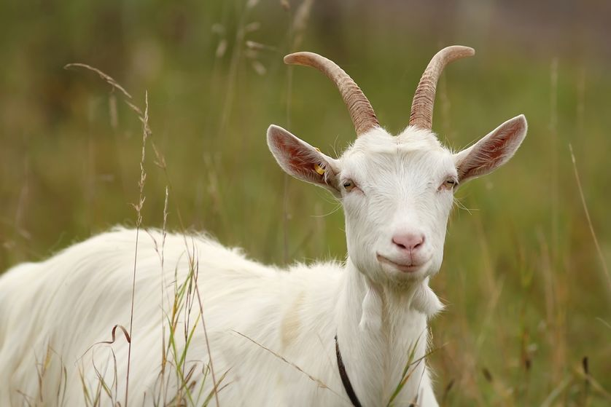
Believers in psychic phenomenal-sheep
Disbelievers in psychic phenomenal-goat

Slide 10
1. Illusions of connections
2 errors:
- Treat connected events as chance coincidences
- Treat chance events as connected and seek for explanations
Trying to find a connection even where there is none might be the reason for people having psychic experiences
That was a chance coincidence!
That cannot be chance!

Slide 11
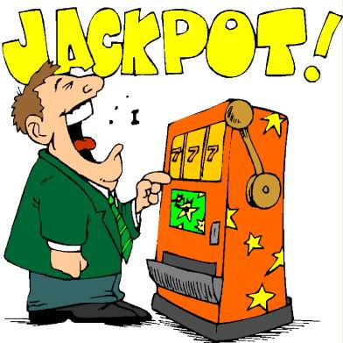
2. Illusions of control
Tendency for people to overestimate their ability to control events
Judgements of control depend on 2 conditions : an intention to create the outcome and the relationship between the action and the outcome

Slide 12
3. Illusions of patterns and randomness
People are bad at judging randomness and they cannot clearly distinguish between pattern and randomness
Experiment of generating a string of numbers, known as subjective random generation (SRG)

Slide 13
String 1
String 2
String 3

Slide 14
3. Illusions of patterns and randomness
People typically give far fewer repetitions of the same digit than would be expected by chance.
ESP experiments are often equivalent to SRG and show the same bias
2 errors: - failure to detect patterns that are there
- tendency to see patterns that are not there

Slide 15
4. Illusions of forms
Experiment: Object identification
3 pictures, the first being the blurriest

Slide 16
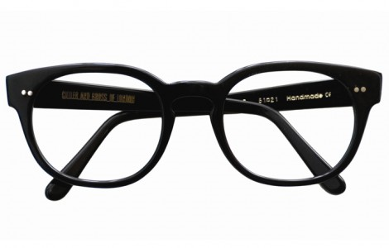

Slide 19
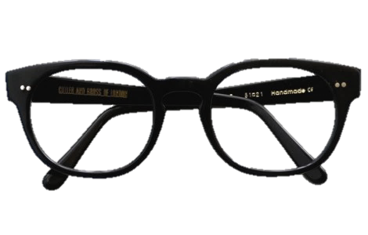

Slide 20
4. Illusions of forms
Goats were willing to say that there was a shape, but less likely in identifying them
The sheep would claim to see the forms earlier in the studies and identify them
Creativity may correlate with belief in the paranormal and the tendency to see forms
For those who often see forms in ambiguity, they are more likely the ones who will believe in paranormal activities or have psychic experiences

Slide 21
5. Illusions of memory
Selective memory may make coincidences appear to occur more often than they actually occur
Fortune telling
People who are prone to memory effects are more likely to have psychic experiences

Slide 22
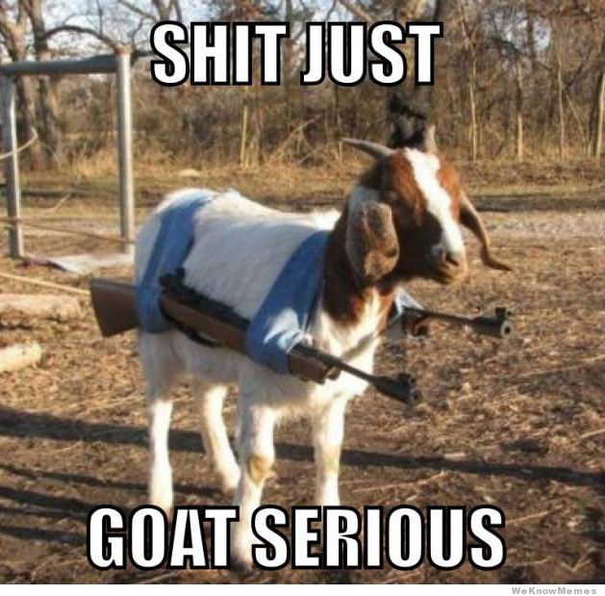
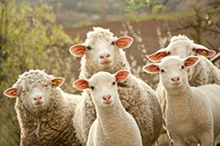
Conclusion
5 types of illusion (connection, control, patterns and randomness, forms and memory) are related to psychic experiences
Sheep tends to show many of these effects of illusions to a greater extent than goats

Slide 23
Thank you!

