Slide 1
How to sell a pseudoscience
Hui Ping, Xuan Qi, Chuan Yin

Slide 2
Contents
Tricks of the trade
How good are these tricks?

Slide 3
The tactics
Create a phantom
Set a rationalization trap
Manufacture source credibility and sincerity
Establish a granfalloon
Use self-generated persuasion
6) Construct vivid appeals
7) Use pre-persuasions
8) Frequently use heuristics and commonplaces
9) Attack opponents through character assassination

Slide 4
Tricks of the trade
1) create a phantom goal
Unattainable goal that looks possible
Prey on feelings of inadequacy
Eg séance where you can talk to the dead
Eg subliminal tapes to lose weight
2) set a rationalisation trap
Once you’re in, you may be motivated to stay to prove you are right
“foot-in-the-door” method
Ask for a small commitment
Then escalate it

Slide 5
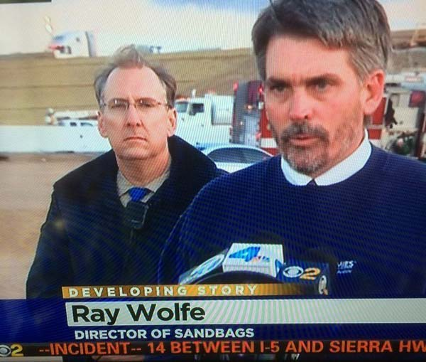
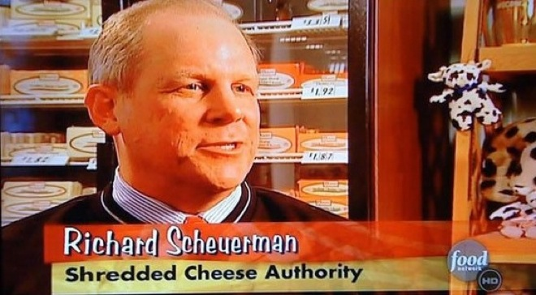
3) Manufacture source credibility

Slide 6
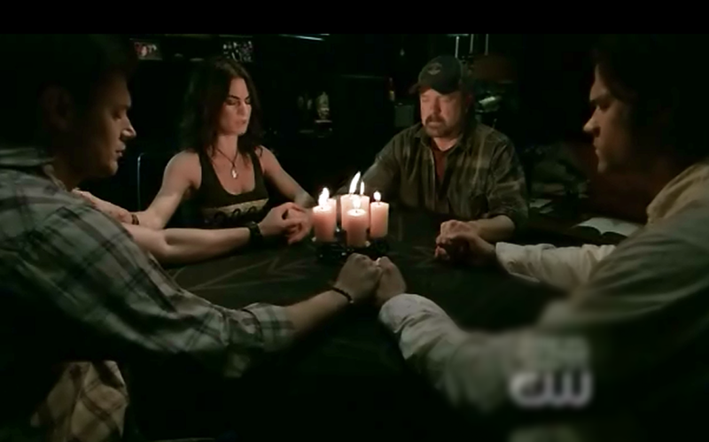
4) Establish a granfalloon
Granfalloon – “a proud and meaningless association of human beings”
When you assign people to groups and label them, and suddenly they are closer to their groupmates and hostile to the other group
Criticism is written off as things the other group, the “evil people”, would say
Eg séance
The medium says the gust of air is due to dead person blowing at them
People at the séance believe
Even if you don’t believe you won’t bring it up

Slide 7
5) Use self-generated persuasion
Let the victim persuade themselves
Eg Multi-Level Marketting (MLM)
Recruit victims to recruit others
When you have to persuade others,
You persuade yourself too

Slide 8
6) Construct vivid appeals
Shocking mental images or statistics
Lasting impression outcompeting rational explanations
Eg Borley Rectory hauntings
Such dramatic “case studies” serve as believer’s refute to truth
7) use pre-persuasion
Redefining the issue
Eg alternative medicine companies labelling their products as “health freedom” – who is likely to say they oppose freedom?
Claiming to be different from the rest – so any negative studies on them don’t apply to you

Slide 9
8) Frequently use heuristics and commonplaces
Consensus heuristic – what everyone agrees to must be true
Natural commonplace – natural = good, manmade = bad
9) Attack opponents through character assassination
Pointing out their flaws, digging up dirt
Changes the discussion from “is this a scam” to “is this person ethical”

Slide 10
The tactics
Create a phantom
Set a rationalization trap
Manufacture source credibility and sincerity
Establish a granfalloon
Use self-generated persuasion
6) Construct vivid appeals
7) Use pre-persuasions
8) Frequently use heuristics and commonplaces
9) Attack opponents through character assassination

Slide 11
How good are these tricks? Do you know anyone who fell for scams?
Sharing session ☺

