Slide 1
The perfect payday - fraud in the stock market
Liew Xuan Qi (A0157765N)
Cheong Hui Ping (A0127945W)
Hong chuan yin (A0155305M)

Slide 2
Forelle and Bandler (2006) The perfect payday Wall Street Journal

Slide 4
Overview
How the stock market works
The main problems
Backdating
Inattentive directors
Academic study findings
Root of problem
Greed
Start up fund
Consequences of Fraud
Methods to reduce the problem
Drawbacks of these methods
Take home message

Slide 5
Overview
How the stock market works
The main problems
Backdating
Inattentive directors
Academic study findings
Root of problem
Greed
Start up fund
Consequences of Fraud
Methods to reduce the problem
Drawbacks of these methods
Take home message

Slide 6
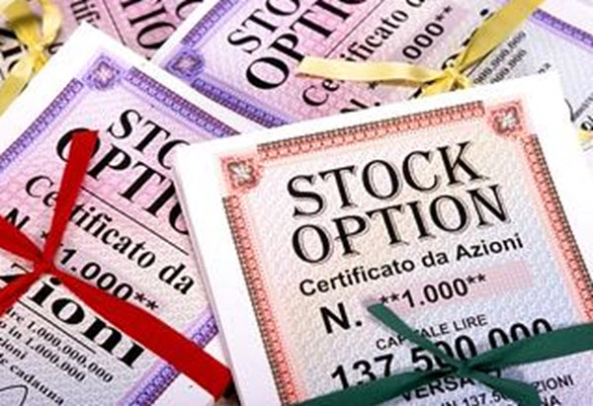
How the stock market works
Stock options give recipients a right to buy company stock at a set price, called exercise price
Exercise price can be
The stock’s 4pm price on the date of the grant
An average of the day’s high and low
The 4pm price of the day before
The exercise price fluctuates and depends on the grant date, which is the date the stock options were bought

Slide 7
How the stock market works
The lower the stock price, the more money the recipient can potentially make someday by exercising the options
The key purpose of stock options is to give recipients an incentive to improve their employer’s performance
Company is doing well → more people feel safe buying company’s stock → demand for stock rises → price rises

Slide 8
How the stock market works - Example
Difference in price of options makes a difference
Executive gets 100,000 options a day when the stock is $30 → pays $3mil
If the grant date was a month earlier, stock is $20 → pays $2mil
Exercising them when stock is $50 → get $5mil
Earns extra $1mil if grant date was 1 month earlier

Slide 9
Overview
How the stock market works
The main problems
Backdating
Inattentive directors
Academic study findings
Root of problem
Greed
Start up fund
Consequences of Fraud
Methods to reduce the problem
Drawbacks of these methods
Take home message

Slide 10
Luck or something else?
Shares of Affiliated Computer Services Inc. sank to the lowest level in the year
Chief Executive Jeffery Rich’s annual grant of stock options was dated that day, entitling him to buy stock at that price
Same pattern throughout Mr Rich’s tenure – all his stock option grants from 1995 to 2002 were dated just before a rise in stock price, often at the bottom of a steep drop
Odds of this happening by chance is very low (1 in 300billion)

Slide 11
The main problems - Backdating
Most effective way to consistently capture low price days for option grants
Wait for stock prices to rise and backdate to a day prior to the rise
Purchase stock options at a lower price and have confidence that the price of their stock will rise
Nobody authorizing grants on a given day would know how the stock would do in the future, post grant price surges would indicate backdating

Slide 12
The main problems - Backdating
Some companies’ top executives receive options on unusually favourable dates. This can help build fortunes even if company stock does not rise steadily
Vitesse Semiconductor Corp. chief executive Louis Tomasetta got a grant to buy 600,000 shares at a date where the shares were priced at its low for the year, allowing him to pocket more profits. 8 of his 9 option grants were dated just before a double digit price surge in the next 20 trading days. The odds of such a pattern occurring by chance is about 1 in 26billion

Slide 13
The main problems - Backdating
It is a way executives enrich themselves during the boom at the expense of shareholders
Option grants are long lived – those holding backdated grants can still profit despite them buying the grants many years ago
HOWEVER, some companies do option grants when there is a dip in stock price – might not be backdating

Slide 14
The Main problems – Inattentive directors
Someone picked a favourable past date for an option grant and gave it to the directors for retroactive approval, counting on them not to notice
A space for the grant date appears to have been left blank on paperwork approved by directors, or dates were later altered

Slide 15
Overview
How the stock market works
The main problems
Backdating
Inattentive directors
Academic study findings
Root of problem
Greed
Start up fund
Consequences of Fraud
Methods to reduce the problem
Drawbacks of these methods
Take home message

Slide 16
Academic study findings
Examined thousands of companies and found odd patterns of movement around the dates of grants
Share prices generally fell before option grants and appreciated sharply after → recipients get options at favourable times
Unlikely to happen by chance → at least some of the grant dates had to have been filled in retroactively
By chance alone, grants ought to be followed by mixed stock performance – some rise, some fall

Slide 17
Academic study findings
To quantify how unusual a grant is, a calculation of how much a company’s stock rose 20 trading days after a grant date. The analysis then ranked that appreciation against the stock performance for all other grant dates in the year according to how the stocks rose/fell
Use 20 days as a benchmark is reasonable because a longer period wouldn’t be a good way to spot backdating of a few days or weeks because the longer term trading would overwhelm any backdating effect
It is very unlikely that several grants spread over a number of years would all fall on high ranked days
Very unlikely that an executive’s overall multiyear grant pattern occurred merely by chance
HOWEVER, some companies make grants in days they thought the stocks were temporarily low. This could explain why the results differ somewhat from chance, but it wouldn’t account for the extreme pattern of consistent post-grant rise.

Slide 18
Overview
How the stock market works
The main problems
Backdating
Inattentive directors
Academic study findings
Root of problem
Greed
Start up fund
Consequences of Fraud
Methods to reduce the problem
Drawbacks of these methods
Take home message

Slide 19
Root of problem - greed
Big option grants tempted executives to do whatever it took to get the stock prices up until they cash in their options
Options richly reward executives due to stock buoyancy (stock prices rise unusually after a period of low) and not their own efforts

Slide 20
Root of problem – start up fund
Young firms with bright prospects but little revenue used stock options to attract and pay executives → stock options became a vast source of wealth

Slide 21
Overview
How the stock market works
The main problems
Backdating
Inattentive directors
Academic study findings
Root of problem
Greed
Start up fund
Consequences of Fraud
Methods to reduce the problem
Drawbacks of these methods
Take home message

Slide 22
Consequences of fraud
Accounting issues
Due to the options being backdated and the recipient receiving more profits → extra cost to the company.
If company failed to include such costs in the records, it will overstate profits and have to restate past financial results

Slide 23
Overview
How the stock market works
The main problems
Backdating
Inattentive directors
Academic study findings
Root of problem
Greed
Start up fund
Consequences of Fraud
Methods to reduce the problem
Drawbacks of these methods
Take home message

Slide 24
Methods to reduce problem
Securities and Exchange Commission (SEC) examine whether option grants carry favourable grant dates due to other reasons – backdating
Option grants are made by directors, with details often handled by a compensation committee. Many companies make their grants at the same time each year, a policy that limits the potential for manipulation of the date
In 2002, Sarbanes-Oxley law stated that companies have to report grants within 2 days, little leeway to retroactively date a grant

Slide 25
Overview
How the stock market works
The main problems
Backdating
Inattentive directors
Academic study findings
Root of problem
Greed
Start up fund
Consequences of Fraud
Methods to reduce the problem
Drawbacks of these methods
Take home message

Slide 26
Drawbacks of the methods
Companies still report about ¼ of option grants later than the 2 day dateline. Delayed reporting is associated with big price gains → suggestive of backdating

Slide 27
Overview
How the stock market works
The main problems
Backdating
Inattentive directors
Academic study findings
Root of problem
Greed
Start up fund
Consequences of Fraud
Methods to reduce the problem
Drawbacks of these methods
Take home message

Slide 28
Take home message
It is important to maintain integrity in the stock market and not take advantage of power to engage in dishonest acts to profit

