Slide 1
Do antidepressants really work?
Group 4: Chan Yong Ming, Timothy Peh, Bernetta Kwek
Presenter: Bernetta Kwek

Slide 2
Assigned reading
Johnson, Blair R. and Kirsch, Irving (2008). Do antidepressants work? Statistical significance versus clinical benefits. Significance 5(2), 54-58.

Slide 3
Outline of the presentation
Background information
Statistical significance
Statistical results
Clinical significance
Clinical results
The odds
Standards of clinical significance
Conclusion

Slide 4
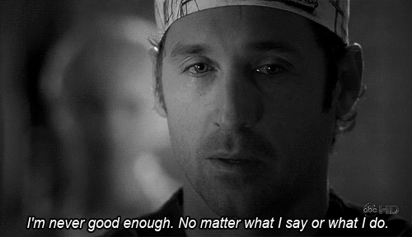

Slide 5
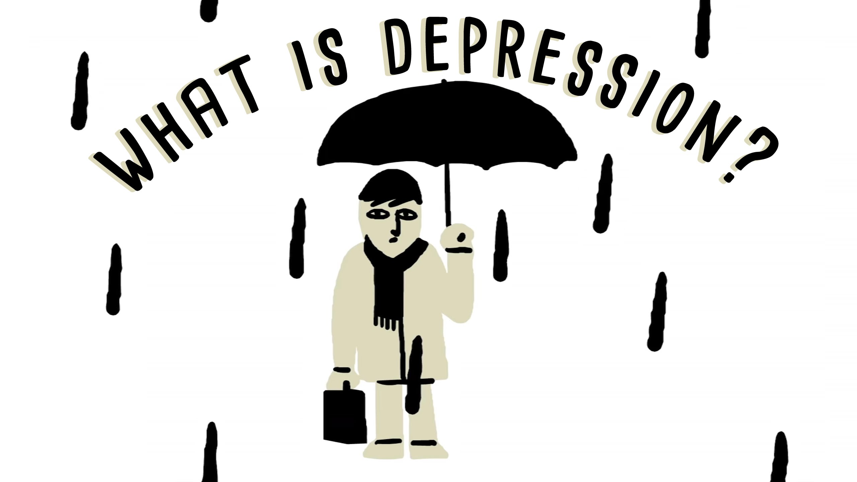
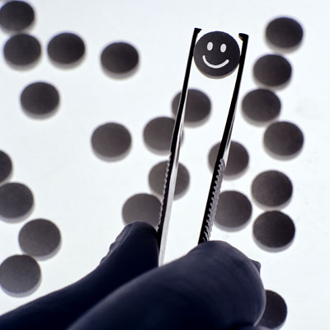
Background information
Depression:
serious issue that affects millions and billions of people
Can be long term or short term problem
Range of severity
Lead to many problems which makes everyday functioning difficult
Antidepressants:
Most common prescription for depression
Believed to “cure” depression

Slide 6
Statistical Experiment
What was done:
35 trials submitted by drug companies to the FDA
Double blinding
Compare responsiveness of patients on antidepressants to those on placebo
Placebo condition provides a test of how much better the drug improves the problem compared with an inert solution

Slide 7
Results
OVERALL,
Patients on antidepressants were significantly less depressed than those on placebo
antidepressants’ benefits depended on how severely depressed patients initially were
worked rather poorly for patients with lower initial levels of depression

Slide 8
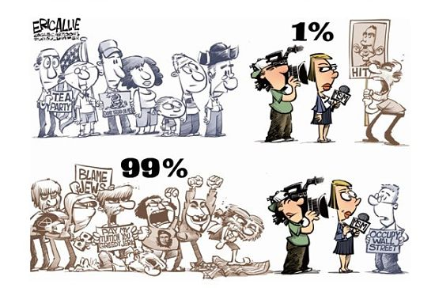
Results – message taken
The media cherry picks
portrayed the results as “antidepressants do not work”
In actual fact, antidepressant works better on people with more severe depression
For patients with low levels of depression, antidepressants were unlikely to give much of an advantage compared with placebo
Antidepressants works better for people with more severe depression
Antidepressants do not work

Slide 9
Statistical significance
results from comparisons of trends in improvement between drug and placebo

Slide 10
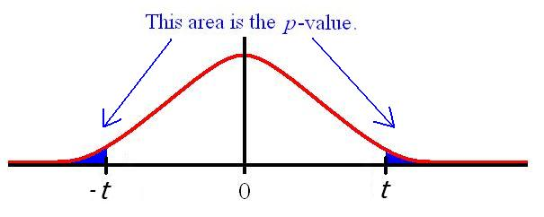
Statistical significance
Calculate test statistic
Find the p-value (probability of obtaining a result at least as extreme as the observed comparison)
H0: no difference in improvement between the groups
H1: there is a difference in improvement

Slide 11
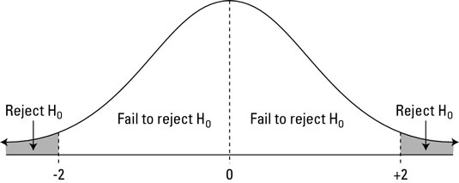
Statistical significance
So how do we determine significance?
We use the p-value obtained and compare it with the significance level
If p-value is less than the significance level,
We reject our null hypothesis
It is statistically significant, there is a significant difference

Slide 12
Clinical significance
How much improvement is needed to be practically important?
People often use clinical standards to interpret statistical results
But they may not be the same
What did they do?
adopted a 3-point difference on the physician-rated Hamilton rating scale of depression (HRSD)
show how useful antidepressants are for the average patient

Slide 13
Clinical significance - results
clinical significance is reached when a careful observer can see the difference in improvement between the 2 groups
The difference of 3 or more points on the HRSD are considered to be clinically significant

Slide 14
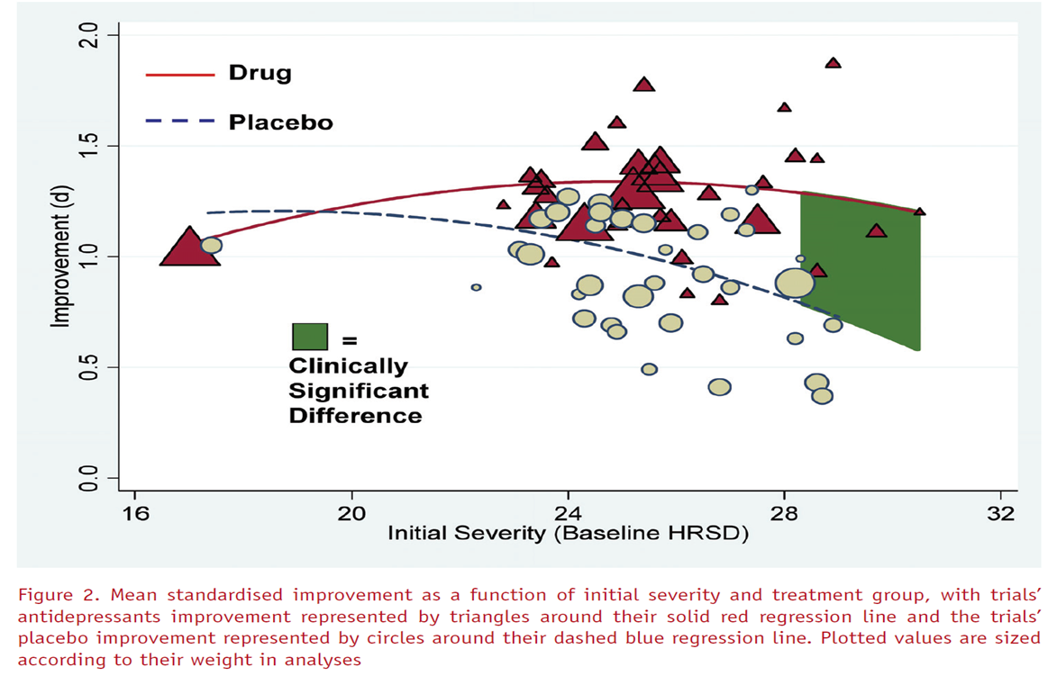
Clinical significance
concluded that there is clinical significance for patients with initial severe levels of depression, vice versa.

Slide 15
Clinical significance
trials rarely met the 3-point clinical significance criterion unless they sampled extremely severely depressed patients

Slide 16
The odds
But don’t patients and physicians claim that antidepressants are highly effective?
Our findings seem to be at odds with clinical practice
Normal clinical practice patients are not routinely prescribed with placebos
Placebos and drugs are not given to patients randomly
Doctors and patients are not double blinded
reported success comes from the changes a patient expects rather than from the drug itself

Slide 17
Standards of clinical significance
Statistical significance itself is not enough; must also consider clinical significance
FDA only considers the statistical significance when licencing antidepressants medications
But is it precise enough?
In other words, should we be satisfied that there is clinical significance only for the severely depressed patients?

Slide 18
Standards of clinical significance
Baseline: 25 (severe)
After taking drug: 15 (moderate)
After taking placebo: 17 (moderate)
Problem: score of around 15 for our average drug patient still leaves him or her with strong depressive symptoms
Even though there is high clinical significance, there is still work to be done to cure the patient’s depression

Slide 19
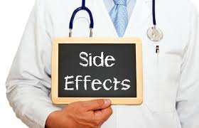
Standards of clinical significance
Conclusion:
more stringent comparison criterion of the clinical significance will make it harder to be obtained
Why is there contrasting viewpoints?
Some individuals may respond better to antidepressants
Side effects often accompany antidepressants

Slide 20
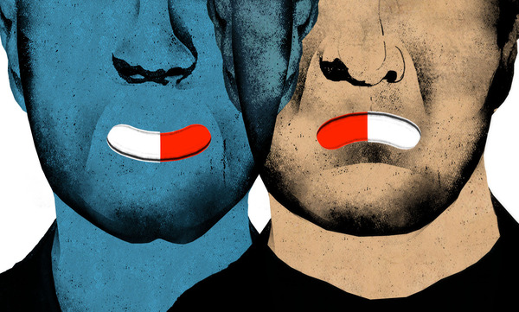
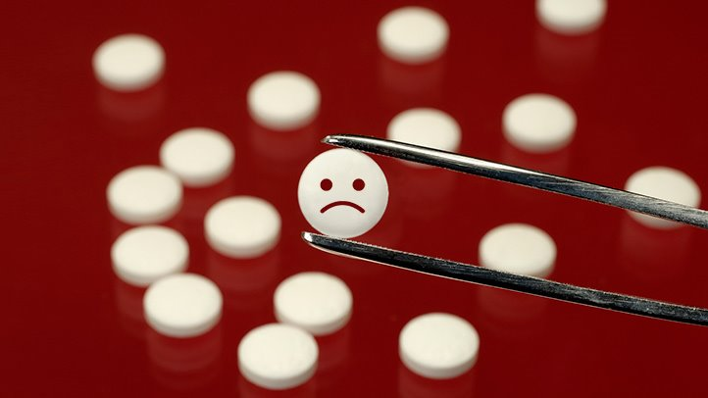
Conclusion
Clinicians do not have the power and ethic to merely prescribe placebos
Antidepressants are generally more expensive and other forms of therapy may be more cost effective
Whatever solution is attempted to reduce depression, there is bound to be costs and benefits
antidepressant are not as great as it has been commonly believed

