Slide 1
Corruption in NCAA basketball, Exposing cheating and corruption
Group 3

Slide 2
Outline
Questions to be addressed
University Of Pennsylvania Vs Harvard
Incentives for Corruption
Types of corruption
Statistical Evidence That Point Shaving Exist In NCAA
Confounding factors
Conclusion

Slide 3
Questions to be addressed
What is the main problem in this article?
Explain the statistical evidence that point shaving exists in NCAA basketball.

Slide 4
University Of Pennsylvania Vs Harvard
The University Of Pennsylvania was widely expected to win.
But, instead of offering short odds on Penn winning the game, bookmarkers offered an almost even bet of ( bet $11 to win $10) on whether Penn would win relative to a spread of 14.5
A spread of 14.5 mean that Penn would win only if they won the game by 15 or more points.While a bet on Harvard will be successful if Harvard either won or lost by 14 or fewer points.
This provides incentive for point shaving as they can bribe the Penn players to win and not cover the spread while they bet on Harvard.

Slide 5
Incentives for Corruption
Derived from: - the structure of basketball betting - the asymmetric incentives of players, and gamblers
gambler offers a contingent payment to the player, with the contingency being that he pay only if the team fails to cover the spread.
Given players indifferent over the size of the winning margin, even a small bribe may dominate his desire to increase the winning margin.

Slide 6
Types of corruption
Point shaving: shave the winning margin below the point spread.
Players will be bribed not to cover the point spread.
Favourites are more likely to shave points than are underdogs.
Strong favourites are more likely to shave points than weak favourites
Point shaving is less likely when the probability of detection is high.

Slide 7
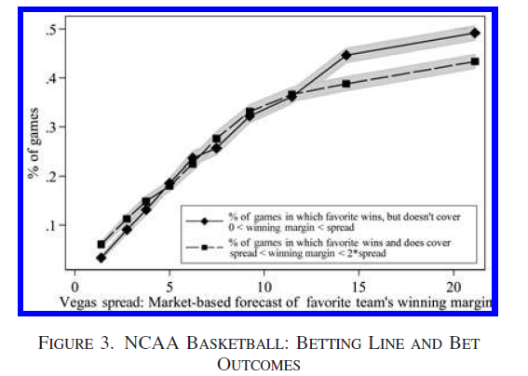
Statistical Evidence That Point Shaving Exist In NCAA
From Figure 3, it can be seen that the % of the favourite team that win and not covering the spread is much higher than the % of them winning and covering the spread.
The strong team are expected to win by a margin and having a high % of them not covering the spread shows that point shaving exist in NCAA.

Slide 8
Confounding factors
Efforts: -players reducing their effort -coaches may use second-tier players -losing team will also reduce its effort → distribution will be largely unaffected.
Betting market inefficiency -Overestimating the favorite’s ability may also be a reason why they did not manage to cover the spread

Slide 9
Conclusion
Point shaving reflected a conspiracy between players and gamblers, selective manipulation by coaches of playing time for star players.
Need not have any gamblers offering bribed, as players can place bets themselves, rendering a coconspirator an unnecessary added expense.
Take home message: Do not gamble as results can be manipulated.

