Slide 1
Week 11!!
Crystal Wang
Foo Jia Yuan
Ivan Lieu

Slide 2
This week’s reading
Sad suspicions about scores in basketball, The New York Times
Questions to address:
What is point shaving?
What is its motivation?

Slide 3
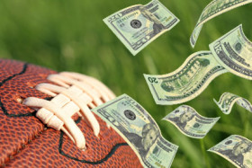
How the story goes…
Given so many sports betting in the world(lotteries, poker, football), college basketball is the easiest sport to fix
Played by young men who are usually not so rich, they will be willing to play badly on purpose to earn the bribe
5 players on the court, 1 person can determine the outcome
Betting is through point-spread system, where bets are based on margin of victory rather than wins and losses, allows players to fix a game without losing it
College basketball is a big business today, its a national pastime
Notes:
Point 1 - by bribing the players
Point 2 - Play badly but his team will still win, just need to fall short of the point spread which i will explain later
Point 3 - Just need 1 player to purposely drop the ball and let opponent pick it up, or purporsely pass the ball wrongly to opponent to let them score.

Slide 4
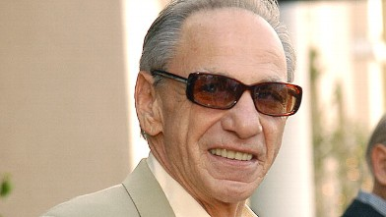
Henry Hill Example
Famous mobster in New York City
One fine day he was sitting in the Boston Garden watching a basketball game that he had helped fix. He had paid off two Boston College players to beat Harvard by less than the 12-point spread. Boston College won, 86-83, and Mr. Hill won his $15,000 bet.

Slide 5
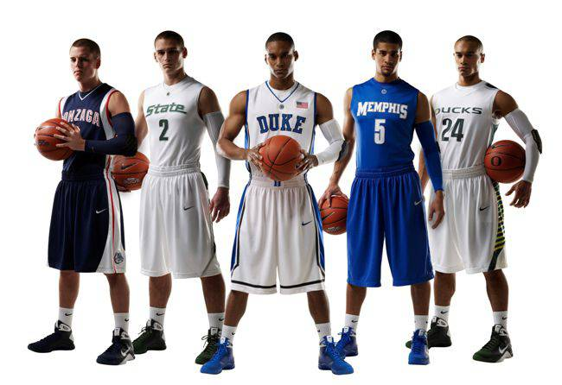
How the story goes...
Mr Wolfers, researcher who sift through data to look for patterns of cheating that otherwise go unnoticed
Collected results of nearly every college basketball game over last 16 years
Turns out that heavy favourite basketball teams just miss covering the spead
Seems that point shaving that occurs in about 5% of all games with large spreads is the reason that can explain the pattern
Notes:
You can probably guess where this is going. Mr. Wolfers has collected the results of nearly every college basketball game over the last 16 years. In a surprisingly large number of them, it turns out that heavy favorites just miss covering the spread. He considered a number of other explanations, but he thinks there is only one that can explain the pattern. Point shaving appears to be occurring in about 5 percent of all games with large spreads.

Slide 6
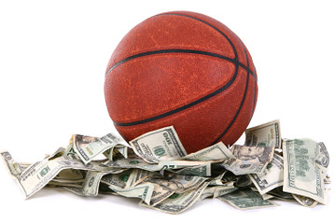
What is point shaving?
Point spread system require gamblers to bet on whether favored team will win by at least a certain margin. By agreeing to fall short of that, players can fix a game and still not lose the game
Eg. Team A(favoured) VS Team B.
Team A expected to win Team B by 12 points spread (20-8, 72-60, etc)
To fix a game, gamblers bet that Team A will win Team B by less than 12 points, and Team A will purposely win Team B by less than 12 points, even if they have the ability to win by more than 12 points (15-8, 65-60)
Team A will still win, its just that the gamblers will also win, and win even more
Notes:
This is the motivation. Players can earn money without losing, gamblers can win more money. Win-win situation

Slide 7
How the story goes...
Favoured teams with big spreads are the ones that have the biggest advantage to be able to do something
Eg Point spread of 20. Team A VS Team B again
Team A just have to win Team B so long as their difference is not more than 20. (50-45, 50-40, 50-35, etc)
The greater the spread, the more the number of outcomes that the teams can win with.

Slide 8
Conclusion
A lot of times things are not what it seems to be on the surface
Simple activity like playing basketball can have so many complications(bribing players, fixing the game)
Defeats the purpose of how sports should be, the fun
Frauds everywhere and we should not blindly trust everything we see

