Slide 1

Blowing in the right direction with statistics
Group 1: Mei Ying (presenter), Fatin, Boon Xuan
Based on: Genton, M. and Hering, A. (2007). Blowing in the wind.
Significance, 4 (1), 11-14.
Notes:
http://clipart-library.com/clipart/34864.htm

Slide 2

What is on the menu?
-Introduction to wind power
-Wind forecasting
-Physical models
-Statistical models
-Model evaluation
-Conclusion
https://www.ovoenergy.com/binaries/content/gallery/ovowebsitessuite/images/ovo-answers/energy-and-environment/how-do-wind-turbines-work-large.png/how-do-wind-turbines-work-large.png/ovowebsitessuite%3Acarousel

Slide 3
Introduction to Wind Power

Slide 4
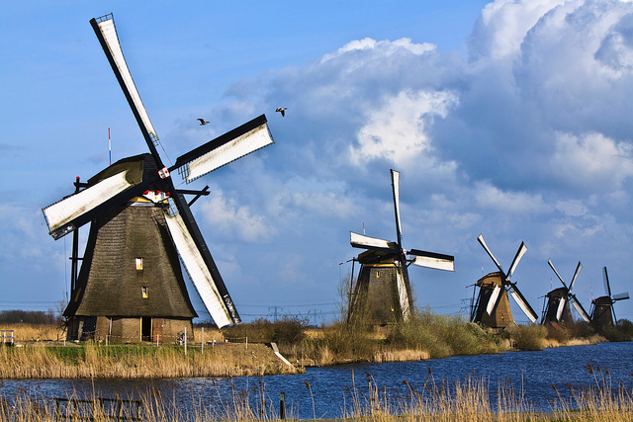
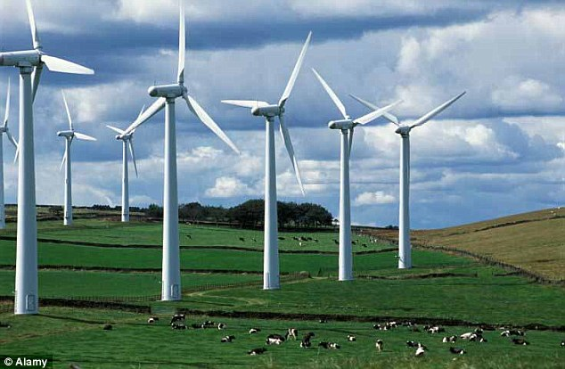
Introduction to wind power
In the past: Windmills
Modern times: Wind turbines
https://farm5.staticflickr.com/4006/4479418995_d35d484e19_z.jpg
http://i.dailymail.co.uk/i/pix/2014/10/26/1414367019982_wps_62_Wind_Farm_Ingbirchworth_W.jpg
Wind energy→ turns windmill→ rotational energy→ mill grains/pump water etc
Wind energy→ turns turbine→ rotational energy→ Electrical energy

Slide 5
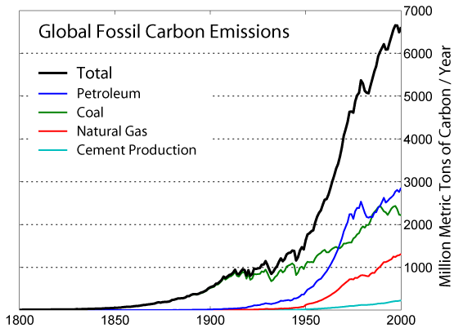
Why wind power?
1
VS
1
Wind Power is cleaner!
2
Wind farms can be set up rapidly and easily
https://scied.ucar.edu/sites/default/files/images/long-content-page/%3Cem%3EEdit%20Long%20Content%20Page%3C/em%3E%20Climate%20Today/co2_emission_1800_2000_0.png
3
Safer than nuclear power
4
Wind is free and abundant, so why not?

Slide 6
Some mind-BLOWING Figures
One onshore turbine can produce up to 1.5-1.8 MW of electricity → can power 1000 homes for a year!
2. The energy produced by all wind turbines in 2010 is 430 TWh/year, more than the energy consumption of the UK.
3. In 2010, Asia had the highest growth rate of 50.6% from the previous year in terms of installed wind capacity.

Slide 7




Problem with Wind power
On normal/windy days
Meets energy demand
Conventional power plants
https://img.clipartfest.com/a38a72b41d593a820f139a835e305982_wind-turbines-and-landscape-clipart-wind-turbine_10176-4033.png
http://us.123rf.com/450wm/soleilc1/soleilc11310/soleilc1131000005/23019489-power-plants-nuclear-plants-factories-and-industrial-buildings.jpg?ver=6
http://clipart-library.com/data_images/352178.png
https://img.clipartfox.com/6475940b9d5cc6ce1e9f4aa2776680d2_gust-of-wind-clipart-wind-pictures-clip-art_236-283.jpeg

Slide 8
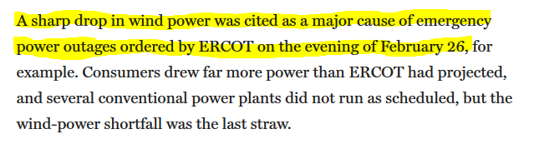
Problem with Wind power
On not so windy days
Not enough energy to meet demand
OMG why no power?!
Conventional power plants
Blackout, power lost
https://img.clipartfest.com/a38a72b41d593a820f139a835e305982_wind-turbines-and-landscape-clipart-wind-turbine_10176-4033.png
http://us.123rf.com/450wm/soleilc1/soleilc11310/soleilc1131000005/23019489-power-plants-nuclear-plants-factories-and-industrial-buildings.jpg?ver=6
http://clipart-library.com/data_images/352178.png
https://img.clipartfox.com/6475940b9d5cc6ce1e9f4aa2776680d2_gust-of-wind-clipart-wind-pictures-clip-art_236-283.jpeg

Slide 9
Wind Forecasting

Slide 10

Wind forecasting- Forecast horizon
To ensure efficient energy supply, wind forecasting is done to predict how much power will be produced by the wind farm so that backup energy can be called up if needed.
How long into the future should I predict for?
Forecast horizon:
The number of hours into the future you want to predict for.
http://cdnjs.cloudflare.com/ajax/libs/twemoji/2.2.0/2/svg/1f914.svg
Notes:
Short term vs long term

Slide 11

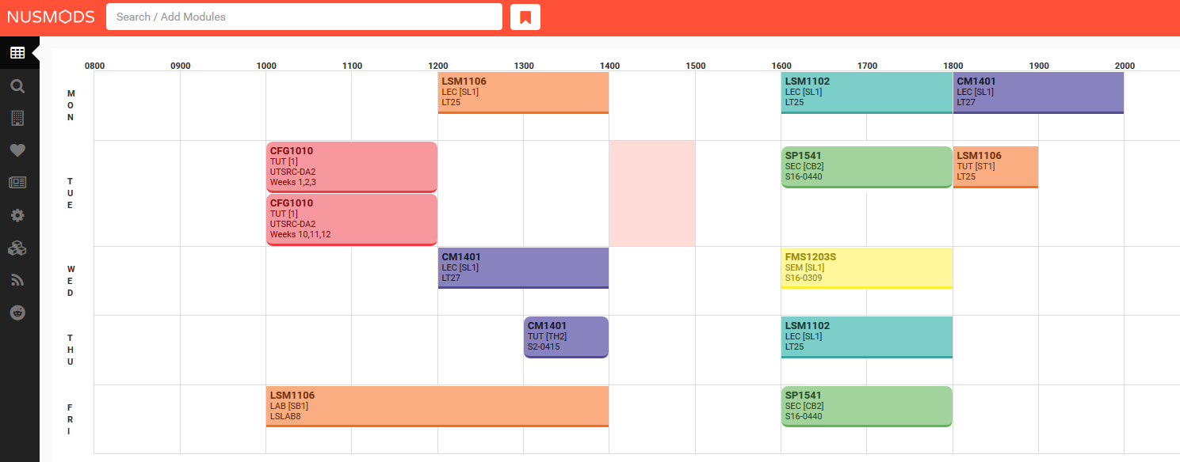
Short-term forecast
Forecast horizon range: a few minutes, 3-10 hours.
Common reasons for a short-term forecast:
Scheduling and dispatch of electrical power
https://www.clipartsgram.com/image/506055525-clock-clipart-for-kids-clipart-panda-free-clipart-images-s3nek2-clipart.gif
Notes:
Short term vs long term

Slide 12

Longer-term forecast
Forecast horizon range: 0-48 hours, 2-5 days.
Common reasons for a longer-term forecast:
0-48 hours: Economical dispatch
2-5 days: maintenance of wind turbines
http://media.istockphoto.com/vectors/january-2017-calendar-illustration-vector-id485427752?k=6&m=485427752&s=170667a&w=0&h=sNAytY6gn9kbqSz08f-dlM-GLPAUp_WCy0GtzqF1pHQ=
Notes:
Not advisable to do more than 5 days as forecast accuracy will drop.

Slide 13
Physical models for forecasting

Slide 14
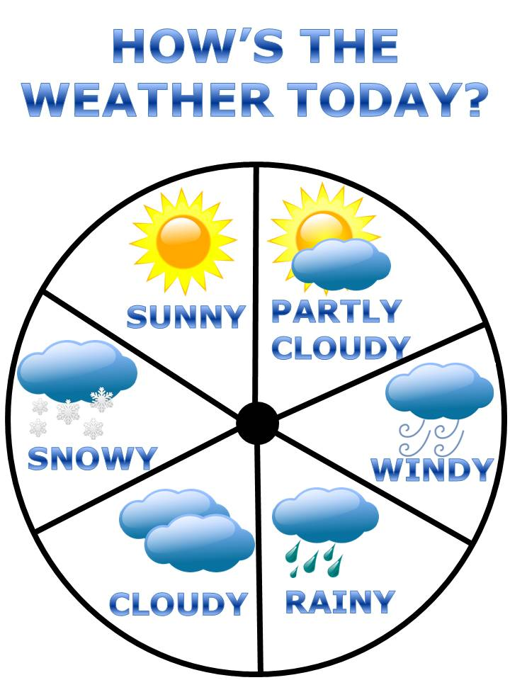
Physical models
Using data from the physical environment to predict wind power
-Using data from numerical weather prediction (NWP) models.
NWP models are used to predict atmospheric behavior during certain periods→ used to predict the day’s weather.
NWP models can also provide information about the wind which helps in wind forecasting.
-Preferred for forecast horizons > 24 hours
https://img.clipartfest.com/24d9b083e7c4ce77782e97727a31dbac_weather-clip-art-weather-free-weather-clip-art_720-960.jpeg
Notes:
http://www.dewi.de/dewi/fileadmin/pdf/publications/Magazin_44/03.pdf
http://www.nea.gov.sg/training-knowledge/weather-climate/numerical-weather-prediction-(nwp)

Slide 15
Statistical models for forecasting

Slide 16
Statistical models
Examples of statistical methods:
Artificial Neural Networks (ANN)
AutoRegressive Moving Average methods (ARMA)
Previously recorded wind data
Purely statistical model→ only good for short term forecast (<6 hours)
Notes:
Structural vs blackbox

Slide 17
Statistical models
Purely statistical model→ only good for short term forecast (<6 hours)
Physical model output eg NWP data
Better, more accurate forecast!
Notes:
Structural vs blackbox

Slide 18
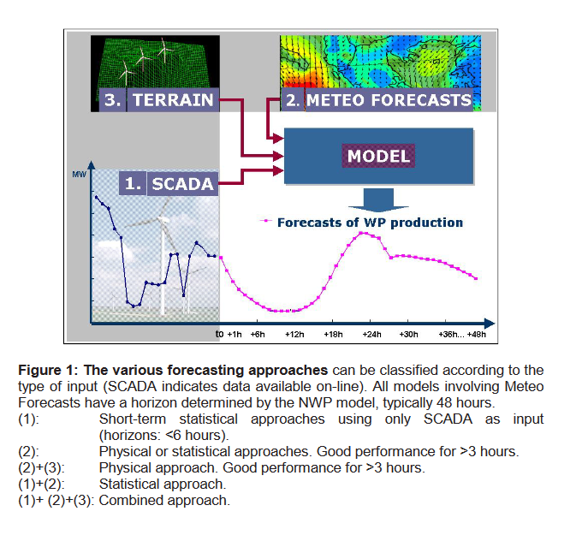
Combining statistical and physical models
Physical/statistical data
Physical data
Statistical data
Source: Giebel, 2003.

Slide 19
Model evaluation

Slide 20
Model evaluation
Question:
Is this model good?

Slide 21
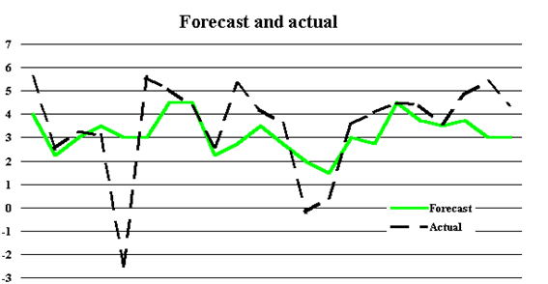
Model evaluation- using RMSE
3
Compare who has lower RMSE
1
Establish your reference model
(Usually people use Persistence model*--> use last hour’s wind speed as the forecast for the next hour)
2
Persistence forecast (reference)
Your model’s forecast
The model with lower RMSE is better
Calculate root-mean-square error (RMSE)
Calculate RMSE
http://www.aph.gov.au/binaries/library/pubs/cib/2000-01/01cib17-2.gif

Slide 22
Conclusion
Wind power is the energy of tomorrow but has a problem with intermittency.
Wind forecasting is done to predict the wind power available for use during a certain period, allowing us to take the necessary action in response.
Physical and statistical approaches are used to create models to forecast wind power.
With increased reliance and complexity of wind power, better forecasting models must be created to meet society’s demands.

Slide 23
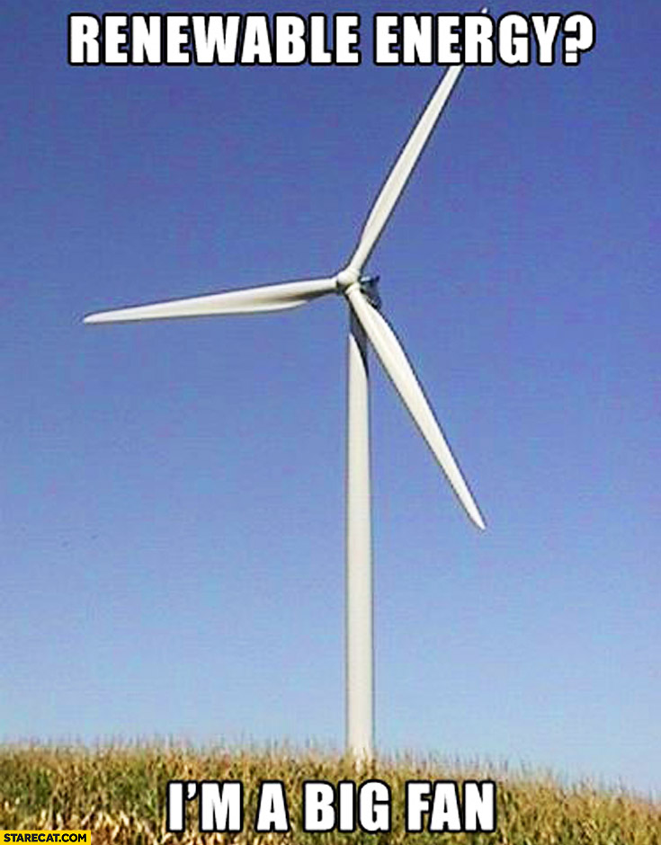
Thank you and have a fantabulous day
http://starecat.com/content/wp-content/uploads/renewable-energy-im-a-big-fan.jpg

Slide 24
References
-Genton, M. and Hering, A. (2007). Blowing in the wind. Significance, 4 (1), 11-14.
-https://www.technologyreview.com/s/409921/scheduling-wind-power/
-http://www.nrel.gov/docs/fy11osti/50814.pdf
-http://www.nea.gov.sg/training-knowledge/weather-climate/numerical-weather-prediction-(nwp)
-http://www.nrel.gov/docs/fy03osti/33956.pdf
-http://www.dewi.de/dewi/fileadmin/pdf/publications/Magazin_44/03.pdf
-http://ecolo.org/documents/documents_in_english/wind-predict-ANEMOS.pdf
-GEH1034 lecture notes

