Slide 1
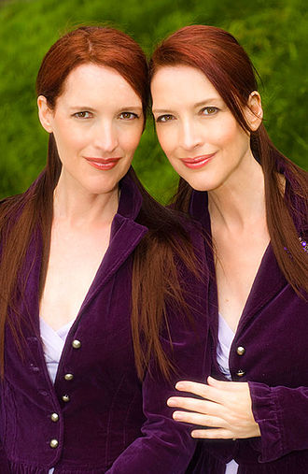
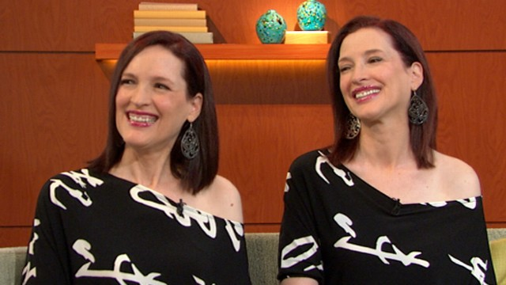
Linda and Terry Jamison
Claimed to have predicted the September 11 attacks on the World Trade Center
during a November 2, 1999 interview on the Art Bell Radio Show

Slide 2
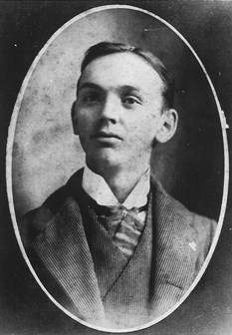
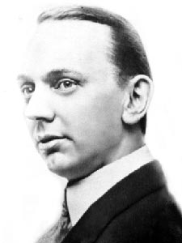
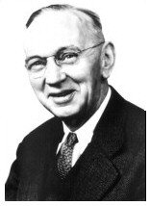
Edgar Cayce
(March 18, 1877 – January 3, 1945)
an American Christian mystic who answered questions on subjects as varied as
healing, reincarnation, wars, Atlantis, and future events while in a trance

Slide 3
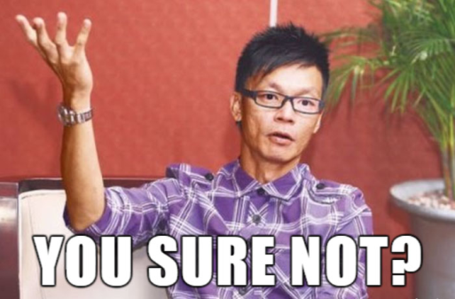
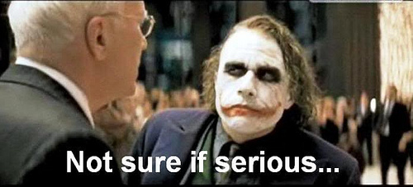
How to be a psychic?
By Group I: Boon Xuan(presenter), Mei Ying and Fatin

Slide 4
Assigned reading
Polidoro (2011), I was a teenage psychic, Skeptical Inquirer, Vol 35.3.

Slide 5
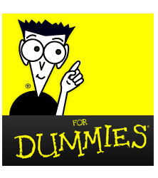
Dummy guide’s to being a psychic
Step 1: Know what is a Psychic
Step 2: Go on TV and perform tricks (Reciprocity Principle)
Step 3: Have friends beside you acting puzzled and believe in that you really have psychic powers (Authority Factor)
Step 4: Motivate spectators to participate in the experiment (Shortage Principle)
Step 5: Have one or two person calling you on TV to start the ball rolling (Social Confirmation Principle)
Step 6: Conclusion

Slide 6
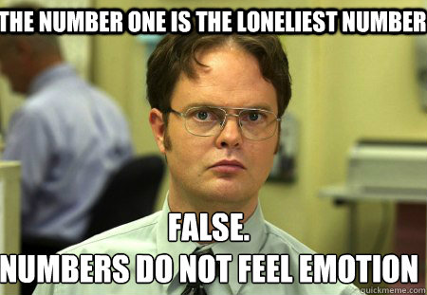
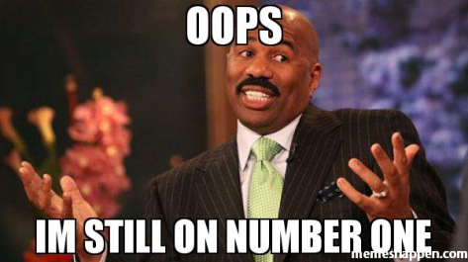
Step 1
What is a psychic?
A psychic is a person who claims to use extrasensory perception (ESP) to identify information hidden from the normal senses. The word "psychic" is also used as an adjective to describe such abilities.
History of the word
The word "psychic" is derived from the Greek word psychikos ("of the mind" or "mental"), and refers in part to the human mind or psyche (ex. "psychic turmoil"). The Greek word also means "soul". In Greek mythology, the maiden Psyche was the deification of the human soul. The word derivation of the Latin psȳchē is from the Greek psȳchḗ, literally "breath", derivative of psȳ́chein, to breathe or to blow (hence, to live).
French astronomer and spiritualist Camille Flammarion is credited as having first used the word psychic, while it was later introduced to the English language by Edward William Cox in the 1870s.

Slide 7
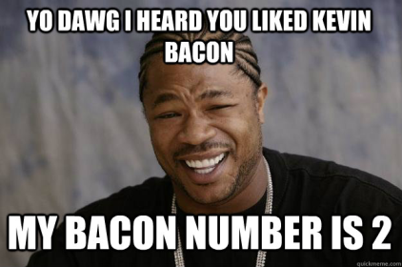
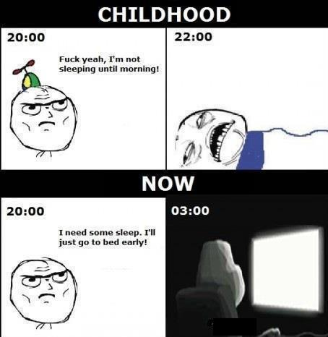
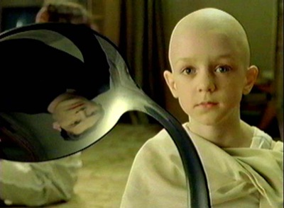
Step 2: Reciprocity Principle(Instructions)
Go on TV to obtain a large enough audience. This is in link with Step 5: Social Confirmation Principle which I will cover later.
Start to perform tricks such as bending spoons, correctly guessing a drawing in an envelope or germinating some radish seed in your hand.
And you are done for Step 2.

Slide 8
Step 2: Reciprocity Principle(explanation)
What you have essentially done is offering something solid to the viewers: convincing demonstrations of extraordinary powers.
This activates Reciprocity Principle which states that we have to reciprocate when we are given something.
In this case, in exchange for the demonstrations you have given, the viewers might have felt more obligated to give what you had to say more attention

Slide 9
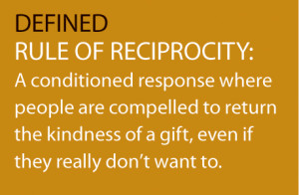
Step 2: Reciprocity Principle(explanation)
What is Reciprocity Principle?
In social psychology, reciprocity is a social rule that says people should repay, in kind, what another person has provided for them; that is, people give back the kind of treatment they have received from another. This sense of future obligation associated with reciprocity makes it possible to build continuing relationships and exchanges. Reciprocal actions of this nature are important to social psychology as they can help explain the maintenance of social norms.

Slide 10
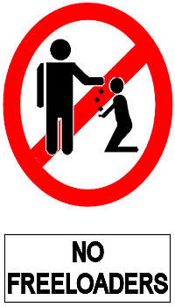
Step 2: Reciprocity Principle(explanation)
Why do we abide by this principle?
A person who violates the reciprocity norm by accepting without attempting to return the good acts of others is disliked by the social group. Individuals who benefit from the group's resources without contributing any skills, helping, or resources of their own are called free riders. Both individuals and social groups often punish free riders, even when this punishment results in considerable costs to the group. Therefore, it is unsurprising that individuals will go to great lengths to avoid being seen as a moocher, freeloader, or ingrate.

Slide 11
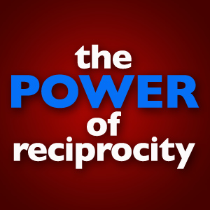
Step 2: Reciprocity Principle(explanation)
Power of Reciprocity Principle
Reciprocity is not only a strong determining factor of human behavior; it is a powerful method for gaining one's compliance with a request. The rule of reciprocity has the power to trigger feelings of indebtedness even when faced with an uninvited favor and irrespective of liking the person who executed the favor.

Slide 12
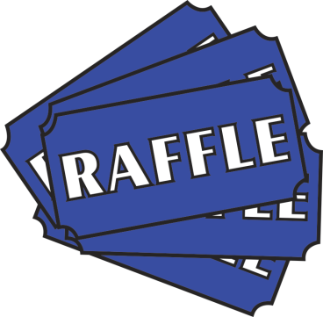
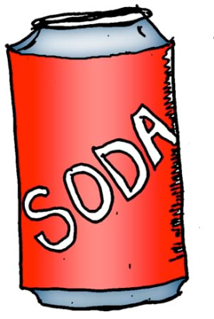
Step 2: Reciprocity Principle(explanation)
Power of Reciprocity Principle
In 1971, Dennis Regan tested the strength of these two aspects of reciprocity in a study where participants believed they were in an art appreciation experiment with a partner, Joe, who was really Regan's assistant. During the experiment, Joe would disappear and bring back a soft drink for the participant. After this phase of the experiment was over, Joe would ask the participant to buy raffle tickets from him. The more the participants liked Joe, the more likely they were to buy raffle tickets from him. However, when Joe had given them a soda and thus indebted them to reciprocate, it made no difference whether the participants liked Joe or not, the rule of reciprocity overpowered liking. Thus, individuals who we might not even like have the power to greatly increase our chances of doing them a favor simply by providing us with a small gift or favor prior to their request. Furthermore, we are obliged to receive these gifts and favors which reduces our ability to choose to whom we wish to be indebted.

Slide 13
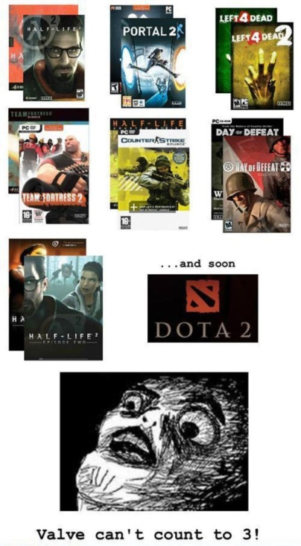
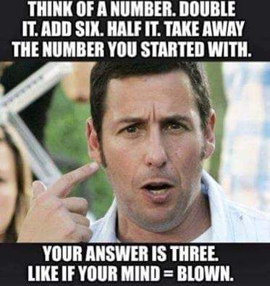
Step 3: authority factor(Instructions)
Have friends or request the hosts of the TV show you are on to act puzzled and believe in that you are really performing something supernatural.
That is all for Step 3. Simple.

Slide 14
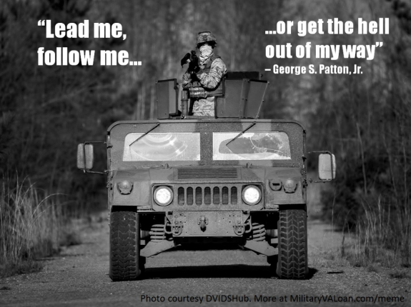
Step 3: authority factor(explanation)
By showing others that there are people believing in you, Authority Factor is activated.
Owing to the sense of compliance towards authority, which is profoundly infused in humans, some viewers may have already surrendered themselves to the judgment of the hosts or your friends helping you and undertake the same attitude of wonder that they exhibited towards your claims.

Slide 15
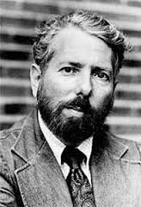
Step 3: authority factor(explanation)
It was shown in the Milgram Experiment(1963).
Milgram (1963) wanted to investigate whether Germans were particularly obedient to authority figures as this was a common explanation for the Nazi killings in World War II.
The procedure was that the participant was paired with another person and they drew lots to find out who would be the ‘learner’ and who would be the ‘teacher’. The draw was fixed so that the participant was always the teacher, and the learner was one of Milgram’s confederates (pretending to be a real participant).

Slide 16
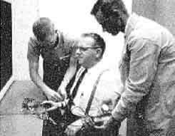
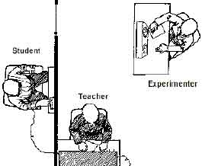
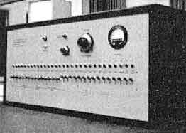
Step 3: authority factor(explanation)
The learner (a confederate called Mr. Wallace) was taken into a room and had electrodes attached to his arms, and the teacher and researcher went into a room next door that contained an electric shock generator and a row of switches marked from 15 volts (Slight Shock) to 375 volts (Danger: Severe Shock) to 450 volts (XXX).
Results: 65% (two-thirds) of participants (i.e. teachers) continued to the highest level of 450 volts. All the participants continued to 300 volts.

Slide 17
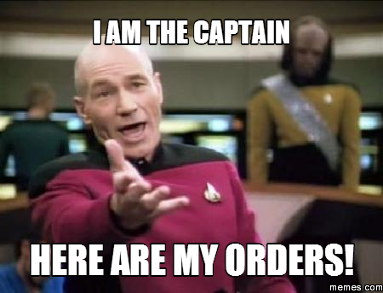
Step 3: authority factor(explanation)
From the results, it was concluded that ordinary people are likely to follow orders given by an authority figure, even to the extent of killing an innocent human being. Obedience to authority is ingrained in us all from the way we are brought up.
People tend to obey orders from other people if they recognize their authority as morally right and / or legally based. This response to legitimate authority is learned in a variety of situations, for example in the family, school and workplace.

Slide 18
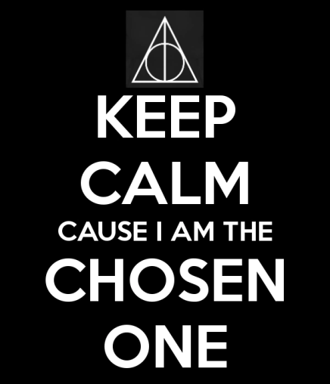
Step 4: Shortage Principle(instructions)
Motivate the viewers that by telling them that not everybody can experience the supernatural phenomenon and only a few “chosen” ones get to live this wonderful experience.
Step 4 is now completed.

Slide 19
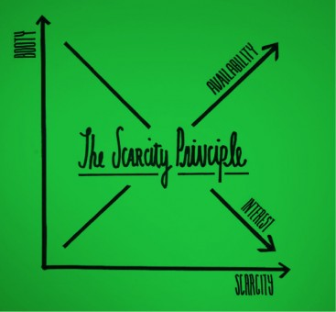
Step 4: Shortage Principle(explanation)
By doing this, you are creating an image that there are only so few people that are able to experience the supernatural phenomenon.
This creates a drive in the viewers to want to experience that supernatural moment.
What is Shortage Principle(Scarcity)?
Scarcity, in the area of social psychology, works much like scarcity in the area of economics. Simply put, humans place a higher value on an object that is scarce, and a lower value on those that are abundant. The thought that we, as humans, want something we cannot have drives us to desire the object even more.

Slide 20
Step 4: Shortage Principle(explanation)
There are two social psychology principles that work with scarcity that increase its powerful force. They are social proof and commitment.
Effects of scarcity can be seen from a study on job advertisement. Subjects were presented with two help-wanted ads, one suggested numerous job vacancies, while the other suggested that few were available. The study found that subjects viewed the company as being better with limited positions available. They felt that suggested limited vacancies translated to higher wages and placed a positive, higher value on the company that suggested that there were scarce job vacancies available.

Slide 21
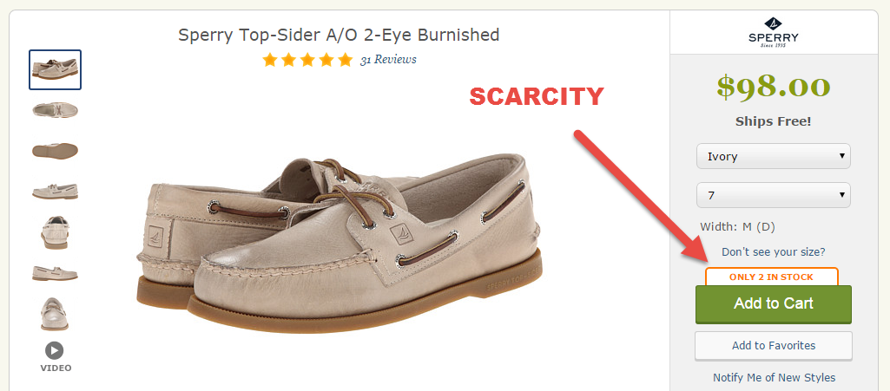

Slide 22
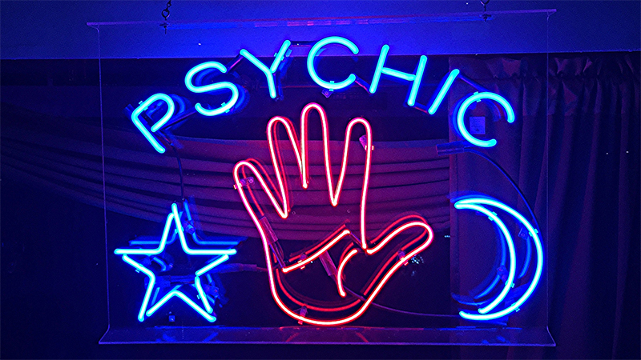
Step 5: SCP(instructions)
SCP = Social Confirmation Principle
Have one or two of your friends to start calling in to share about their “experience” of supernatural encounters in their home.
Once done, congratulations, you have successfully transformed into a “psychic” as per popular beliefs.

Slide 23
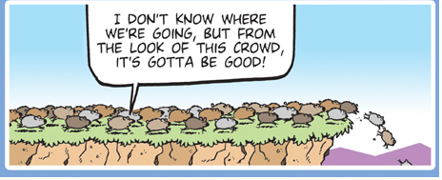
Step 5: SCP(explanation)
The illusion created by the number of phone calls coming in was that all the spectators tuned into that same channel were personally experiencing some spectacular demonstration of psychic phenomena.
“If so many people call to say that their cat is behaving strangely or that their watches are working again,” some spectators may have wondered, “maybe I should call in to say that the light went off for a few seconds!”

Slide 24
Step 5: SCP(explanation)
Can be a known as Behavioral Confirmation.
is a type of self-fulfilling prophecy whereby people's social expectations lead them to behave in ways that cause others to confirm their expectations.
Preconceived beliefs and expectations are used by human beings when they interact with others, as guides to action. Their actions may then guide the interacting partner to behave in a way that confirms the individual's initial beliefs.

Slide 25
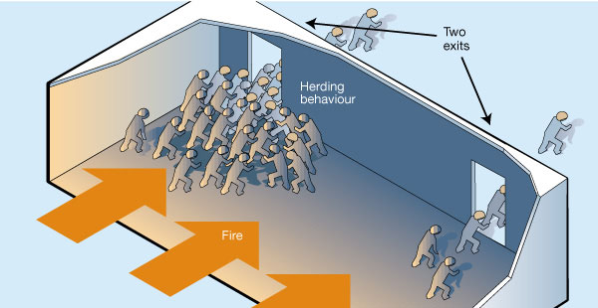

Slide 26
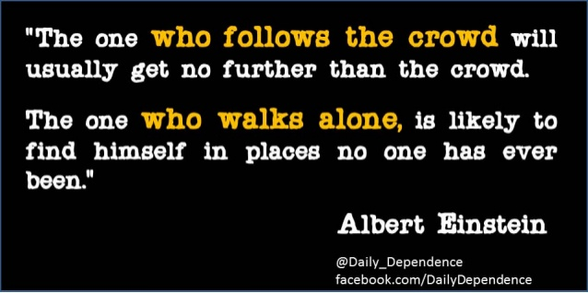
Step 6: Conclusion
Take advantage of all the available data to make your own conclusion.
Do not make inferences on the basis of incomplete data.

Slide 27
disclaimer
The authors of these slides are NOT liable to be responsible for any failure in being a psychic or ANYTHING by following the set of instructions given.

Slide 29
References
https://en.wikipedia.org/wiki/Linda_and_Terry_Jamison
https://en.wikipedia.org/wiki/Edgar_Cayce
https://en.wikipedia.org/wiki/Reciprocity_(social_psychology)
https://www.simplypsychology.org/milgram.html
https://en.wikipedia.org/wiki/Scarcity_(social_psychology)
https://en.wikipedia.org/wiki/Behavioral_confirmation

