Slide 1
Fraud in the investment world Liew xuan qi (A0157765N) Cheong hui ping (A0127945W) Hong chuan yin (A0155305M)

Slide 2
The end of the financial world as we know it new York times Michael lewis & david einhorn

Slide 3
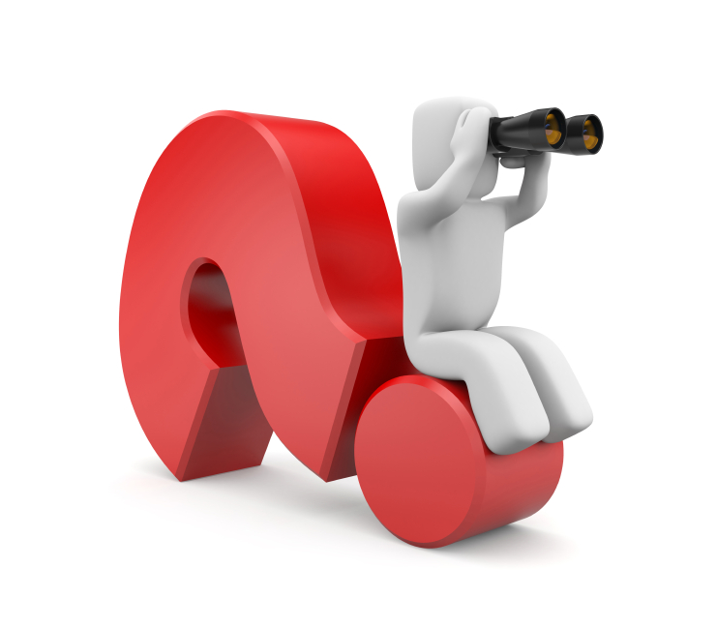
Overview
Who is Bernard Madoff and Harry Markopolos
How did Harry Markopolos uncover the fraud
Reasoning
Reliability
Why no action was taken
No interest
Greed
Systemic problem
Difficulties in implementing change
Peer Pressure
Lack of independent pressure
Credit-rating agencies
SEC
Government

Slide 4
Overview
Who is Bernard Madoff and Harry Markopolos
How did Harry Markopolos uncover the fraud
Reasoning
Reliability
Why no action was taken
No interest
Greed
Systemic problem
Difficulties in implementing change
Peer Pressure
Lack of independent pressure
Credit-rating agencies
SEC
Government

Slide 5
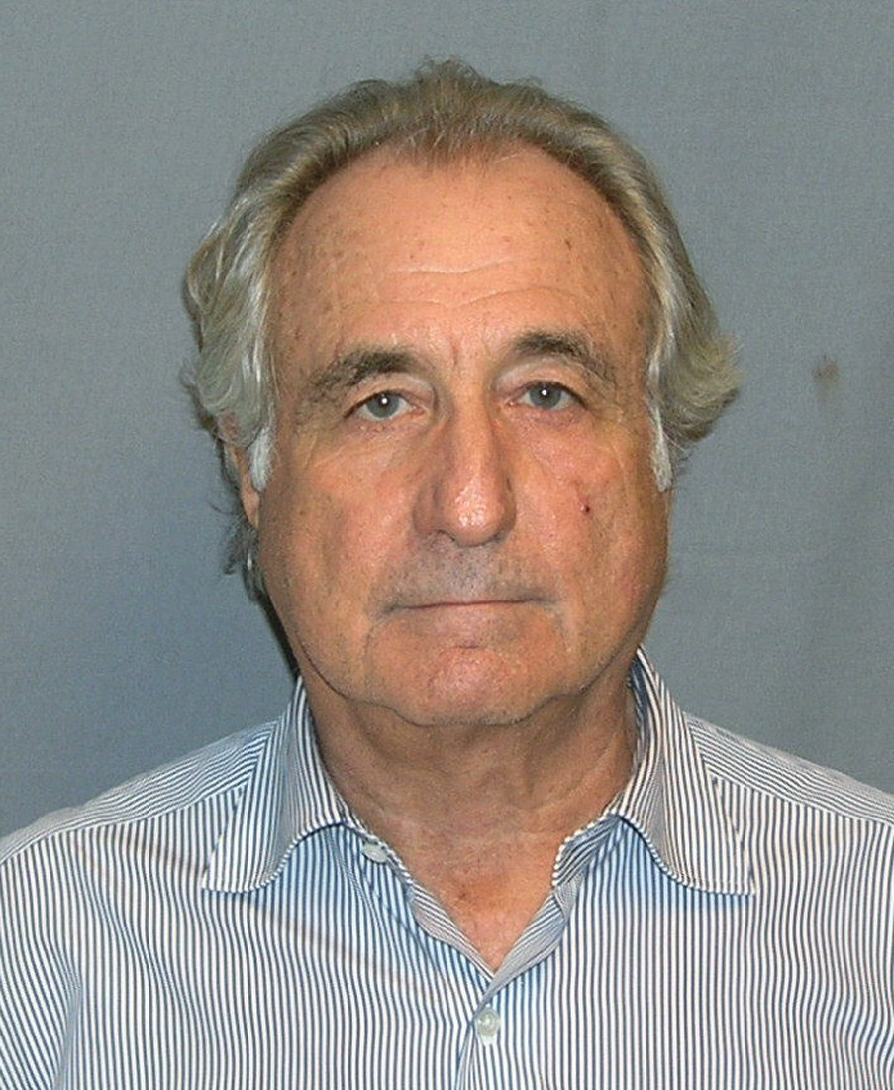
Who is Bernard Madoff
American fraudster
Works for Madoff Securities

Slide 6
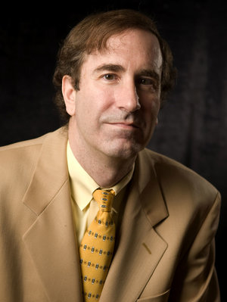
Who is harry markopolos
Former investment officer with Rampart Investment Management in Boston

Slide 7
Overview
Who is Bernard Madoff and Harry Markopolos
How did Harry Markopolos uncover the fraud
Reasoning
Reliability
Why no action was taken
No interest
Greed
Systemic problem
Difficulties in implementing change
Peer Pressure
Lack of independent pressure
Credit-rating agencies
SEC
Government

Slide 8
How markopolos uncover the fraud - reasoning
Madoff’s investment performance, given his stated strategy, was not just improbable but mathematically impossible
2 possible scenarios:
1. “Unlikely scenario”
Madoff acted as a broker and an investor, ‘front-running’ his brokerage customers.
Eg. A customer submits orders to Madoff Securities to buy I.B.M. shares. Madoff Securities hold customer’s order and buys IBM shares for its own portfolio. He then submits the customer’s order. The price of shares increases. Madoff securities then sells the shares at a higher price to the customers and profits
2. “Highly likely scenario”
Madoff Securities is the world’s largest Ponzi scheme
Eg. Madoff Securities pay its returns to investors from new capital it gets from new investors instead of profits from legitimate sources. This requires an ever increasing flow of money to sustain the scheme. They attract new investors by offering short term high returns.

Slide 9
How markopolos uncover the fraud - reliability
Spent 9 years trying to convince the Securities and Exchange Commission (SEC) that Madoff was a fraud
Markopolos sent his report to the SEC in 2005 and has been trying to explain the fraud since 1999.
He has no direct interest in exposing Mr Madoff – independent source
He even declined to put his name on the report
Yet the SEC declared Mr Madoff free of fraud

Slide 10
Overview
Who is Bernard Madoff and Harry Markopolos
How did Harry Markopolos uncover the fraud
Reasoning
Reliability
Why no action was taken
No interest
Greed
Systemic problem
Difficulties in implementing change
Peer Pressure
Lack of independent pressure
Credit-rating agencies
SEC
Government

Slide 11
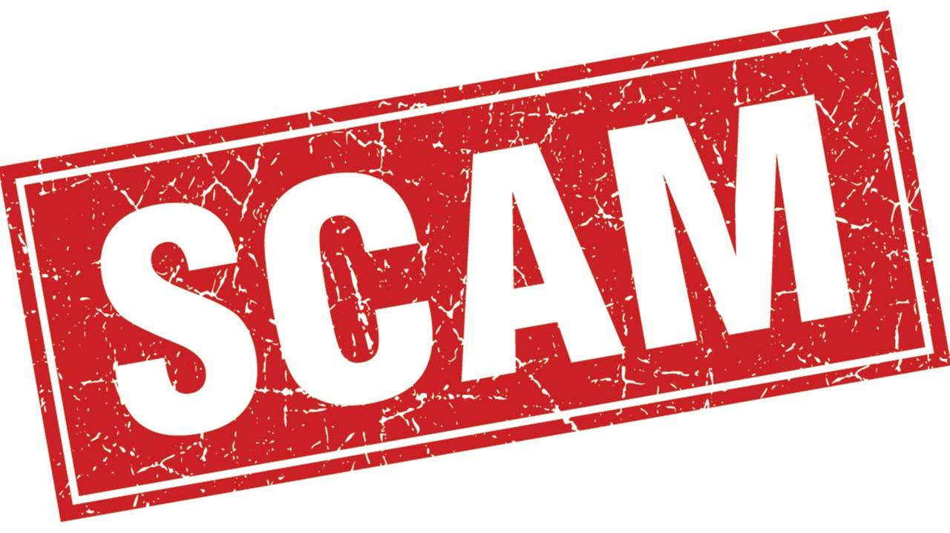
Why no action taken – no interest
People inside the financial system had little interest in exposing the fraud
Some refused to do business with Mr Madoff, others doubted his profits or assumed he was front-running his customers and steered clear of him
Even his customers suspected they were beneficiaries of a scam, yet they willingly participated because they were earning money

Slide 12
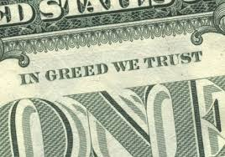
Why no action taken - greed
It is not just about the lack of checks done on companies, it is not just about the greed of a few people
It is the misaligned interest of many
It takes many people to fuel the ongoing fraudulent behaviour

Slide 13
Why no action taken – systemic problem
Leaders of public financial corporations are only required to lead for a short period of time, before they move to higher paying jobs
Many chief executives of huge companies such as Merrill Lynch or Lehman brothers pay themselves huge sums of money at the end of each year from the bogus market they operate

Slide 14
Overview
Who is Bernard Madoff and Harry Markopolos
How did Harry Markopolos uncover the fraud
Reasoning
Reliability
Why no action was taken
No interest
Greed
Systemic problem
Difficulties in implementing change
Peer Pressure
Lack of independent pressure
Credit-rating agencies
SEC
Government

Slide 15
Difficulties in implementing change – peer pressure
If anyone decides to stand up for what is right, stand up and claim that this business is irresponsible and they will not participate, they will probably get fired
Parties such as their subordinates or the shareholders would not be happy losing large amounts of money and incurring huge debts, resulting in their push for his resignation
Lose their job and high earnings. Many people compromise on their integrity for the prospects of wealth

Slide 16
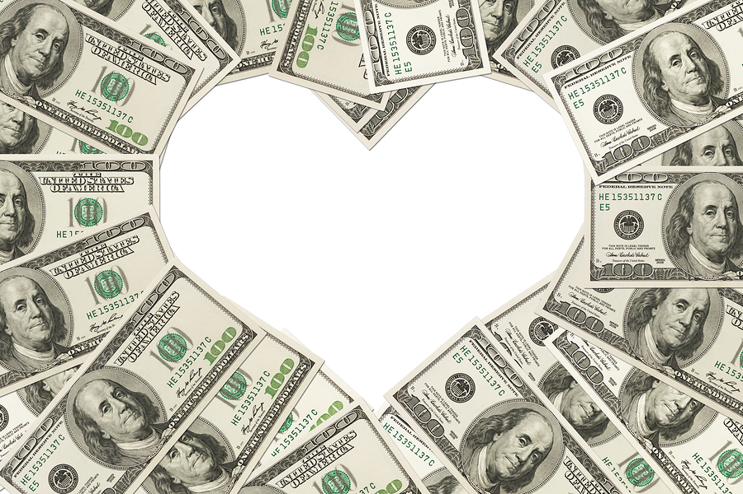
Difficulties in implementing change – lack of independent pressure
People are willing to sacrifice their long term interests for short term gains
With the high pressure to excel in short term gains, there is a need for an even greater pressure from outside to consider long term gains. However, there is currently no such outside pressure and hence everyone is motivated by their own self interest

Slide 17
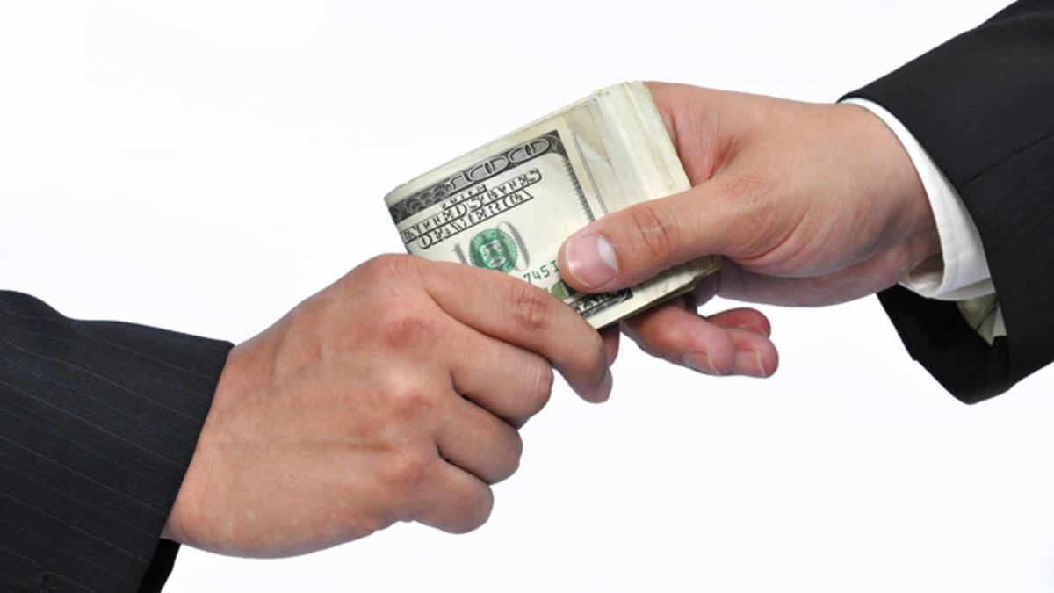
Difficulties in implementing change – credit rating agency
Rating agencies are paid by the companies they are supposed to rate
Large investment banks, which are undertaking fraudulent activities, pay the rating agency highly, and enjoy solid investment ratings
It is as if the higher the investment ratings, the more likely the company contributes to financial catastrophe
Rather than exposing financial risks, the agencies systematically disguise it

Slide 18
Difficulties in implementing change – credit rating agency
Example:
In 1990, the MBIA company had $931mil in equity and $200mil in debt. They were given a triple A rating
In 2006, the MBIA company had plunged to $7.2bil in equity and an astounding $26.2bil in debt. They were still given a triple A rating
Credit rating agency would not downgrade MBIA as it was not in their short-term financial interest
Downgrading would mean the costly and cumbersome process of re-rating tens of thousands of credits that bore the triple A due to bribery
They would be paid less if they did not give MBIA a triple A rating

Slide 19
Difficulties in implementing change – sec
Created to protect investors from financial predators, but has become a mechanism to protect financial predators from political influence (impose rules on those who try to bring the problem up in the political arena)
Seldom penalizes companies’ wrongdoings with the belief that it would cause stock prices to fall, shareholders to suffer and people to lose confidence in the company. Preserving confidence, even when the confidence is false, has been at the top of their agenda
Workers in the SEC know that if they maintain good relations with the big and ‘rich’ companies, they will soon be paid a huge sum

Slide 20
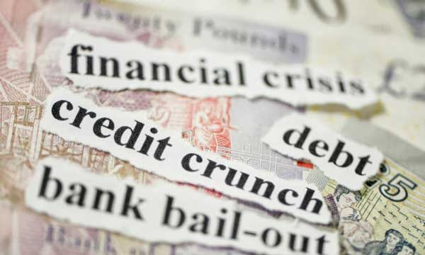
Difficulties in implementing change – government
When companies face bankruptcy and contribute to financial crisis, the government gifted these companies with enormous government loans to ensure they are able to continue their fraudulent activities
The SEC protecting the companies from political influence and the ratings portray confidence, government continues to fund and support the fraudulent activities
In short, the banks are taking taxpayer’s money and spending it imprudently

Slide 21
Take home messages
There is no fast way to make money
It is important to work with integrity
Long term planning is as important as short term gains

Slide 22
“
No one was responsible for the great Wall Street crash. No one engineered the speculation that preceded it. Both were the product of free choice and decision of hundreds of thousands of individuals
John Kenneth Galbraith
”

