Slide 1
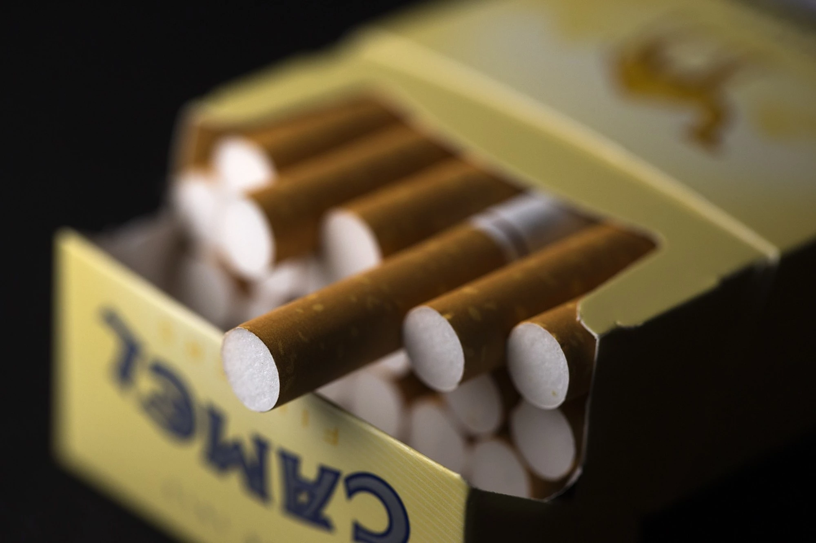
PRELUDE (AGAIN) A topic on Opiates (Again)

Slide 2
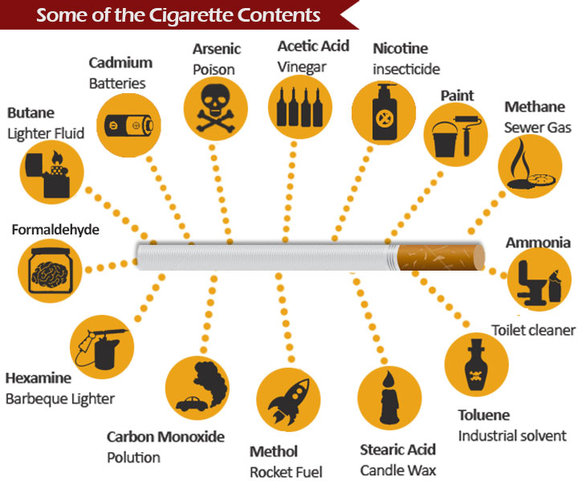
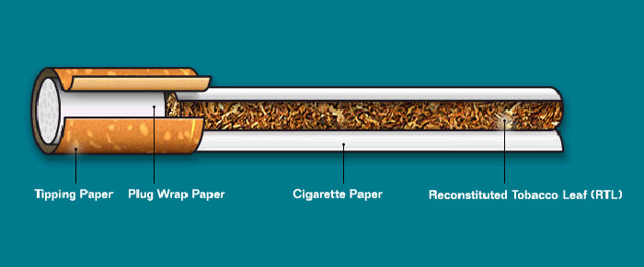
Our “Lead” today… Cigarettes

Slide 3
Misleading by withholding crucial data – The cigarette Industry
Goh Jie Sheng/ Bok Wen Xuan/ Annabella Fong
Presenter for this week: Goh Jie Sheng

Slide 4
Tricks of the Industry
Product Design
Controlling of data
Data is power
Authority Fallacy
The “Frank” Statement
Misperceptions of the public
Biased research

Slide 5
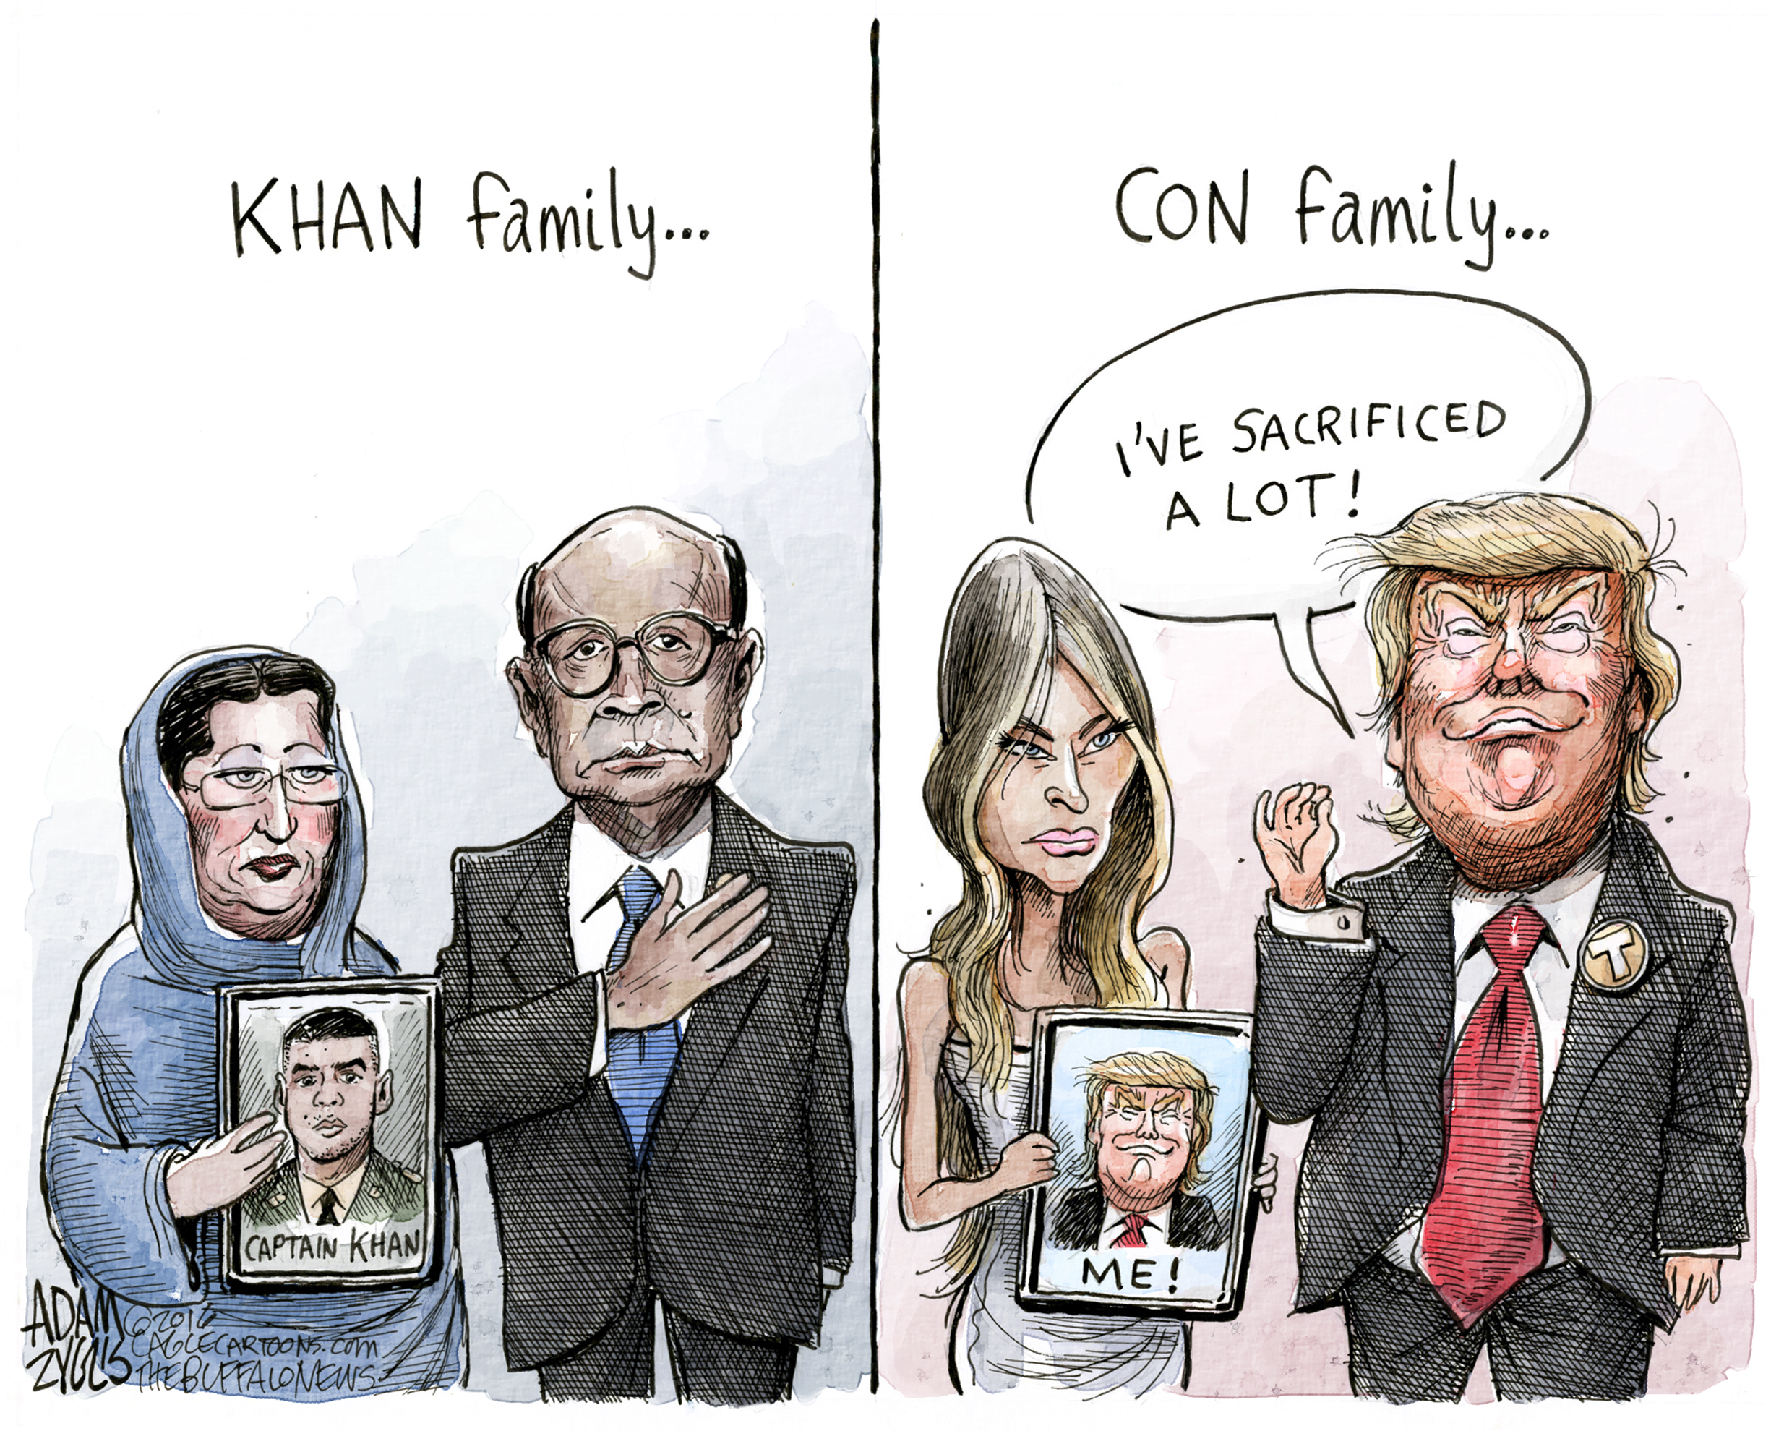
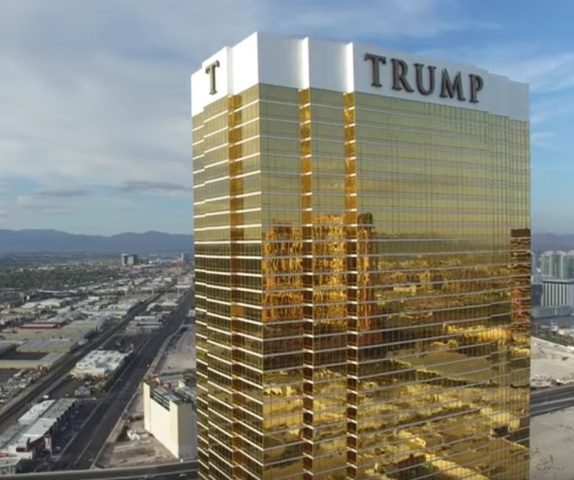
Who Controls the Data?
Governments
Large Companies
Academics, who are controlled and paid by the above two.

Slide 6
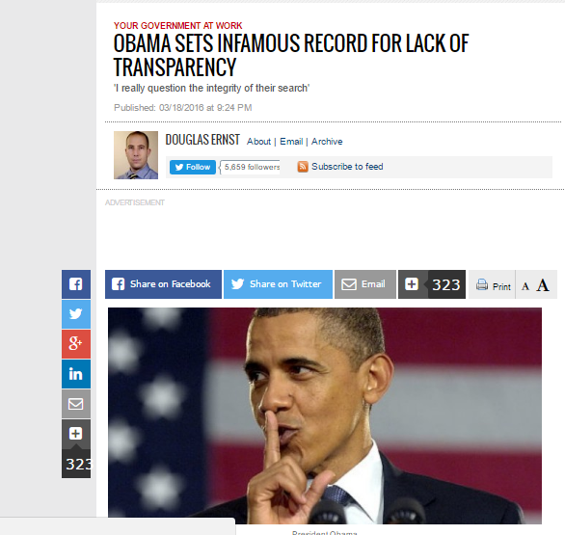
Data are tools to conquer
The Environmental Protection Agency regional office that oversees New York and New Jersey failed to find records 58 percent of the time.
And there are much more data that was left unpublished to the public by the US government.
Data often was not released to the people when needed because of unknown reasons.
UNKNOWN REASONS… REALLY?

Slide 7
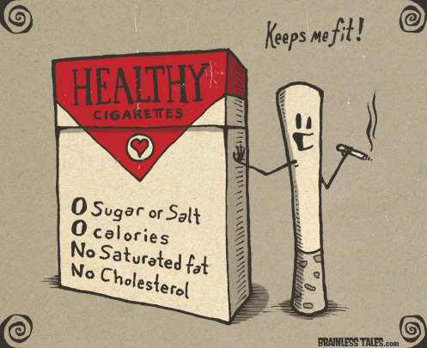
Advertisements are platforms for conquering with Manipulated data
If you were a smoker, what if I told you that my cigarette was:
BETTER
SMOOTHER
MILDER
And it causes LESS IRRITATION to your throat.
Will you believe my cigarette is therefore healthier?

Slide 8
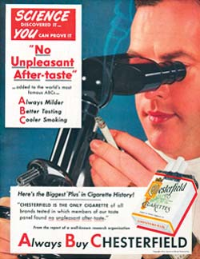
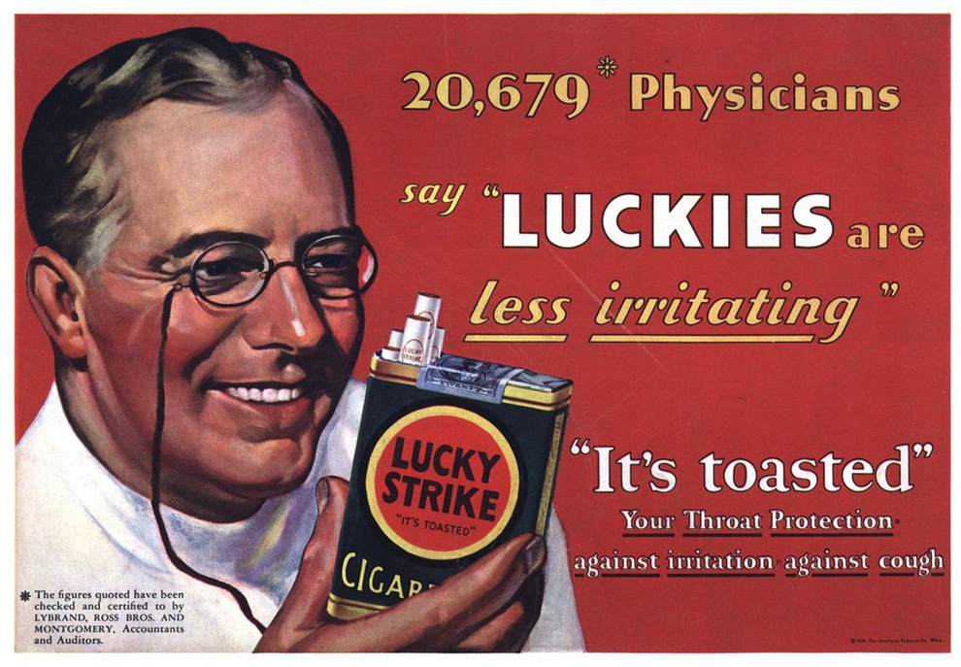
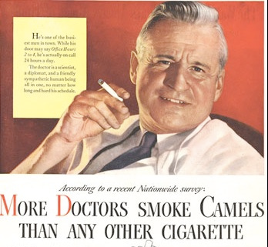
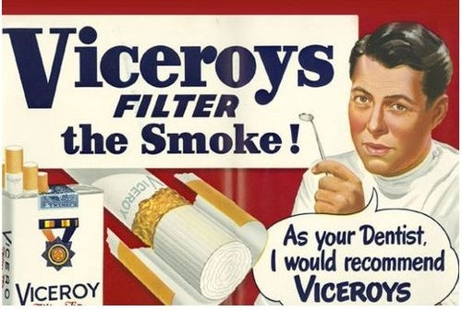
Companies used Authority to dictate their stand…
Commonly, cigarette companies will use lines like these:
“MEDICAL SCIENCE/EXPERTS offers PROOF, that my cigs are better etc. etc.”
So poor “suckers” easily believe what they are selling…
WHY SO?

Slide 9
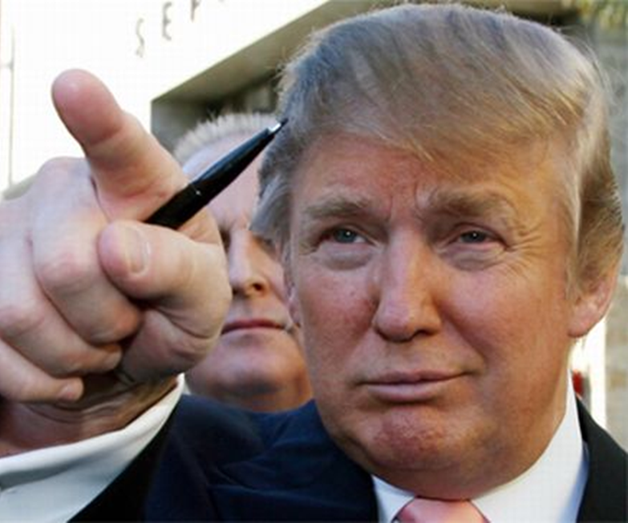
FALLACY: an appeal to authority
An Appeal to Authority is a fallacy with the following form:
Person A is (claimed to be) an authority on subject S.
Person A makes claim C about subject S.
Therefore, C is true.
When a person falls prey to this fallacy, they are accepting a claim as true without there being adequate evidence to do so.

Slide 10
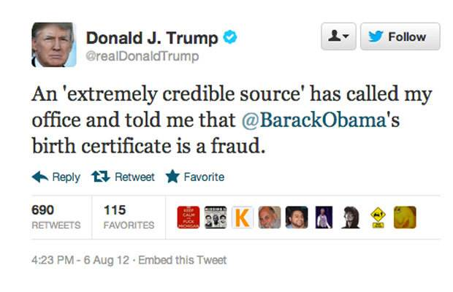
Fallacy: An Appeal to Authority
Typically, the person making the argument will say things like :
"I have a book that says...", or "they say...", or "the experts say...", or "scientists believe that...", or "I read in the paper..“ etc.
In such cases the person is often hoping that the listener(s) will simply accept the unidentified source as a legitimate authority and believe the claim
If accepted, the person has fallen to the fallacy

Slide 11
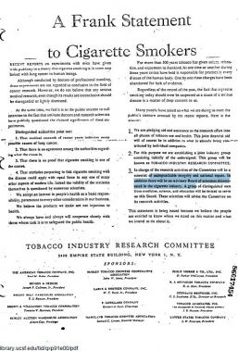
The Cigarette Industry and its Lies
In 1954, US tobacco manufacturers released
“A Frank Statement to Cigarette Smokers”
which appeared in 448 newspapers in 258 cities, reaching an estimated 43++ million Americans
This statement is misleading since some of the medical authorities identified as questioning the evidence that smoking was a cause of cancer, and not supporting it.

Slide 12
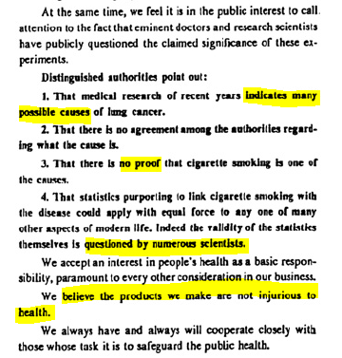
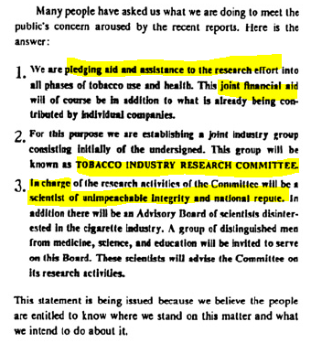

Slide 13
Biased Citations in research
Given the industry’s promise to investigate the smoking and health question,
Research papers should be bountiful and accounted for.
BUT IT ISN’T THE CASE
An author query reveal that:
only <100 citations to papers out of 63120 were authored to the 29 company execs/industry scientists/scientific leaders.

Slide 14
THIS SHOWED THAT SCIENTISTS AND EXECS IN THE CIGARETTE INDUSTRY WERE RELECUTANT TO SHARE THEIR RESULTS TO THE WIDE SCIENTIFIC COMMUNITY, AND THE PUBLIC.

Slide 15
Misperceptions of the Public – the STATS
Misperceptions were partly copulated by the Fallacy to Authority
In 1954, only 41% of people believed that smoking is a cause of cancer, compared to 92% in 1999 where research was done intensively, and released to the public.
Back then smokers were misdirected about health issues, where concerns were directed to avoidance of throat irritation.
Without concrete information, many smokers believed that their personal risk of illness are no greater than average.

Slide 16
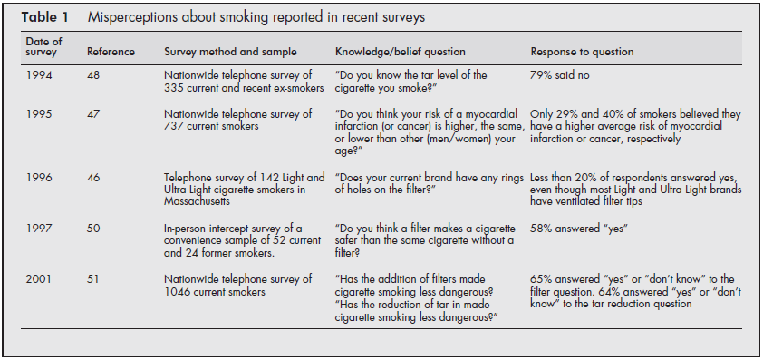

Slide 17
Ending off…
Here are some topics that can revolve around these “lying” scenarios too:
Going Vegan, good for Mother Earth?
Medicinal Marijuana etc etc.

Slide 18
References:
Cummings, K.M., Morley, C.P. and Hyland, A. (2002). Failed promises of the cigarette industry and its effect on consumer misperceptions about the health risks of smoking. Tobacco Control, 11 (Suppl I):i110–i117.
Tobacco Industry Research Committee (TIRC). A Frank Statement to Cigarette Smokers. 4 January 1954. Bates No. 03046592-03046593
Rodgman, A. The analysis of cigarette smoke condensate. I. The isolation and/or identification of polycyclic aromatic hydrocarbons in Camel cigarette smoke condensate. R. J. Reynolds Tobacco, 28 September 1956, Bates No. 504912057-504912091.
Hans, H. "Fallacies". The Stanford Encyclopedia of Philosophy (Summer 2015 ed.). The Metaphysics Research Lab, Center for the Study of Language and Information, Stanford University. ISSN 1095-5054

