Slide 1
Prelude
Notes:
Would you all believe reports seen in TV and news very easily? How many times will these reports be useful in addition to our experiences and information? What you see, and what you read in a story, might be just fiction modelled to be scientific…

Slide 2
When FACTS get in the way of a story
Goh Jie Sheng/ Bok Wen Xuan/ Annabella Fong
Presenter for this week: Goh Jie Sheng

Slide 3
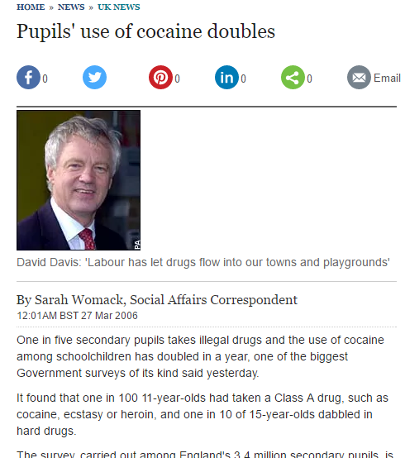
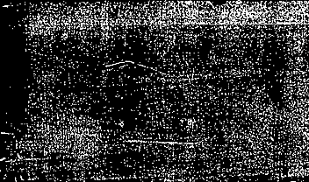


Shocking news…
In 2006, the British Media allegedly reported an astonishing piece of news that sensationally went viral.
A TWO FOLD increase in COCAINE USE by schoolkids.
But, HOW TRUE is this?

Slide 4
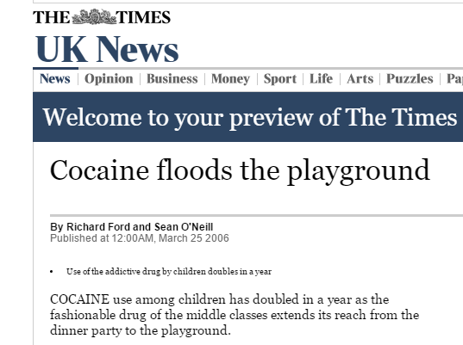
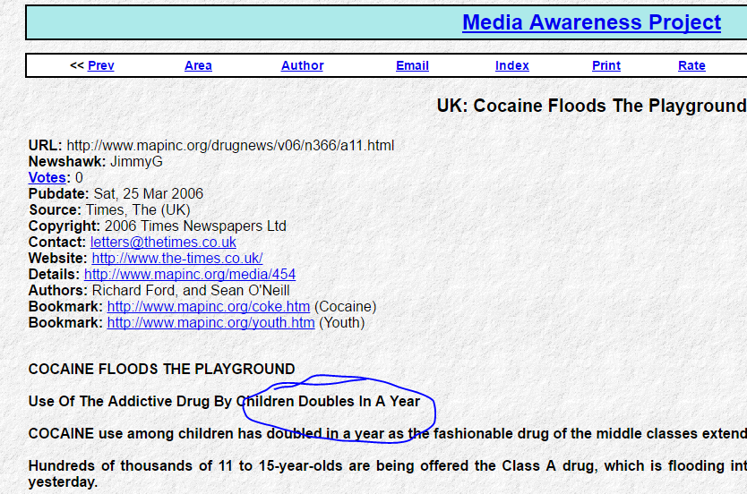

Slide 5


Are these reports reliable?
A terrible social issue….

Slide 6
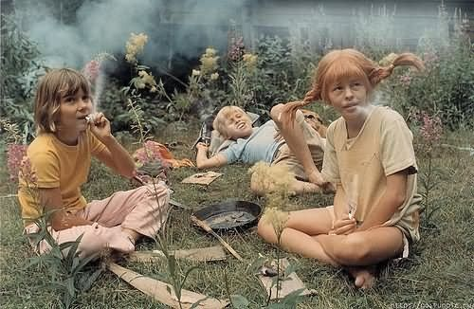
Could these really be true??

Slide 7
Breaking down the Stats
Survey of 9,000 children, aged 11 to 15, in 305 schools
Data tables about using cocaine in the past years:
1% said yes in 2004, and 2% said yes in 2005.
Except almost all the figures were ROUNDED to 1%, or 2%.
Actual figures were 1.4% for 2004 and 1.9% for 2005 → So it hadn’t doubled. It merely increased…
Acts like this, to seek out obnoxious data for creating news, are known as:

Slide 8
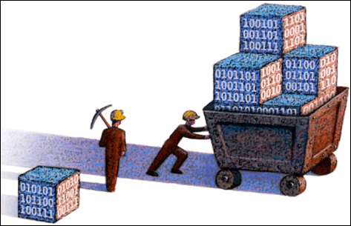
DATA MINING

Slide 9
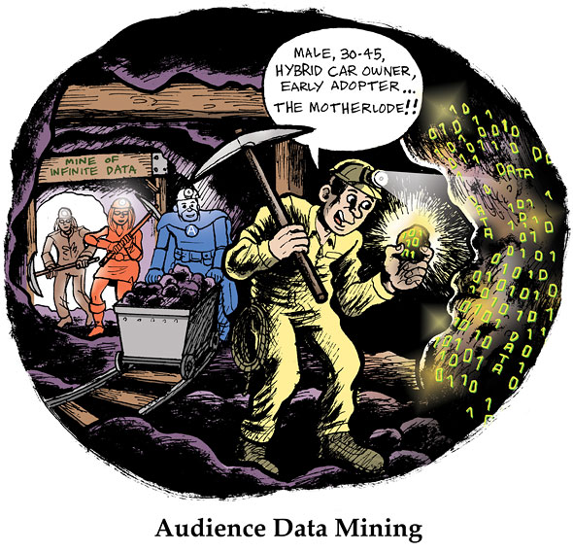
Data Mining
Gets you a lot of information
But usually information is too complex if not analysed and processed
As such MISLEADING if not processed properly and used.

Slide 10
The actual increase – 0.5%
(1.4 to 1.9%)
Points to a small increment of teens saying “Yes” to Crack
= 45 more kids in a 9000 kid sample.
Well, this is statistically significant (p < 0.05)!
When we believe something is statistically significant we believe the difference is larger than it can reasonably be explained as a chance occurrence.

Slide 11
Statistical significance in terms of evidence
Smaller values usually constitute more evidence,
And a sample size of 9000 is not really small…
Hence it is valid!
Moreover, the usage of clusters (i.e. surveying different schools), increases VARIATION in data.
As such, it is likely that a 45 kid increase is not by chance.
Variation → possibly data are independent!

Slide 12
A statistical test assumes every data point is independent.

Slide 13

BUT THESE ARE
NOT DATA
THEY ARE
REAL KIDS.

Slide 14


Children are living things
(and so are we!)
Children:
Interact with each other
Mimic each other’s actions
Pick up crazes and hobbies off each other
Well, children tend to hang out together in groups and influence each other
INFLUENCES RENDER DATA COLLECTED BIASED
and likely insignificant!

Slide 15



Variations
Variations not only happen in the individual child
But variations happen too in clusters.
Each cluster, a school, is affected by spatial factors, such as: neighborhoods, academic excellence, proximity to vice etc.

Slide 16
Explaining the cause of insignificance
Naughty delinquents concentrated here (epidemics of crackheads)
Naughty delinquents concentrated here
(mini epidemics)

Slide 17
Data was significant because:
The sample size was large (9000 kids), albeit in clusters!
Data became insignificant because:
Children in groups (clusters) are not independent data points!
As such there is a need to treat clustered data.

Slide 18
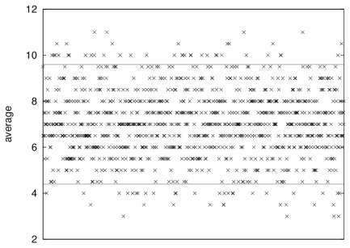
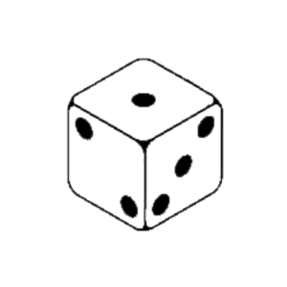
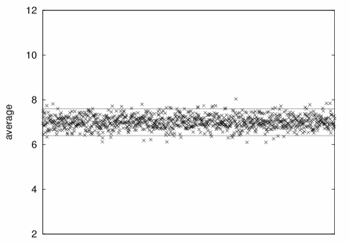
Correct for Clustering
It is like comparing throws (of a 1000 times) of 2 dice and 50 dice to get an average.
50 dice and 1000 throws would achieve a smaller standard deviation of the averages.
Example average of 8 will be of different significance on the bias of the dice.
Figures:
Top: SD 9.5 to 4.5
Bottom: SD 7.5 to 6.5

Slide 19

Correct for Clustering
The need to treat the 9000 data collected like a smaller sample.
Here we are doing the survey just ONCE, which is not very fair, and it could have been by CHANCE that such data was obtained.
Doing more surveys can significantly reduce the standard deviations of the data,
Rendering the 0.5% increment possibly insignificant
(and not news-worthy)

Slide 20

In conclusion
“If you do not know your science, you take a big chance when you delve under the bonnet of a study to find a story”
Thank you ☺ ☺

Slide 21
References:
Goldacre, B. (2007). When the facts get in the way of a good story. Significance, 4(2), 84–85.
Lambert, T. (2003) Why you need to correct for clustering, ScienceBlogs LLC, America.

