Slide 1
Story of Sally Clark
Ivan Lieu
Crystal Wang
Foo Jia Yuan

Slide 2
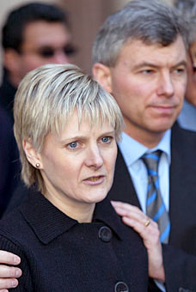
Background Information
Sally Clark - an English Solicitor found guilty of murder of her two sons, Christopher and Harry, and became a victim of miscarriage of justice November 1999.
She was later freed from prison at 2003, after serving her sentence for 3 years but through this experience developed psychiatric problems.
She later died in March 2007 from alcohol poisoning

Slide 3
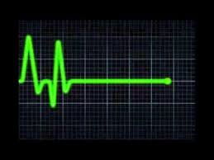
Main Story
Clark’s first son, Christopher, was born on 26 September 1996. However, just 3 months later, was declared dead enroute to the hospital after falling unconscious after being put to bed.
Clark’s second son, Harry, was prematurely born on 29 November 1997, Unfortunately, he was also found dead 8 weeks later.
On both occasions, Clark was alone with the baby and there was evidence of trauma. Clark and her husband were arrested for murder on 23 Feb 1998 but the case against her husband was later dropped.
Is it a pure (unlucky) coincidence or did she really murder her children?

Slide 4
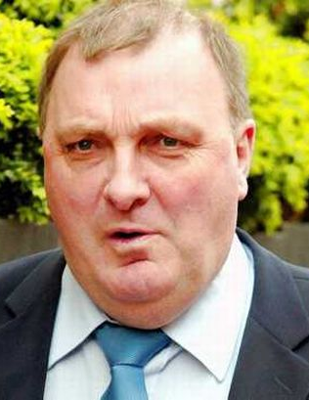
Main Story
Involvement of Paediatrician Prof. Sir Roy Meadows
Testified on court stating that the trial of the chance of 2 cot deaths from an affluent non-smoking household is “1 in 73 million” based on Bayes analysis.
Prosecution’s pathologist, Dr Alan Williams withheld bacteriology results of Harry which show the presence of the bacterium staphylococcus aureus in multiple sites including his cerebro-spinal fluid.
This was not known to anybody including other medical witnesses, police officers and lawyers.
Notes:
Dr Alan Williams - even when the jury asked specifically if there were any 'blood' test results for this child.

Slide 5
Second Appeal
Clark’s husband managed to unearthed evidence that Harry died from natural causes from hospital records obtained by divorce lawyer Marilyn Stowe who was suspicious of how the case was going.
It also became clearer that the statistical evidence presented at Clark's trial was seriously flawed.
Her case was referred back to the Court of Appeal by the Criminal Cases Review Commission and her convictions were overturned in a second appeal in January 2003.
So what went wrong in the Statistical Evidence?
Notes:
microbiological tests showed that Harry had colonisation of staphylococcus aureus bacteria, indicating he had died from natural causes

Slide 6
CALCULATION OF THE QUOTED PROBABILITY
“ 1 in 73 million ”:
Calculated based on a “Sudden Unexpected Deaths in Infancy” (SUDI) report
The SUDI study was conducted between February 1993 and March 1996 in a study area consisting of five regions of the country, having a total population of nearly 18 million.
470,000 live births, 456 of these babies suffered SUDI, 363 of these deaths being classified as cases of Sudden Infant Death Syndrome (SIDS). Of these, 325 were subjected to further analysis. For each of the 325 “index cases”, four “control” babies, born at around the same time but not suffering SUDI, were identified by the health visitor.
Notes:
During the study period -> 470,000 live births in the study area.
SIDS - sudden unexplained death of a child less than one year of age. Diagnosis requires that the death remains unexplained even after a thorough autopsy and detailed death scene investigation.

Slide 7
CALCULATION OF THE QUOTED PROBABILITY
“ 1 in 73 million ”:
Based on a table that classify the risks of SIDS according to “three prenatal factors with the highest predictive value” :
Anybody who smokes in the household
No wage income in household
Mother is < 27 years old and not her first child
An incidence rate of SIDS given based on:
Presence/absence of each factor considered individually
Presence of none
Presence of exactly one
Presence of exactly 2
Presence of exactly 3
For Sally Clark, none of these factors were present. For such a case, the table gave a rate of 0.117 SIDS cases per 1000 live births, i.e. 1 in 8,543 live births. The figure of 1 in 73 million mentioned above was calculated by squaring this.
Notes:
During the study period -> 470,000 live births in the study area.
SIDS - sudden unexplained death of a child less than one year of age. Diagnosis requires that the death remains unexplained even after a thorough autopsy and detailed death scene investigation.

Slide 8
Effectiveness of the Calculation
The factors are selected, routinely by statistical methods, on the basis of the study data. The factor should be tailored as closely as possible to all the characteristics of the Sally Clark case— not just the three that were picked out on the basis of the statistical study.
Very misleading to use them to construct precise numerical formulae for predictive or explanatory purposes
The report does not make it clear how the estimated rate of 0.117 per 1000 live births was calculated
a reasonable interval of plausible values for the SIDS rate among cases having no factors goes from 0.04 to 0.32 deaths per 1000 live births. When squared, this would lead to a figure of about 1 in 9 million
Notes:
No reasons to exclude 3 times the rate quoted

Slide 9
Effectiveness of the Calculation
Squaring the figure 1 in 8,543 would be relevant if, and only if, the SIDS death rate for the second child remained at 1 in 8,543, even after it was known that the first child had died of SIDS.
The SUDI report does not take account of other possible familial incidence of factors.
It is highly possible that there are unmeasured characteristics, whose presence would predispose to SIDS.
This leads to a probability of two SIDS deaths very much larger than the figure of 1 in 73 million.
Notes:
No reasons to exclude 3 times the rate quoted
be they genetic or environmental, shared between the two babies

Slide 10
Statistical Flaws
Professor of Mathematics Ray Hill concluded using extensive SIDS statistics for England, that "after a first cot death the chances of a second become greatly increased", by a dependency factor of between 5 and 10.
Although double SIDS is very rare, double infant murder is likely to be rarer. Hill calculated the odds ratio for double SIDS to double homicide at between 4.5 : 1 to 9:1

Slide 11
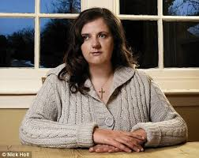
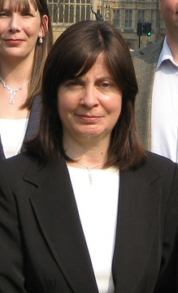
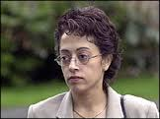
Aftermath
Clark's release in January 2003 prompted the Attorney General to order a review of hundreds of other cases.
Two other women convicted of murdering their children, Donna Anthony and Angela Cannings, had their convictions overturned and were released from prison. Trupti Patel, who was also accused of murdering her three children, was acquitted in June 2003.
In each case, Roy Meadow had testified about the unlikelihood of multiple cot deaths in a single family.
Notes:
Two other women convicted of murdering their children, Donna Anthony and Angela Cannings, had their convictions overturned and were released from prison. Trupti Patel, who was also accused of
murdering her three children, was acquitted in June 2003.

Slide 12
Conclusion
The quoted “1 in 73 million” is highly misleading and prejudicial and have not been estimated with anything with precision.
Such a figure could only be useful if compared with a similar figure calculated under the alternative hypothesis that both babies were murdered

