Slide 1
In Search of the Magic Lasso: The Truth About the Polygraph
Group 3

Slide 2
Outline
Timeline of Events
Polygraph - an effective tool for screening purposes?
Data from the NRC Study
Why is the government agency unwilling to use polygraph?
Conclusion
Take-Home Message

Slide 3
Questions to address
Do you think polygraphs are an effective tool for security screening purpose?
Why do you think government agencies were unwilling to adopt the recommendations of the committee?

Slide 4
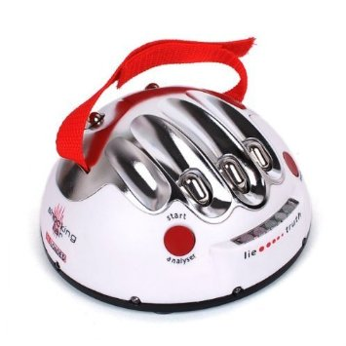
Introduction to Polygraphs
aka lie detectors
Measures blood pressure, pulse when subject is asked and answers questions
Belief that deceptive responses produce physiological responses different from that of non-deceptive responses

Slide 5
Timeline of Events - 1923
Case of Frye v. United States
Introduced use of systolic blood pressure to measure deception in lab or legal settings by William Moulton Marston
Frye initially denied to the crime -> confessed but then retracted his confession -> judge refused to accept his systolic blood pressure measurement to prove his innocence -> eventually convicted -> turned out Frye was innocent
Frye general acceptance test

Slide 6
Timeline of events -1993
Daubert test superseded Frye general acceptance test
Trial court judges to decide whether the scientific, technical or other specialised knowledge is reliable and valid
More and more courts infused general accepted test with Daubert test

Slide 7
Timeline of events - 2000 onwards
1998: Wen Lo Hee - accused of theft of classified nuclear-related documents
Debate over whether he ‘failed’ polygraphs tests administered to him
National Research Council(NRC) conducted a study of polygraph testing’s ability to accurately distinguish lying and truth-telling in various situations
Assembly of Committee to Review the Scientific Evidence on the Polygraph

Slide 8
Timeline of events - 2000 onwards (con’t)
2001 Sept 11 changed US public’s perception towards to polygraph testing
Placed greater faith that modern tech can precisely detect evildoers
Problem: lack scientific basis

Slide 9
Is polygraph an effective tool for security screening purpose
The validity of polygraph depends on the purpose for which it is used.
However, when the questions asked are too generic, there may be some ambiguity and this may result in the test being inaccurate.
Validity is further compromised when prospective(future) questions are asked as they are making inference about future behaviors.

Slide 10
Is polygraph an effective tool for security screening purpose
Limitation to research methods
Laboratory studies→ lack realism (the consequence associated with lying never mirrored the seriousness of these actions in real-world settings)--> overestimate accuracy)
Field studies→ difficulty of identifying the truth against which test results should be judged and lack control of extraneous factors.
Estimates of accuracy from these studies are almost certainly higher than actual accuracy of specific-testing in field.

Slide 11
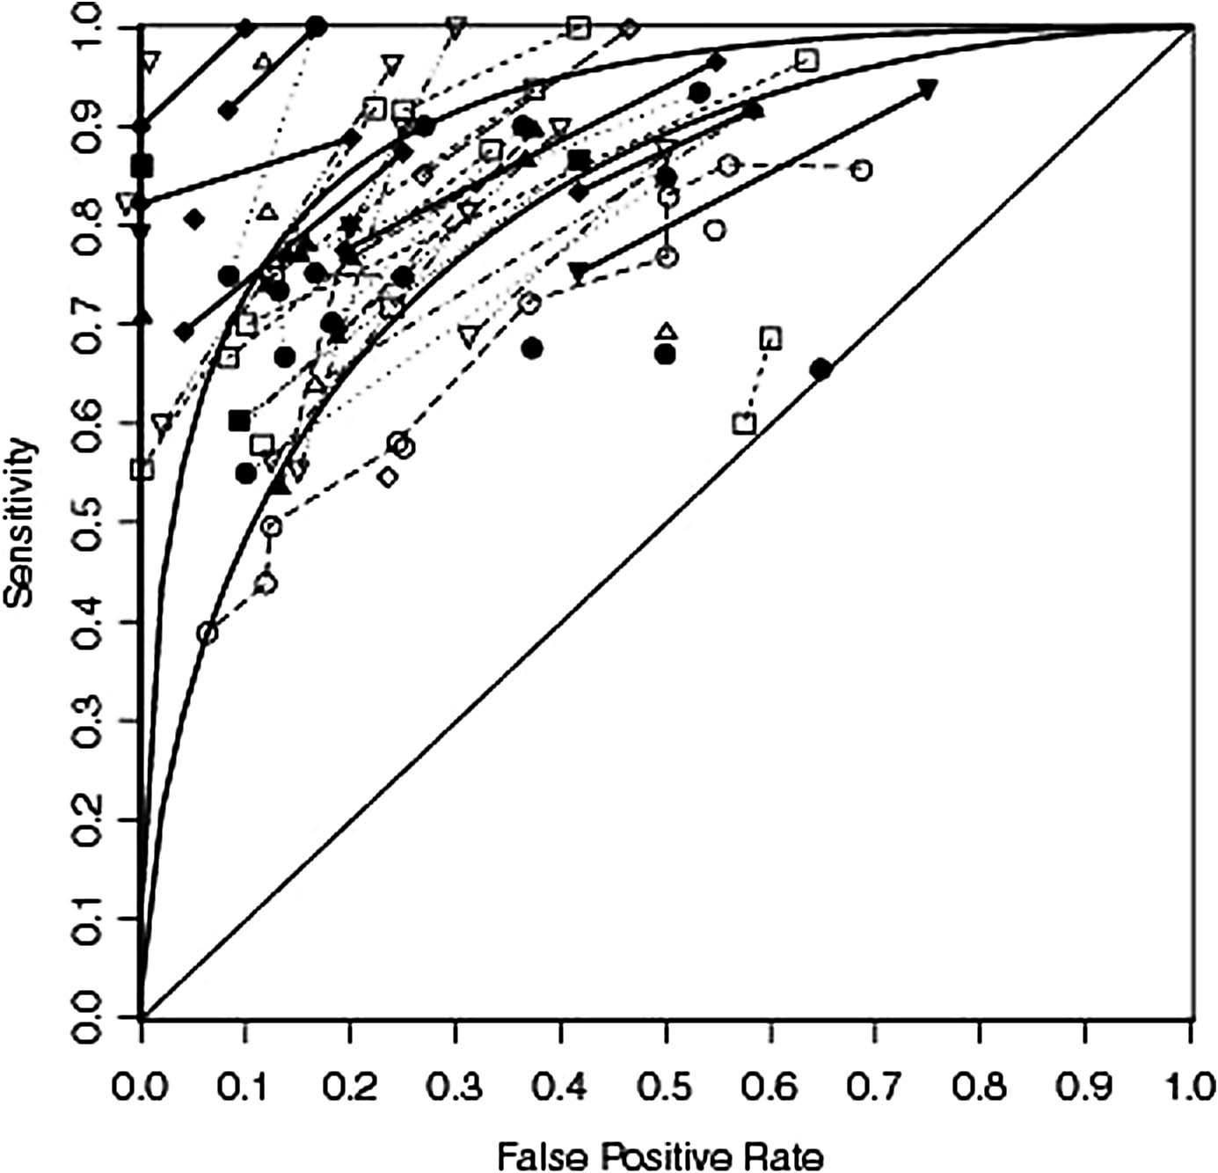
Representation of data from the nrc study - #1
Use of scatterplot
Advantage:
Summarise all the relevant data from the study
Visible variability in results
Better than presenting numbers -> easily misunderstood as percentage of correct results -> misimpression that polygraph perform better than chance

Slide 12
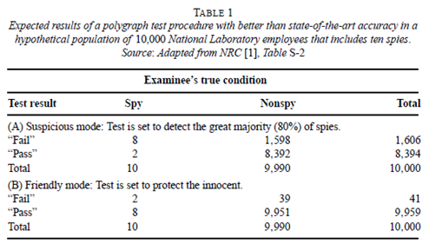
Representation of data from the nrc study - #2
Calculations of the results of hypothetical series of polygraph examinations in hypothetical large populations with known populations of liars and truth-tellers

Slide 13
Timeline of events - 2000 onwards (con’t)
NRC’s conclusion:
Avoid overconfidence in polygraph screening results
NRC’s recommendation:
to minimise reliance on polygraph tests and seek ways to improve public safety and national security
Government agencies responsible for national security were not pleased

Slide 14
Why is the government agency unwilling to not use polygraph?
Absence of an alternative solution to polygraph testing, thus no desire to change its polygraph policy

Slide 15
Why is the government agency unwilling to use polygraph?
Polygraph test that are sensitive enough to spot most security violators will also mistakenly marks many innocent test-takers as guilty.
While those that are not sensitive enough will not be able to catch the major security violators.
The government agency believes that the use of polygraph will do more harm than good.
They feel that national security is too important to be left for a such blunt instrument.

Slide 16
Conclusion
The polygraph can be use to assist law enforcers and intelligence agencies to help detect criminals, spies or saboteurs when direct evidence is lacking.
However, it cannot be use as a conclusive evident as in some cases there may be some ambiguity which may result in the test being inaccurate.

Slide 17
Take-home message
Myths are not meant to be believed, but for entertainment purposes.

