Slide 1
Group 4:
Tan Yong Jia, Somesh, James

Slide 2
Fear and numbers in Fukushima. Significance

Slide 3
Qns addressed
How dangerous was the radiation from the Fukushima disaster?
Were the risks well communicated to the general public?

Slide 4
HOW BAD WAS IT????

Slide 5
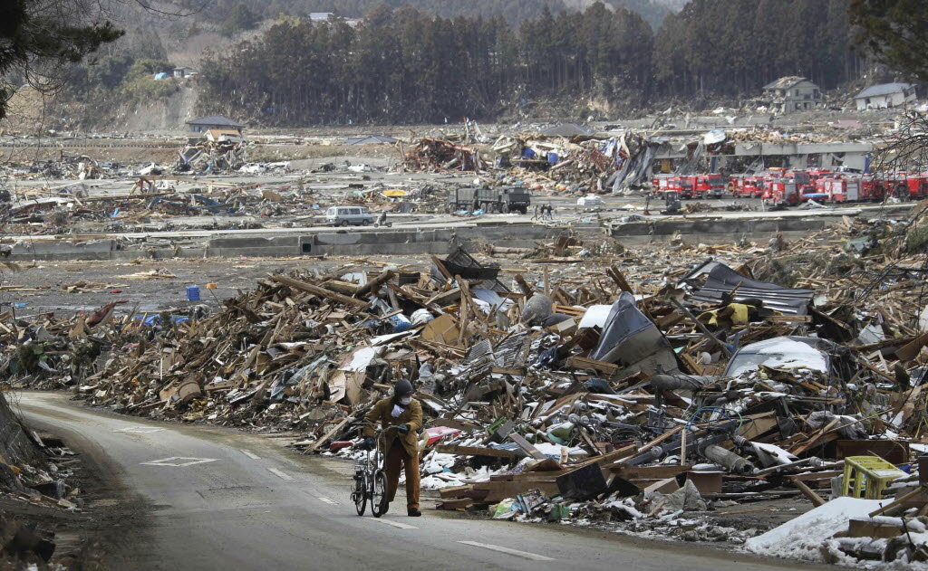
SHORT SUMMARY of JAPAN Triple disaster
Magnitude 9 Earthquake
2. Tsunami
3. Fukushima Dai-chi nuclear power station

Slide 6
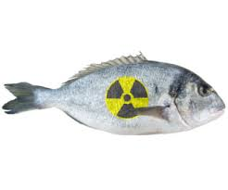
International Nuclear and Radiological Event Scale (INES) rating of 7(highest level)
5,000 to 15,000 terabecquerels of radioactive material was reaching the ocean.
Several species of fish caught off the coast of Fukushima in 2011 and 2012 had cesium levels that exceeded Japan's regulatory limit for seafood

Slide 7
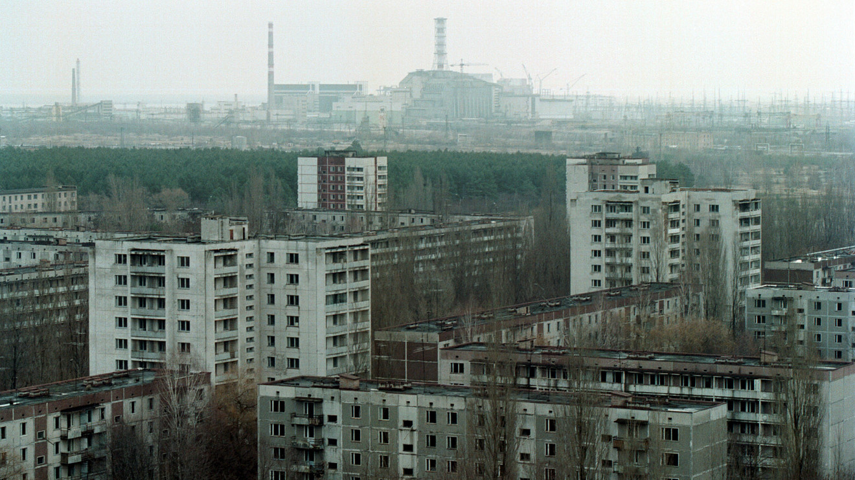
COMPARISON WITH CHERNOBYL
Same INES level
Chernobyl 7 times more severe
Chernobyl affected more humans //japan more to the ocean
Little public health risk in japan as compared to chernobyl

Slide 8
Were the risks well communicated to the general public?
Risks analysis by government
2. Risks explanation by the media

Slide 9
What did the government say?
government representative chief scientific adviser, Sir John Beddington
11th March- reassured public that under the “worst-case scenario” there would be no health problems in Tokyo,
March 18th- Sir John's “worst-case scenario” became enhanced
"the danger to Tokyo would be modest” and would only involve staying indoors for 48 hours.
Later on - change to “consider leaving”

Slide 10
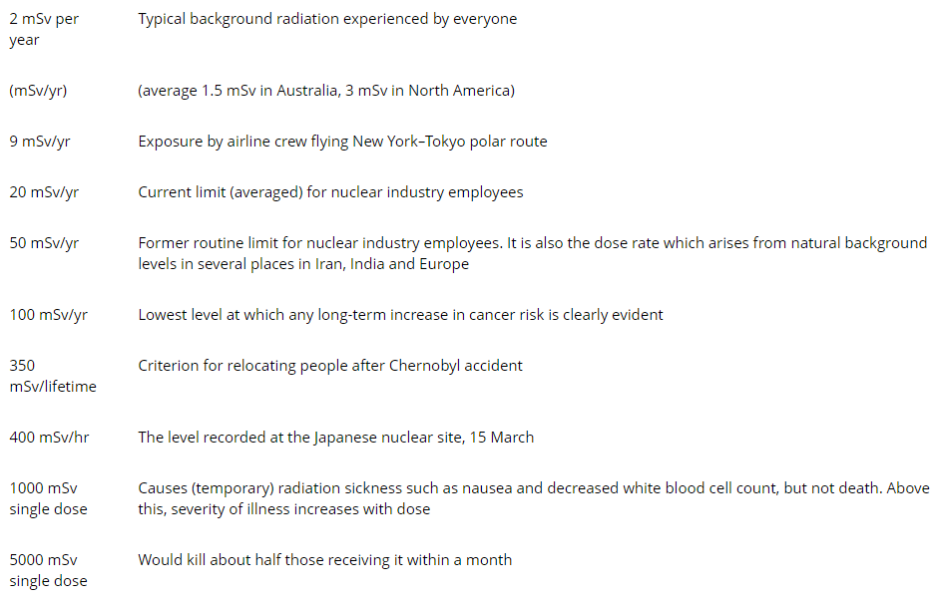
Media attempting to explain the exposures using a single uni (millisievert)
Notes:
total exposure is relevant VS rate at which it is ingested

Slide 11
RATE VS TOTAL EXPOSURE

Slide 12
Another common form of explanation
a sample of spinach was estimated to have 1.47 becquerels of 131I per kilo – they estimated you would need to eat 750 kg of this spinach to get the same exposure as from a single round trip flight from San Francisco to Washington, DC (0.05mSv).
MSV = millisievert

Slide 13
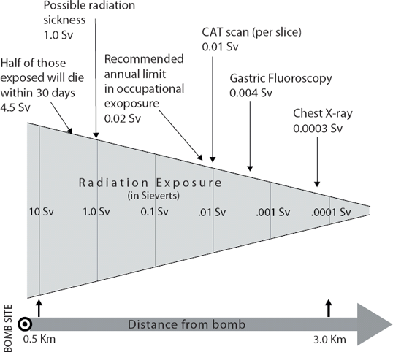
750KG of spinach == 0.05mSv

Slide 14
QUESTION
DO YOU FEEL MORE ENLIGHTENED ABOUT THE RADIATION RISKS OF FUKUSHIMA NOW?

Slide 15
SO BACK TO THE QUESTION
Were the risks well communicated to the general public?

Slide 16
Take Home Message
Don’t anyhow bomb.
Don’t Know Say Don’t Know.
Don’t try to act smart when you are not.
Do not make empty promises.

