Slide 1
Failed promises of the cigarette industry and its effect on consumer misperceptions about the health risks of smoking
Group 3

Slide 2
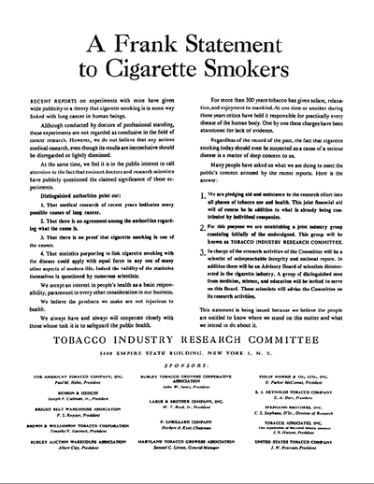
Background
In 1954, US cigarette manufacturers released an ad titled “A Frank Statement to Cigarette Smokers”
Ad appeared in 448 newspapers in 258 cities, ie. estimated reach of 43245000 people
Aimed to debunk research findings that cigarettes cause cancer; to emphasize safeness of their products
Made several ironic promises (to be mentioned later)

Slide 3
Promise 1
Cigarette manufacture make promises about how their products are not harmful.
In 1943,Philip Morris told smokers that his cigarette has been scientifically proven to be less irritating to the nose and throat.
In 1946,Brown Williamson used baseball legend Babe Ruth to assure his consumer that his product is safe.But,it was later found that Babe Ruth had died of lung cancer.

Slide 4
Promise 2
Promised to support and make known research related to tobacco use and human health
Led to the establishment of Tobacco Industry Research Council (TIRC), now known as Council for Tobacco Research (CTR)
However, most funded projects researched on the relation of smoking and health, and few on studying cancer and heart disease
Reason: Chairman of TIRC (back then) felt that time would be wasted since no studies has been conducted on tobacco smoke; TIRC was not involved in epidemiological studies

Slide 5
Promise 2 (cont’d)
Majority of scientists in CTR believed the causation between cigarette smoking and fatal diseases, but CTR refused to acknowledge this causation
Period when cigarette companies invested billions to redesign their products that seemingly reduce consumers’ exposure to smoke, literally no research was done on the new products

Slide 6
Promise 3
The cigarette manufacture also claim that they will alway cooperate closely with those whose task is to safeguard the public health.
However,there is abundant evidence to show that the tobacco industry actually went to great lengths to undermine tobacco control effort.
In 1972, the Tobacco Institute Vice President Fred Panzer,had described the industry of creating doubt of the health charges and also advocating the public to smoke.

Slide 7
Failed promises
Despite the promises made to disclose information about smoking and health issues to the public,internal industry documents reveal that they actually failed to keep their promises.
The purpose of the Frank Statement advertisement was just there to assure the smokers that it was safe to smoke rather than showing the negative implication of smoking.

Slide 8
Consumer beliefs about the health risk of smoking
Consumers optimistically believed that their personal risk illness is no greater than average.
Due to misperception that they will be able to stop smoking before health problems occur.
Misperception ignores the fact that majority of smokers are dependent on nicotine.
beliefs about smoking as a cause of lung cancer have changed over time.

Slide 9
Consumer misinformed about smoking
recent surveys shows that consumers continues to be misinformed.
A national probability telephone survey (conducted by cohen) found that: a) little knew about the tar levels of their own cigarettes b) most did not know how to interpret the tar ratings
Convenience survey of 52 current and 24 former smokers (conducted by Hastrup and colleagues) showed that: a) 58% incorrectly believe that addition of filter would make their cigarette safer
1995 nationwide survey found that: 30-40% of smokers failed to acknowledge their higher average risk of heart disease and cancer caused by smoking.

Slide 10
Conclusion
Failure of cigarette companies to honour the promises has resulted in a public that even today remains misinformed about the health risks of smoking.
The Frank Statement tells us that producers may not always be honest about their products, especially when the products are likely to be harmful to human health.
Carry out activities in moderation (heavy smokers found it difficult to quit due to addiction to nicotine).

