Slide 1
DatA AND CONSUMER – DANGER AND OPPORTUNITY BAD SCIENCE, CH 8
Cheong Hui Ping | Liew Xuan Qi | Hong Chuan Yin

Slide 2
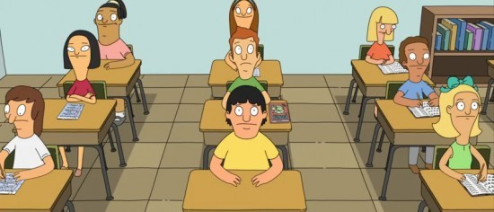
Question
Do you think that trials have been done on mainstream children about fish oil pills’ effectiveness?

Slide 3
Answer
Surprisingly, NO
The media are not referring to real trials and studies

Slide 4
Areas of Discussion
What lessons can we learn from the Durham “trials”?
Medicalisation
Media and misreporting
Why still happening?
Impacts

Slide 5
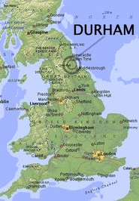
Durham case study
5000 children involved
6 fish oil pills a day donated
by Equazen
Track if their GCSE results are
better than predicted
Widely covered in media

Slide 6
“WILL FISH OIL PILLS MAKE MY CHILD A GENIUS?”
Medicalisation – reframing issues as easily solvable by medicine
Notes:
So the durham trials are an example of medicalization
The city council certainly seem to think so – if they decided to run the study

Slide 7
Proper trials…
have control groups – placebos
To account for the natural tendency of children to make progress anyway
Also to check whether effect is due to pill and not act of taking a pill, or fact that one is being observed (Hawthorne effect)
Don’t confidently assert they know the end results for sure
Conducted in an objective manner – measurable outcomes
Class | Fish pill | Placebo
Class 1 | 30 | 30
Class 2 | 20 | 20
Class 3 | 10 | 10
Notes:
Often medicalisation has shoddy research work thrown in as well to try to give it a legit appearance

Slide 8
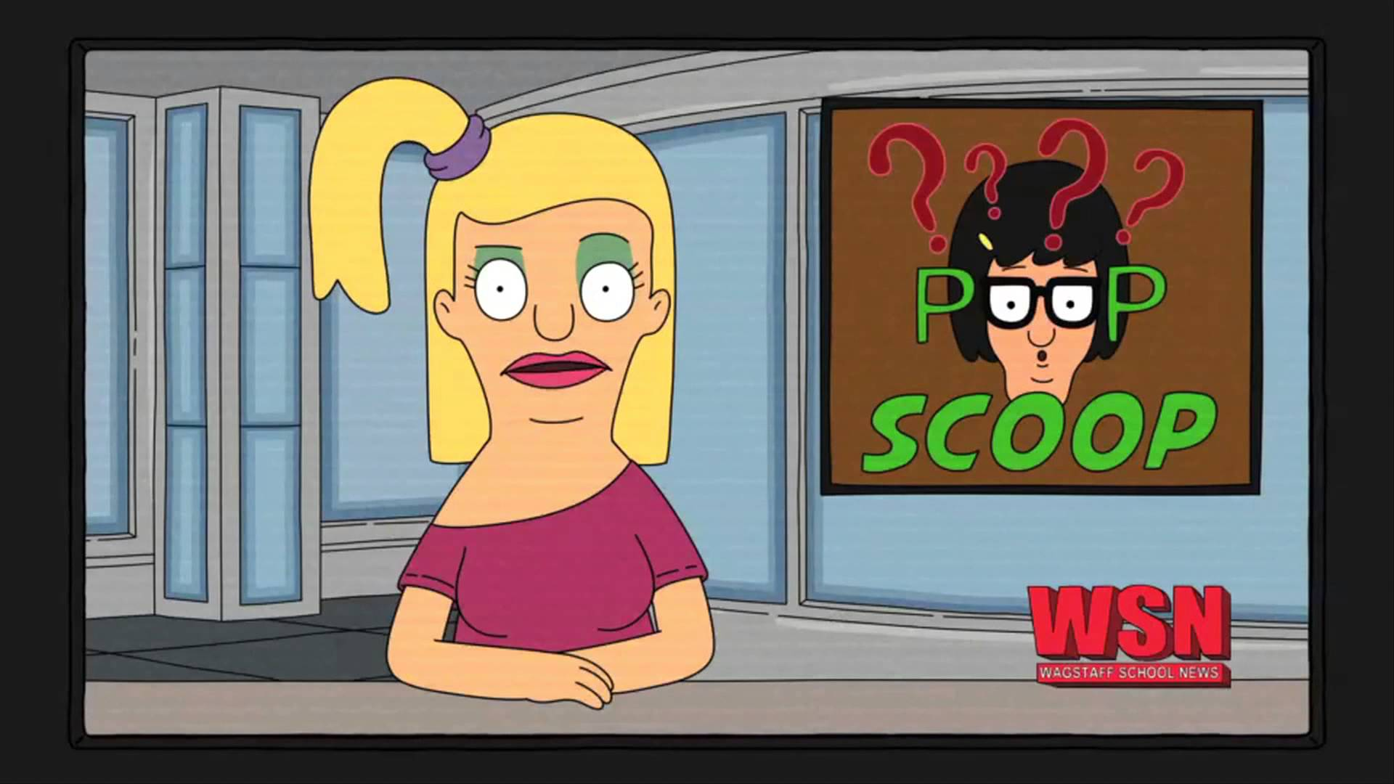
Proper trials… BUT WHAT ABOUT DURHAM “TRIALS”?
Madeleine Portwood, psychologist
Dave Ford, Head of Education
NO control groups – placebos
Confidently assert they know the end results for sure
Media frenzy framing the exercise
Priming
Notes:
Link to next – in fact, the media was used multiple ways to mislead and confuse

Slide 9
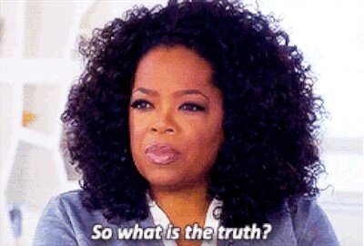
Tracking the media outreach
2006 – “Fish Oil Study Launched to improve GCSE Grades”
The term “trial” is removed from website’s original press releases
SO WHAT IS THE TRUTH?
2008 – council denies ever intending to track exam grades
Termed a “trial” in media, and website, and parent information leaflets
2008 – improvement rate of GCSE results falls
Refuse to provide data from their supposed studies

Slide 10
Why and how do problematic trials still occur?

Slide 11
Who’s involved?
Media journalists
Government
Big Pharma
Notes:
Durham – very bad exam track record –govt fighting to pull up grades, throwing many different initiatives at the kids. Political agenda may not align with proper science and research
Media journalists – coached, rewarded and outright provided with things to write about. Little statistical knowledge

Slide 12
How come medicalisation persists?
Public
Big pharma
Fast and easy solution
Reality – complex problems usually have complex causes, and would require effort and time to improve
Running out of ideas!
50 drugs registered a year in 1990s → 20 now, and copies
Solution? Invent new problems that can be solved by their existing drug arsenal

Slide 13
WHAT ARE THE IMPACTS?

Slide 14
Impacts of problematic research
Harms public faith in real research
Trivialise effort needed to produce quality research
Public has the right to know – yet there was no publishing of actual trial data, or statistical significance. The little information given doesn’t stand up to scrutiny.

Slide 15
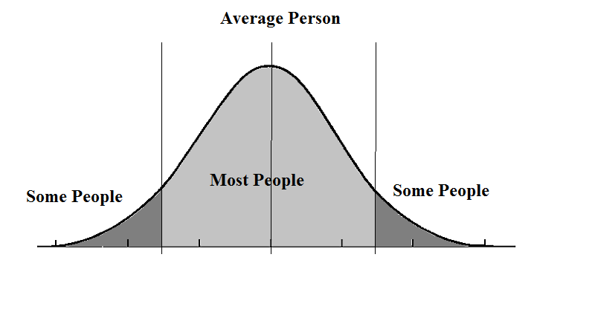
Goldacre’s opinion of the Durham “trials” fiasco
Unethical! Children were involved in study, but parents and educators denied access to data
Cost of pills $1.42/day VS school meal spending $1.15/day
Demeaning to cultivate
impression that we need
pills to solve what are
presented as problems

Slide 16
Areas of Discussion
What lessons can we learn from the Durham trials?
The trend of “medicalization”
What is Goldacre’s opinion on the Durham fish oil trials?
Why do and how do problematic studies still occur? What are the impacts of such exercises?
Notes:
What lessons can we learn from the durham trials?
Durham story as a case study
Misuse of terms and medicalisation
Different multiple agenda and why it still persists
Impacts – ethic breaches, reduce public faith

Slide 17
Closing thoughts
Research needs to be done experimentally in the correct way
We cannot rely on just the media to talk about research
The scientific field needs to be able to communicate in a clear manner that is not excessively technical

Slide 18
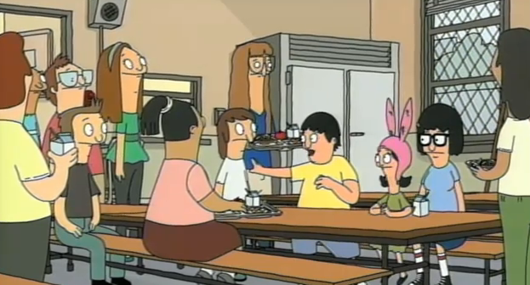
Thank you

