Slide 1
When will we see people of negative height?
By Group 1: Boon Xuan, Mei Ying and Fatin
Based on “When will we see people of negative height” by Patrik Perlman, Beat H. Possen, Veronika D. Legat, Arnd S. Rubenacker, Ursel Bockiger and Lisa Stieben-Emmerling in Significance (Feb 2013)

Slide 3
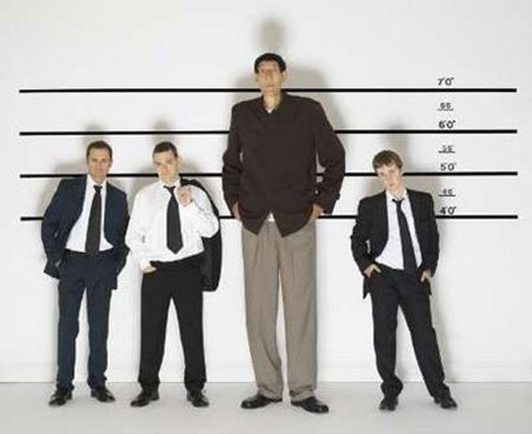
Negative Height?
Sultan Kösen, Turkey, 8'3" (2.51 m)
Zhang Juncai, China, 7'11" (2.42 m)

Slide 4
Negative height?
Chandra Bahadur Dangi, a 72-year-old Nepali declared the world's shortest man by Guinness World Records officials at 21.5 inches

Slide 5
Overview
Background
Normal Distribution
The Problem
The Counter-Argument
The Proving
Conclusion

Slide 6
Background
The heights of Human Beings follow the normal distribution
Taking Americans as a gauge, most of them centre round a mean value of 1.776m for Grown males, 1.632m for females.
A minority of them will be taller than 1.90m and lesser than 1.50m.
Graph it out, you will get a bell curve, a normal or a Gaussian Distribution.

Slide 7
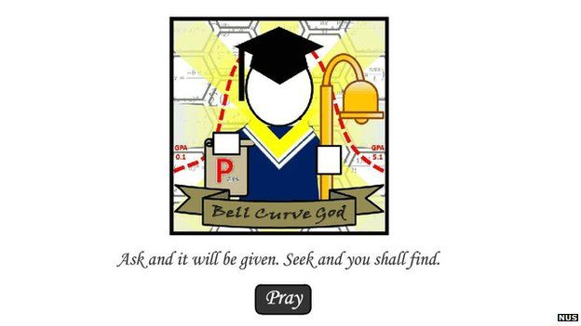
Normal Distribution
What is it?
A very common continuous probability distribution.
Often used in the natural and social sciences to represent real-valued random variables whose distributions are not known.
Notes:
a very common continuous probability distribution. Normal distributions are important in statistics and are often used in the natural and social sciences to represent real-valued random variables whose distributions are not known.

Slide 8
Normal Distribution(empirical rule)
Notes:
The empirical rule states that for a normal distribution, nearly all of the data will fall within three standard deviations of the mean. The empirical rule can be broken down into three parts:
68% of data falls within the first standard deviation from the mean.
95% fall within two standard deviations.
99.7% fall within three standard deviations.

Slide 9
Normal Distribution(CLT)
Why is it useful?
Central Limit Theorem
It establishes that, for the most commonly studied scenarios, when independent random variables are added, their sum tends towards a normal distribution even if the original variables themselves are not normally distributed.
This implies that the probabilistic and statistical methods that work for normal distributions can be applicable to many problems.
Notes:
In probability theory, the central limit theorem (CLT) establishes that, for the most commonly studied scenarios, when independent random variables are added, their sum tends toward a normal distribution (commonly known as a bell curve) even if the original variables themselves are not normally distributed. In more precise terms, given certain conditions, the arithmetic mean of a sufficiently large number of iterates of independent random variables, each with a well-defined (finite) expected value and finite variance, will be approximately normally distributed, regardless of the underlying distribution.^{[1][2]} The theorem is a key concept in probability theory because it implies that probabilistic and statistical methods that work for normal distributions can be applicable to many problems involving other types of distributions.

Slide 10
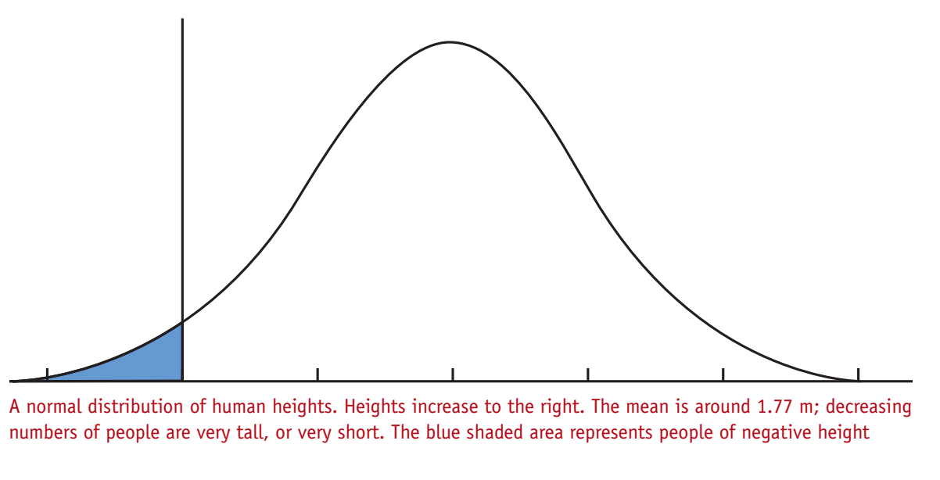
The Problem

Slide 11
The Counter-Argument

Slide 12
The Counter-Argument
So is using a normal distribution as a model for human heights wrong? I mean how can there be a person with negative height?

Slide 13
The Counter-Argument
However, do we really have enough evidence to exclude the occurrence of negative body height among adults?

Slide 14
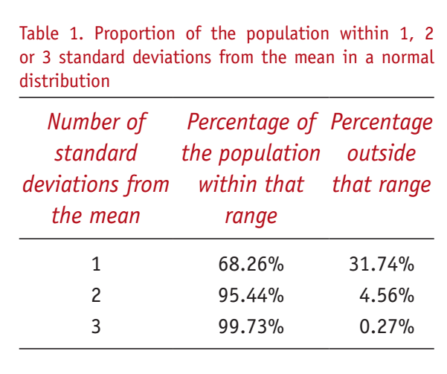
The Proving
We are given the mean and the standard deviation.

Slide 15
The Proving
So what proportion is more than 18.5 SD away from the mean?
Using a software to calculate, the answer will be 1.03 x 10^-76.
That is on average one person in 9.71 x 10^75 which is the probability of a person being of zero or negative height.

Slide 16
The Proving
What is the Probability of there being a fully grown adult with negative body height?
We can estimate there to be 5.17 billion adults in the world.
So using results from earlier on and some math techniques, we get the probability to be 1 in 2 x 10^66.

Slide 17
The Proving
What is the probability of a fully grown adult with negative height among the people who have lived on earth?
It has been estimated that number of people who ever lived on earth is 107.6 billion.
Using the same technique previously, we yield a probability of 1.11 x 10^-65

Slide 18
The Proving
How many people are necessary to have ever lived on earth in order to observe at least one fully grown adult with negative body height with a probability of at least 95%?
The answer is 2.9 x 10^76 as given by a software.

Slide 19
The Proving
By when can we expect to reach this necessary number of people ever lived on earth?
Assuming that population is growing at 11.15 per 1000 per year. We will need to wait for 13842 years from now, in the year ad 15855.

Slide 20
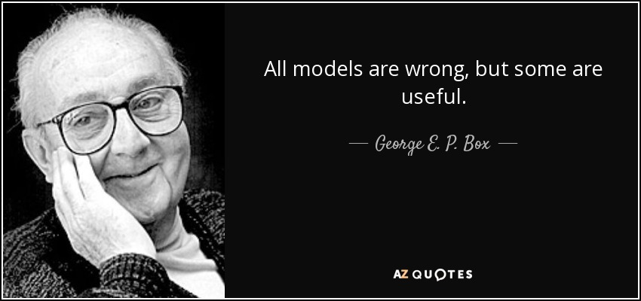
Conclusion
Even after combining with current information available on height of fully grown adults, is just not enough to exclude the possibility that a person with negative body height could exist.

