Slide 1
THE NONSENSE DU JOUR
Somesh*
Yongjia
James

Slide 2
LE OVERVIEW
"Four key errors" made by so-called "nutritionists"
The case for/against antioxidants.

Slide 3
DOES THE DATA EXIST?

Slide 4
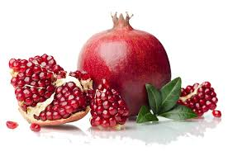
Notes:
Asks crowd abt pomegranate and try to sell them idea!

Slide 5
THE POMEGRANATE STORY
PREVENTS WRINKLES
NO OFFICIAL STUDIES
SPECIFIC CLAIMS
THE “BULLSHIT” IDEA
Notes:
The study talked about pomegreneate or pomo juice in helping the skin stay young and prevent wrinkles
Specific claim about plastic surgery where those who drink after surgery can heal in half the time.
No concrete studies about the topic at hand
Lack the academic experience
bulshit - neither true nor false(picks them out or makes things up to suit his purpose)(basically its not backed up by any evidence)

Slide 6
OBSERVATION OR INTERVENTION?

Slide 7
OBSERVATION VS INTERVENTION
Notes:
OBSERVATION STUDY
Drawing inferences from sample in a population( so no assignemnt)
INTERVENTION STUDY
RANDOMLY ASSIGNED TO AN EXPERIMENTAL GRP RECIEVEING THE INTERVENTION AND TREATEMENT GRP(pLACEBO GRP)

Slide 9
Study was done
BUT OBSERVATIONAL
LEADS TO…...
Notes:
So there was a study that was done, different eating habits, different pools of people, can assume different amount of wrinkles (so obrsevational)

Slide 10
CONFOUNDERS

Slide 11
confounder is an unobserved exposure associated with the exposure of interest and is a potential cause of the outcome of interest.Confounders lead to bias that distorts the magnitude of the relationship between two factors of interest.

Slide 12
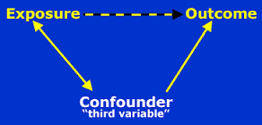
Notes:
Basically an extra varable that you didnt count for so in this case it could be the type of background, the number of varying wrinkles, the type of food that they use live oil, the type of olive oil etc etc

Slide 13
FROM THE LAB BENCH TO THE GLOSSIES
Notes:
Extrapolating studies done form the lab to urself
Can up regulate or downregulate the results

Slide 14
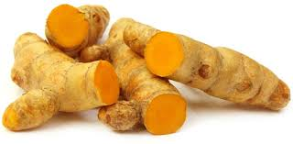
Notes:
So apparently tumeric, helps to prevent cancer !!! it has this in it called curcumin. So if they say tumeric helps to prevent cancer, its not like u can takethat much of tumeric.. But each amount of tumeric only hold so much of it. So there is alot more to think about

Slide 15
Curcumin
The maount of it in each amount of tumeric.

Slide 16
Case Study
‘Britain’s Leading Nutritionist’, Dowden
Advice given ‘based on research’:
=>Eat more olive oil: Protection against skin wrinkling
Matches research findings?
=> Research was OBSERVATIONAL STUDY
CONFOUNDING VARIABLES at play
Notes:
See pg 89 -91 of book
Pt1. A monicker given.
Pt2. Baseless cllaim made by her (Dowden)
Pt3. Research doesn’t actually show Dowden’s claim: intervention study needed to prove her claim.
Pt4. Turns out that observational study involves plenty of possible confounders: ppl who eat more olive oil may be more health-conscious / or richer / come from different cultural background.

Slide 17
Lessons Learnt
Careful with extrapolating results from observational study
=> CONFOUNDERS may affect results

Slide 18
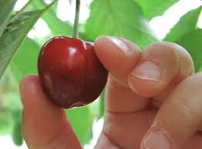
“CHERRY PICKING”

Slide 19
What is CHERRY PICKING
Supressing evidence
To ignore evidence that may contradict their data
Only using the data that support your stance.

Slide 20
Why is it bad?
The idea of using all the information at your disposal instead of only those that might be useful to you.
Here’s an example…..

Slide 21
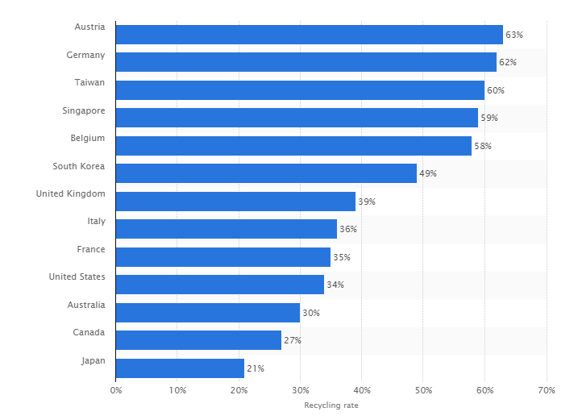
World recycling rates 2015

Slide 22
Waste Type | Recycling rate (%)
CONSTRUCTION DEBRIS | 99
Ferrous metal | 99
Scrap tyres | 92
Wood | 79
Paper/cardboard | 51
Glass Food | 19
Food | 13
Textiles/Leather | 8
PLASTICS | 7

Slide 23
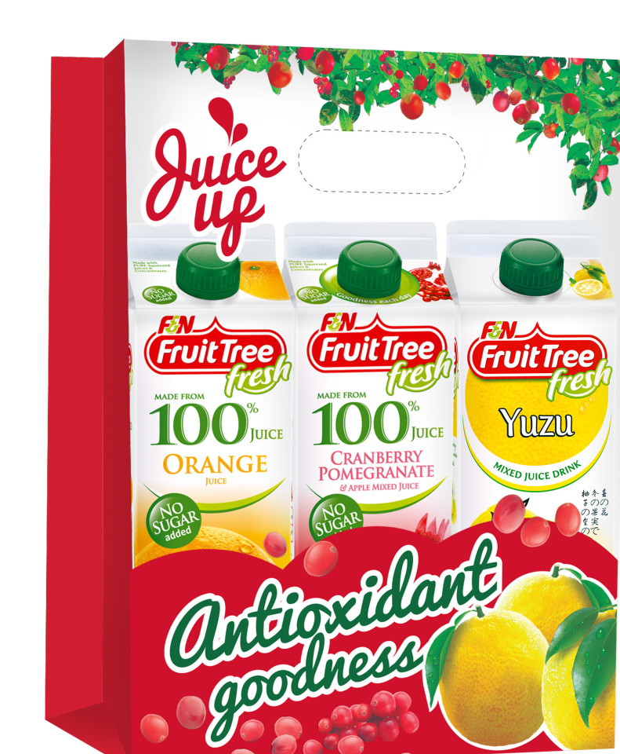
The Case of
Antioxidants
The free radical theory of ageing

Slide 24
The Case FOR Antioxidants
Higher beta-carotene intake => lower risk of cancer
Case-control study and cohort study

Slide 25
The Case AGAINST Antioxidants
2 large trials of antioxidants
=> 30,000 participants high-risk of lung cancer to receive beta-carotene, vitamin E
=> ‘CARET’ Study
Apparent harm instead of benefit with use of antioxidants

Slide 26
Why don’t we know about this?
(Public Ignorance)
Unexpected finding
Food supplement industry’s publicity gimmick
Media’s inability to challenge industry’s claim
Paralysed by confusion

Slide 27
TAKE HOME MESSAGE
Never bullshit your way through life.
A Good research is grounded on true data and not bullshit.

