Slide 1
The nonsense du jour
Topic: Misleading with or without data
Group 4: Yong Ming, Timothy, Bernetta
Presenter: Bernetta

Slide 2
Outline Of presentation
Types of misleading data
Observational study
Does the data exist?
From lab bench to the glossies
Case study: Antioxidants
Conclusion

Slide 3
Types of misleading data
Without data
Essential data are not stated
Not taken into account during the research
With irrelevant data
Any random science added just to add credibility
Theoretical data from lab used

Slide 4
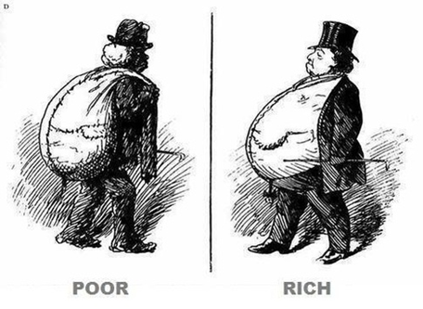
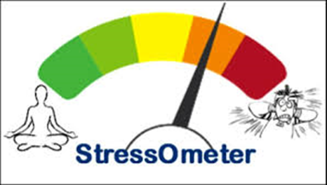
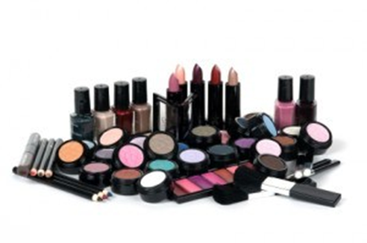
Observational study
Context: olive oil offers measurable protection against skin wrinkling
Variables: Wrinkles and food
Confounders

Slide 5
Observational study and its data
Need to be very cautious
Observational study prone to confounders
Extrapolated too far from the actual data
Withholding crucial data
Mislead people to make the wrong decisions

Slide 6
Does the data exist?
Misleading with irrelevant data
Example: pomegranates and wrinkles
An article from Newsnight concluded that a recent study in American proves that eating pomegranates can protect us against aging
There is no such study
The authors actually knows the truth but only wants to impress us

Slide 7
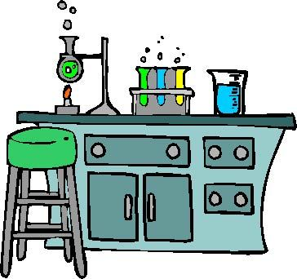
From lab bench to the glossies
Magazines often quote the results from lab research
Searching thoroughly through the internet to find random bits of science
Wants to add credibility to the article
Need to be cautious about how to extrapolate from lab to real life complex system

Slide 8
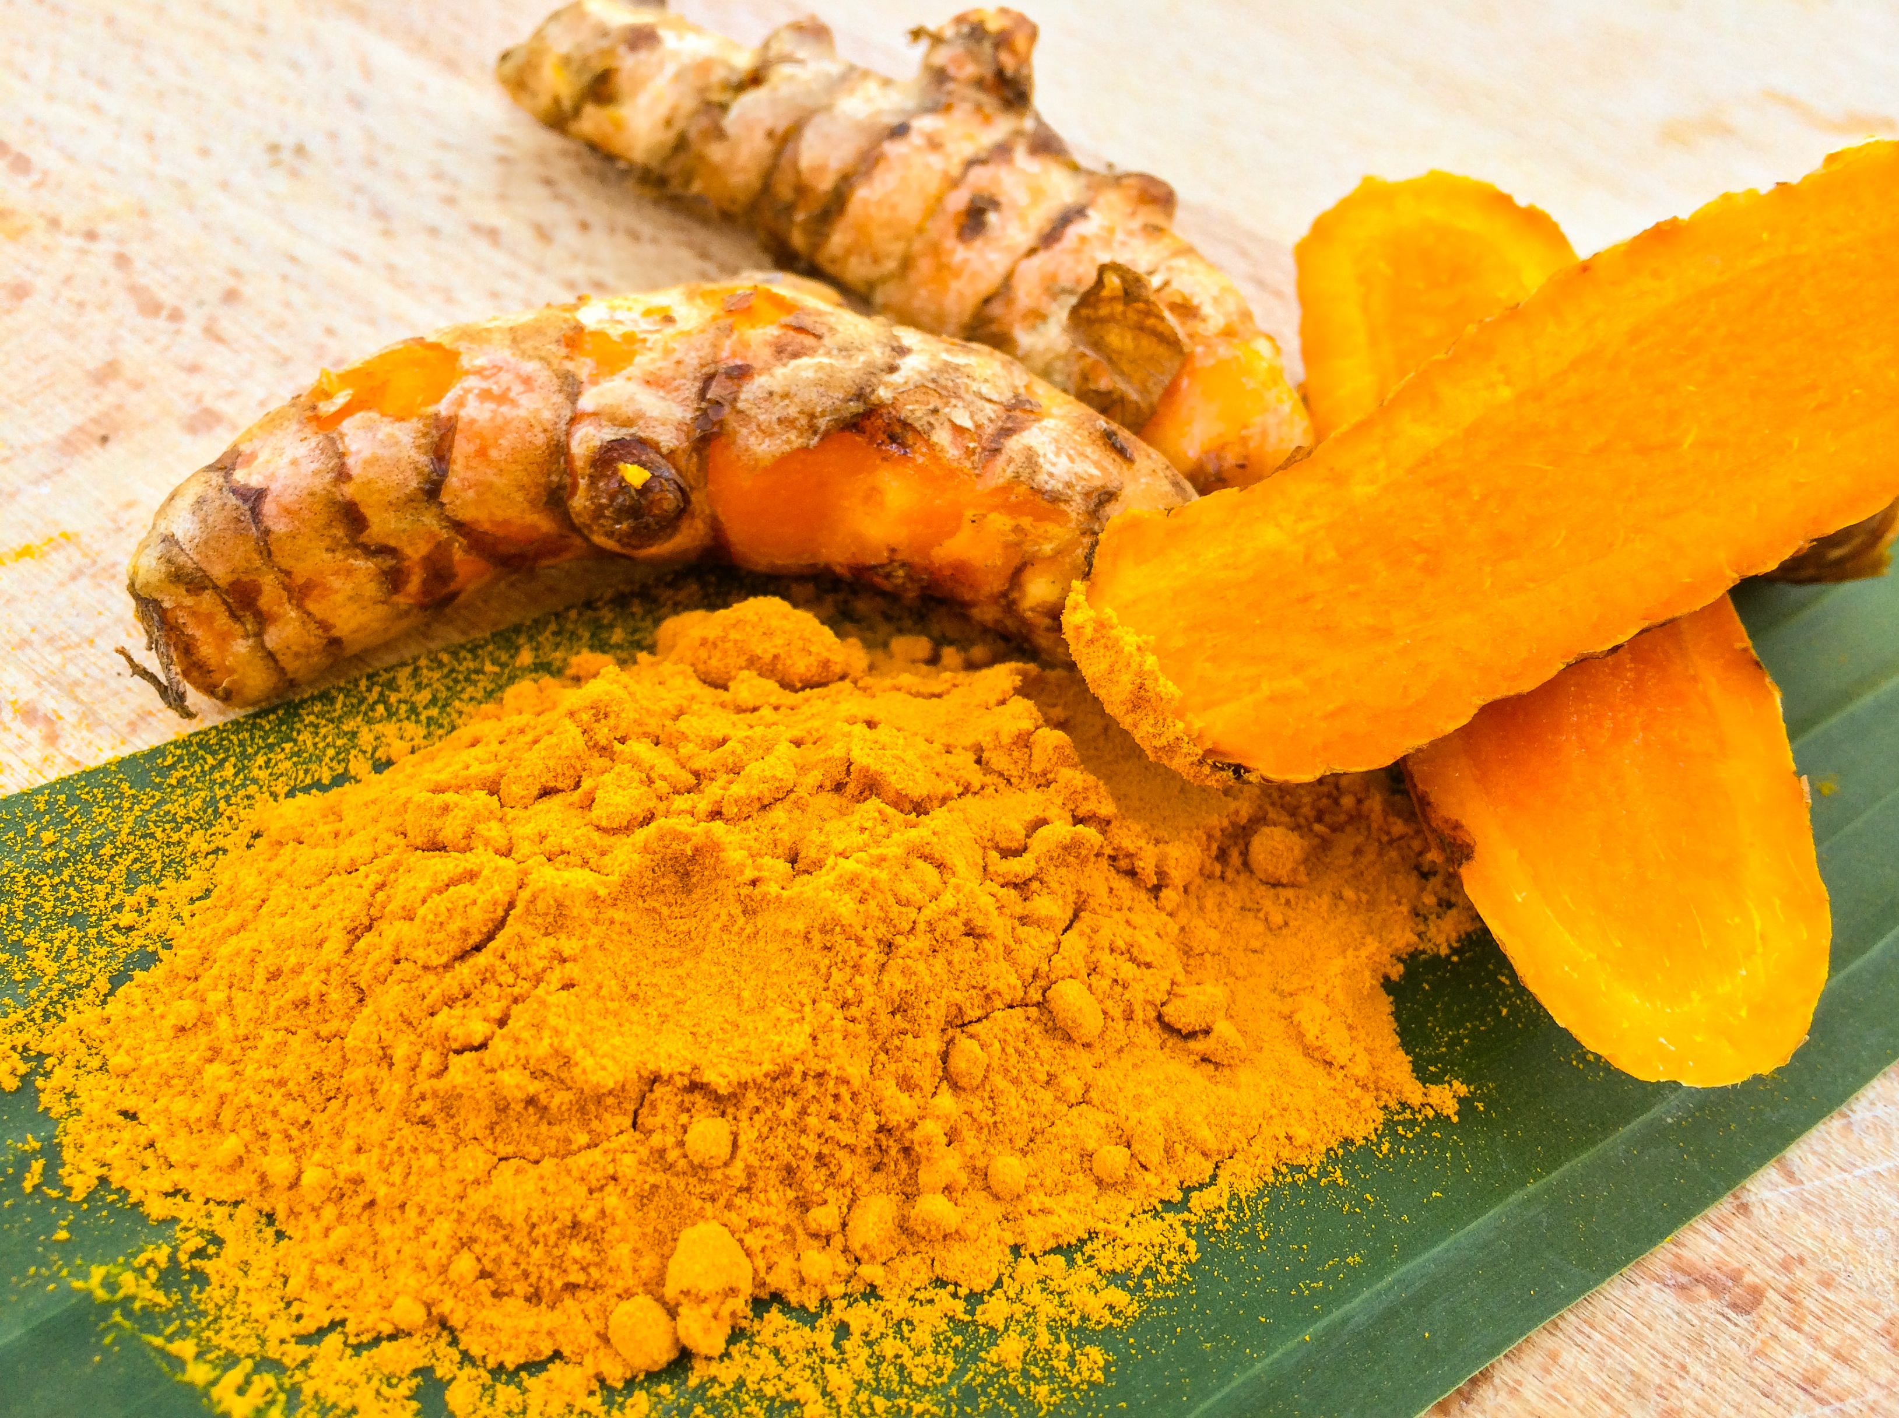
From lab bench to the glossies
Example: turmeric (curry)
Protective against cancer
Turmeric extract tipped on animal cells
Can we conclude the results from this experiment?
Very little curcumin is absorbed in our body
Need to eat a few grams to reach a significant serum level
Means that we need to eat 100g of turmeric

Slide 9
From lab bench to the glossies
Context: drug companies
Making claims on tenuous grounds
Even though they are not allowed to talk to patients, they constantly annoy doctors to help them
Use theoretical advantages, animal experiment data or ‘surrogates outcome’ to add credibility to their product

Slide 10
From lab bench to the glossies
Misleading with irrelevant data
Often weakly associated with real world issues (disease)
Developed in a very idealised world of an experimental animal
Does not show clear dose-response relationship
Kept under conditions of tight physiological control
Tissue and disease in animal model may be very different to living human system, even worst with a lab dish model
May be related to the disease in a different way

Slide 11
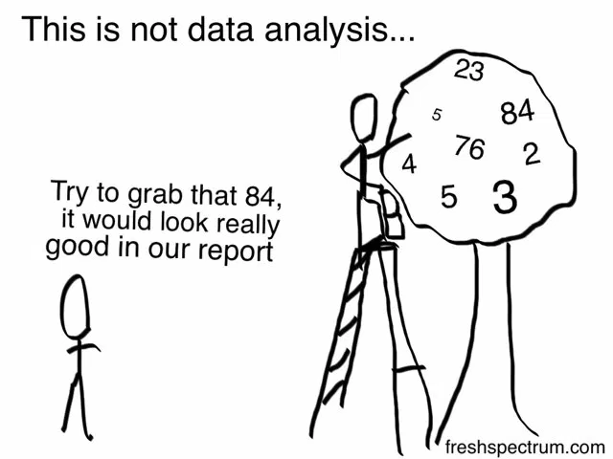
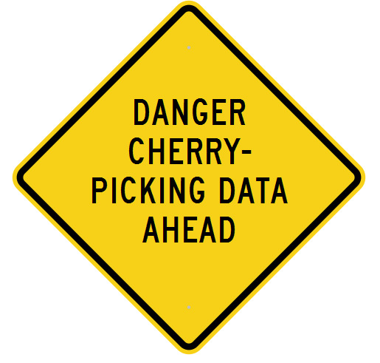
Cherry-Picking
“The idea is to try and give all the information to help others to judge the value of your contributions; not just the information that leads to judgement in one particular direction or another.”
~Richard P. Feynman

Slide 12
Cherry-Picking
Leads to misleading with irrelevant data
Solution: systematic review
Do an explicit research strategy to find data
Tabulate characteristic of each study
Measure the methodological quality
Compare alternatives
Give a critical, weighted summary
Can save more lives than you could possibly imagine

Slide 13
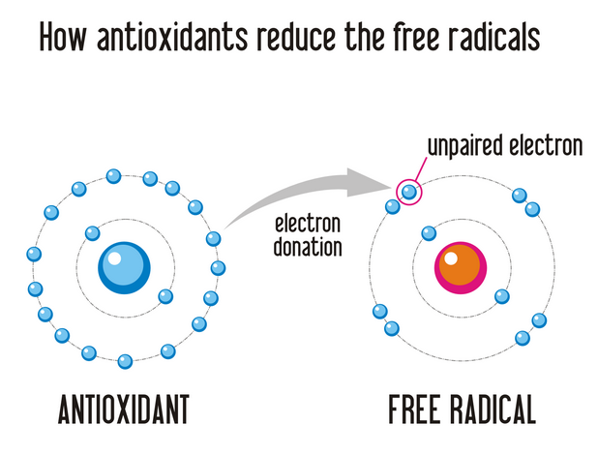
Case-study: Antioxidant based on a research done in the past
Helps to remove free radicals in our body
Free radicals will damage DNA, leading to cancer
Does eating more antioxidants prevent cancer?

Slide 14
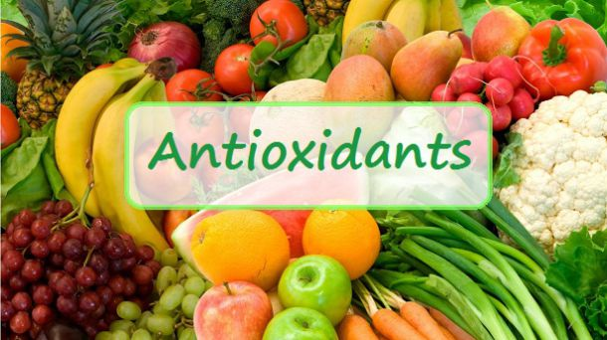
Case-study: problems
Free radicals are not always bad
Does not necessarily make processes more efficient
Results are not definite
Why antioxidant seem to be good 20 years ago
People are healthier back then and eat more fruits and vegetables which have a lot of antioxidants

Slide 15
Case-study: past experiment
Studies showed a positive relationship between a lot of B-carotene and reduced risk of cancer
Case control studies: cancer free subjects have higher plasma carotene
Prospective cohort study: there is twice as much lung cancer in the group with lowest plasma carotene compared with those with the highest
Shows that antioxidants are very good

Slide 16
Case-study: modern experiment
18,000 participants recruited and randomised
All at high risk of lung cancer
Half received B-carotene, other half received placebo
Results: people having antioxidant 46% more likely to die of cancer than those who took the placebo
Terminated early due to ethical issues
Systematic research
Assess quality of studies
Results: antioxidants are either ineffective or actively harmful
Results in more deaths instead

Slide 17
Case-study: conclusion
Things that work in theory often do not necessarily work in practice
Misleading with irrelevant data
Should not be blindly following theoretical data and assuming that this must be automatically map into a dietary advice

Slide 18
Overall conclusion
Misleading by withholding crucial data:
Observational studies
Misleading by irrelevant data:
Quoting directly from theoretical lab data
Cherry-picking
Systematic processes
THANK YOU

