Slide 1
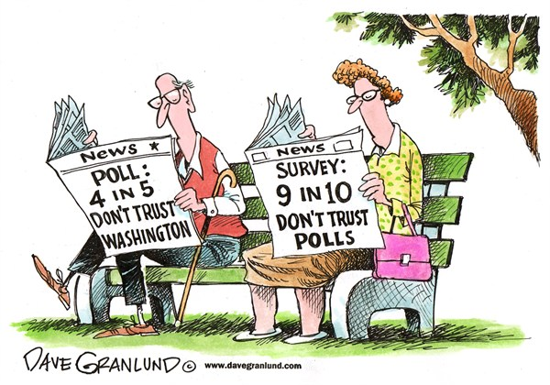
Misleading Election Polls
Liew Xuan Qi (A0157765N)
Cheong Hui Ping (A0127945W)
Hong Chuan Yin (A0155305M)

Slide 2
Curtains at Number Ten:
predicting the general election
Significance 7 (1), 24–26.
Moon, N. (2010).

Slide 4
What happens in an election?

Slide 5
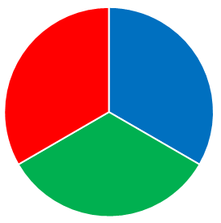
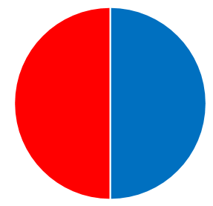
What happens in an election?

Slide 6
What happens in an election?
Parliament

Slide 7
Election Poll
Opinion Poll
Randomly draw out 1000 people’s votes and use it to calculate the election results
Unbiased - random sampling is used
1000 people is representative of an electorate of 50 million votes
Polling results are calculated by verbally asking people who they are going to vote for
Bias:
Sampling bias (Volunteer Sample)
People might not be truthful

Slide 8
What can opinion polls reasonably tell us and what they cannot

Slide 9
3 Questions
Why does Moon think that reporting of polls in the newspapers is often misleading?
Why is prediction of the result from the national poll difficult?
Did Moon correctly predict the hung parliament as a possibility?

Slide 10
3 Questions
Why does Moon think that reporting of polls in the newspapers is often misleading?
Why is prediction of the result from the national poll difficult?
Did Moon correctly predict the hung parliament as a possibility?

Slide 11
Why does Moon think that reporting of polls in the newspapers is often misleading?
Media Attention
Betting

Slide 12
Why does Moon think that reporting of polls in the newspapers is often misleading?
Media Attention
Publish polls with surprising results that catches the attention of readers even though it might not be true
The more surprising a poll result was, the more likely it is wrong, and the more media coverage it is likely to get

Slide 13
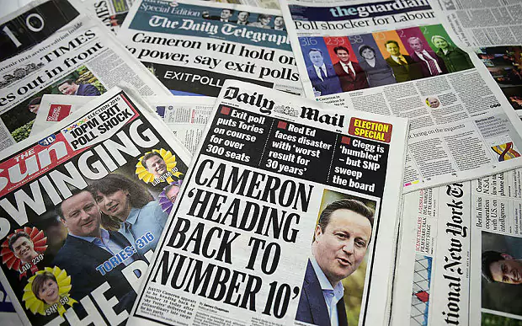
Why does Moon think that reporting of polls in the newspapers is often misleading?
Media Attention
Publish polls with surprising results that catches the attention of readers even though it might not be true
The more surprising a poll result was, the more likely it is wrong, and the more media coverage it is likely to get

Slide 14
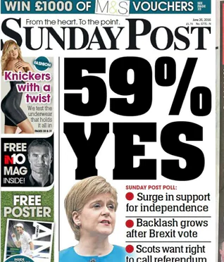
Why does Moon think that reporting of polls in the newspapers is often misleading?
Media Attention
Publish polls with surprising results that catches the attention of readers even though it might not be true
The more surprising a poll result was, the more likely it is wrong, and the more media coverage it is likely to get

Slide 15
Why does Moon think that reporting of polls in the newspapers is often misleading?
Media Attention
Publish polls with surprising results that catches the attention of readers even though it might not be true
The more surprising a poll result was, the more likely it is wrong, and the more media coverage it is likely to get

Slide 16
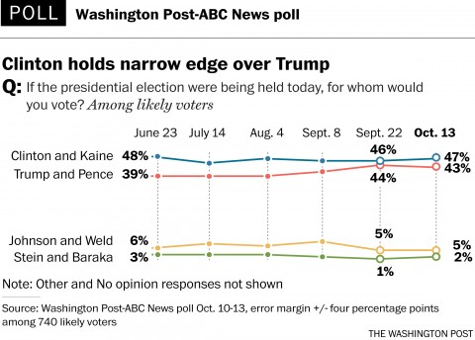
Why does Moon think that reporting of polls in the newspapers is often misleading?
Media Attention
Publish polls with surprising results that catches the attention of readers even though it might not be true
The more surprising a poll result was, the more likely it is wrong, and the more media coverage it is likely to get

Slide 17
Why does Moon think that reporting of polls in the newspapers is often misleading?
Betting
People place their bets on the back on these untrue results
Bets on offer tend to be in terms of the number of seats while opinion polls tell us about the popular votes → it is difficult to make a conversion between these two

Slide 18
3 Questions
Why does Moon think that reporting of polls in the newspapers is often misleading?
Why is prediction of the result from the national poll difficult?
Did Moon correctly predict the hung parliament as a possibility?

Slide 19
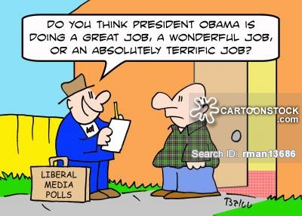
Why is prediction of the result from the national poll difficult?
BIAS
Electoral System
Electoral Geography

Slide 20
Why is prediction of the result from the national poll difficult?
Electoral system
A system of single-member constituencies each won on a first-past-the-post basis
Majority of votes does not translate into majority of MPs
The red electoral party won 100% of the seats on the back of 40% of the votes
28%
27%
39.5%
51%
49%
25%
20%

Slide 21
Why is prediction of the result from the national poll difficult?
2. Electoral geography
Gerrymandering of seats
Shifting in boundaries results in wasted votes in safe areas

Slide 22
Difficulties in reducing bias
‘Vote share equals seat share’
‘Equal seat size’
‘Boundary refinement’

Slide 23
Difficulties in reducing bias
‘Vote share equals seat share’
If a party wins 30% of the votes overall, it gets 30% of the seats in Parliament
Labour seats are smaller and ‘easier’ to win
Difference in constituency size

Slide 24
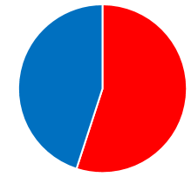
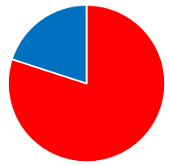
Difficulties in reducing bias
‘Equal seat size’
All constituencies need the same amount of votes to win
Abandon some guiding principles such as taking into account geography → some countries bigger than others
Difference in percentage of votes
55%
80%

Slide 25
Difficulties in reducing bias
‘Boundary Refinement’
Commissions refine boundaries based on electorate size (every country has 10 million people)
Electorate size changes (change in number of people who are eligible to vote)
Time is needed for the review
New revision would be out of date when it is put in place

Slide 26
3 Questions
Why does Moon think that reporting of polls in the newspapers is often misleading?
Why is prediction of the result from the national poll difficult?
Did Moon correctly predict the hung parliament as a possibility?

Slide 27
Did Moon correctly predict the hung parliament as a possibility?
Hung parliament: no majority in the house for either major party
It is ideal to have a parliamentary majority
→ vote for laws to be
passed
Parliament
Parliament

Slide 28
Did Moon correctly predict the hung parliament as a possibility?
Yes. He predicted a hung parliament for the 2010 elections
Currently the conservatives are leading, but by a small margin → small drop in the current conservative lead could lead to a hung parliament
The results were a hung parliament
The conservatives formed an alliance with the social democrat

Slide 29
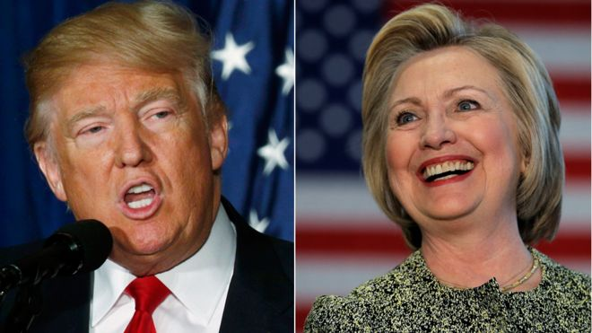
Take home message
Do not trust what the polls says fully.

Slide 30
99% of all statistics only tell 49% of the story
Ron DeLegge II

Slide 31
Thank YoU!
Any Question?

