Slide 1
When the facts get in the
way of a story
GROUP 1
Celestine
Walter
Jun Yue (Presenter)

Slide 2
OUTLINE
Background information
The Times report vs Government survey results
What is p-value?
What is clustering?
What is multiple comparison?
Do you think the journalist who wrote the story was misleading readers deliberately or merely through ignorance?

Slide 3
‘When the facts get in the way of a story’
Appeared in Significance, a bimonthly magazine in the United Kingdom and the United States
Author: Ben Goldacre, Bad Science column writer in The Guardian
Published on 1st April 2006
Won the Royal Statistical Society (RSS) Journalism Competition in 2007

Slide 4
‘Cocaine floods the playground’
“Cocaine floods
the play-ground.
Use by children
doubles”
Could
this be true?
Front page of The Times: “Use of the addictive drug by children doubles in a year”
The Telegraph, The Mirror also reported a double in the usage
Government survey reported “almost no change in patterns of drug use, drinking or smoking since 2000”

Slide 5
Who is right?
9000 children, aged 11 to 15, in 305 schools
No change in prevalence of drug use
Reported figures: 1% yes in 2004, 2% yes in 2005 Doubled? YES
Actual figures: 1.4% yes in 2004, 1.9% yes in 2005 Doubled? NO
Increase of 0.5%, about 45 more kids saying “yes” to the question

Slide 6
It IS significant
p-value < 0.05

Slide 7
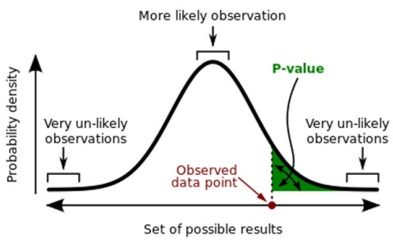
p-value
The probability of obtaining a result equal to or ‘more extreme’ than what was actually observed
Small p-value (≤ 0.05) indicates strong evidence against the null hypothesis
Large p-value (> 0.05) indicates weak evidence against the null hypothesis

Slide 8
It IS significant
p-value < 0.05

Slide 9
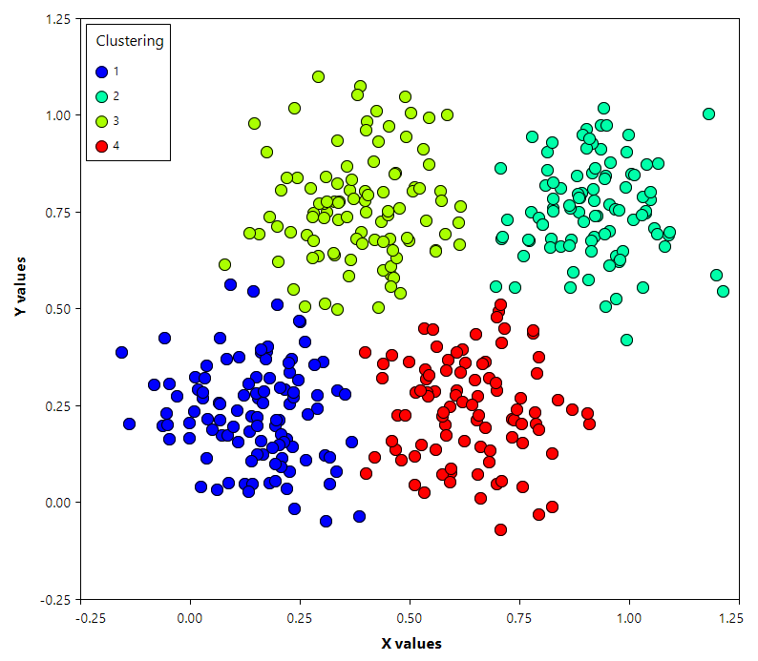
It IS LESS significant
Simply looking at figures then judging significance is misleading
Assumes that every child is independent
Data is ‘clustered’

Slide 10
Clustering
Grouping a set of objects; objects in the same cluster are more similar to each other than to those in other clusters
A main task of exploratory data mining
Unclear, unknown population; geographically convenient sample clusters; clusters form ‘naturally’ in a population
Reduce the total number of interviews and costs given the desired accuracy
Used to estimate high mortalities in cases such as wars, famines and natural disasters

Slide 11
Advantages of clustering
Cheaper – save up on travel expenses, admin-istration costs
Logistically feasible – large populations taken into account

Slide 12
Disadvantages of clustering
Respondents in the same cluster are likely to be somewhat similar to one another; reduced variation – biasness or not?
Effective sample size is reduced
Higher sampling error, compared to any other method; loss of effectiveness – ‘design effect’
Cluster size increases, results in an increase in design effect

Slide 13
It IS LESS significant
Likely to be residing around the same area or learning in the same school; high chance of interaction among the kids
Social factors due to clustering can play a part in influencing the drug use
Since each child is not independent of other children in this experiment, effective sample pool is reduced
Clustering here has increased the p-value

Slide 14
Multiple Comparison
A set of statistical inferences simultaneously or infers a subset of parameters selected based on the observed value
Number of comparisons increases, more likely that groups being compared will appear to differ in terms of at least one attribute
Problem: (Test performed at significance level 5%) Out of 100 comparisons, there can be 5 statistically significant false positives

Slide 15
Multiple Comparison in context
Data points include solvents, smoking, cannabis, ketamine, cocaine
Problem: 5 of the comparisons made can be false positives
Need to do a ‘correction for multiple comparisons’; reduces significance of findings dramatically, but still an important step to test the significance of the data

Slide 16
Do you think the journalist who wrote the story was misleading readers deliberately or merely through ignorance?
News reporters are not Science specialists, unaware of significance of reporting accurate data instead of rounded off figures
Compete for headlines; rounding off figures in order to claim that the rate has ‘doubled’

