Slide 1
Grp 4
Polls??
* James
Somesh Yongjia

Slide 2
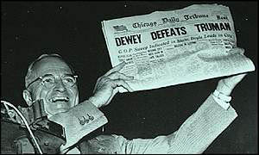
Overview
HOW TO READ A POLL.
Answers to Online Poll
Story behind the photograph
Notes:
Dewey presidency inevitable’ predicted by polls

Slide 3
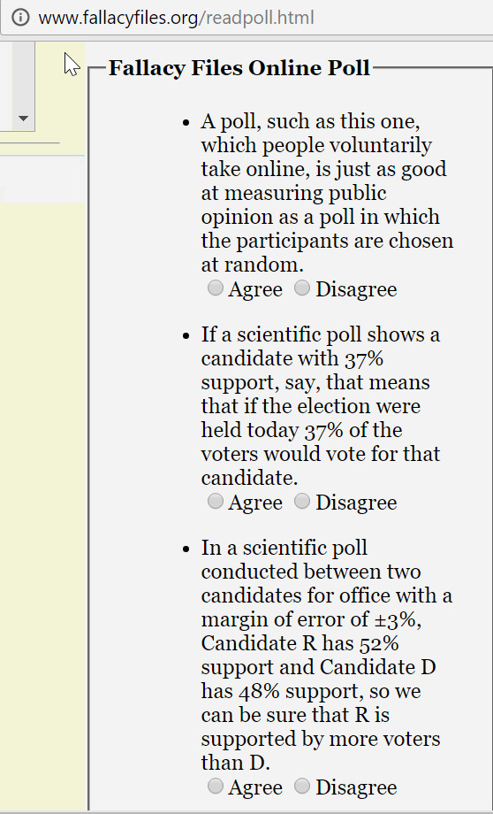
ONLINE POLL
Looks something like this

Slide 4
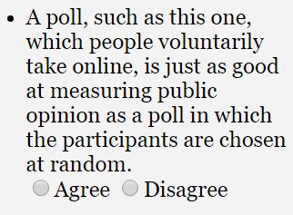
What Do YOU Think?
Q1

Slide 5
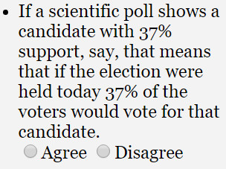
What Do YOU Think?
Q2

Slide 6
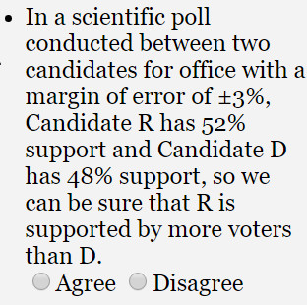
What Do YOU Think?
Q3

Slide 7
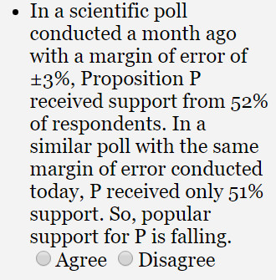
What Do YOU Think?
Q4

Slide 8
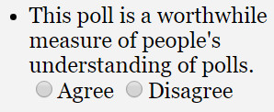
What Do YOU Think?
Q5

Slide 9
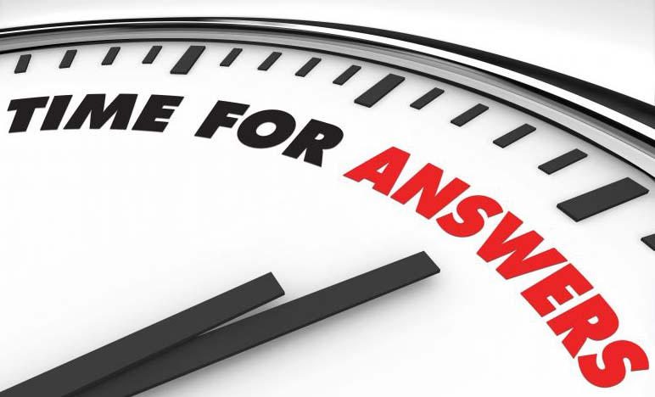

Slide 10
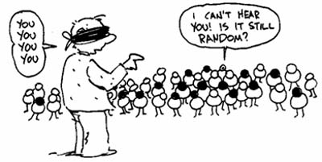
Answer Revealed
Random Sample
Q1
Notes:
Online poll:
Ppl take part voluntarily.
Some ppl do not know about the poll, and others who know about it may not participate.
=> a lot of ppl not involved in poll
VS particpants chosen at random (equal chance of being selected)

Slide 11

Answer Revealed
Self-selected Sample
Q1
Notes:
Online poll:
Ppl take part voluntarily.
Some ppl do not know about the poll, and others who know about it may not participate.
=> a lot of ppl not involved in poll
VS particpants chosen at random

Slide 12
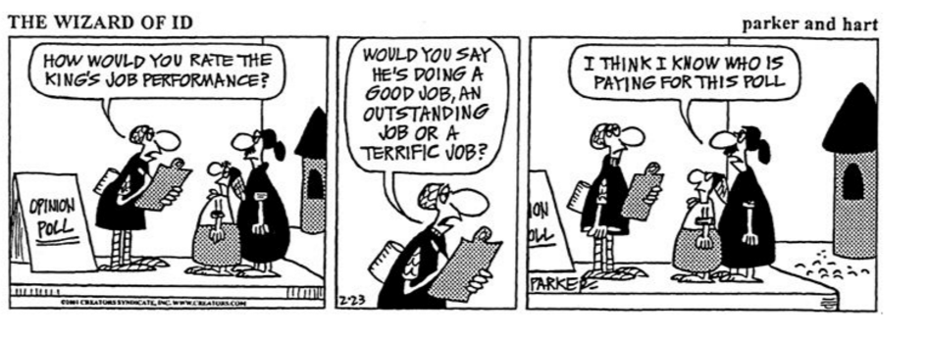
Answer Revealed Q1
BIAS
More motivated response
Can vote more than once
Notes:
Online poll:
Ppl take part voluntarily.
Some ppl do not know about the poll, and others who know about it may not participate.
=> a lot of ppl not involved in poll
VS particpants chosen at random

Slide 13

Answer Revealed
MOE
Q2
Notes:
MoE: for Q2-4

Slide 14
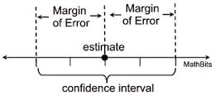
Answer Revealed
MoE (Margin of Error)
Q2
Notes:
MoE: for Q2-4

Slide 15
QUESTION
For each of the following given percentage of supporters in the sample, deduce the CI.
MOE Percentage of supporters for R CI
+-3% 51% (48%-54%)
+-1% 20% (19%-21%)
+-10% 1% (???????)
Notes:
?????? == (go and redo)

Slide 16
Answer Revealed
Q3
R VS D
(49%-55%) VS (45%-51%)

Slide 17
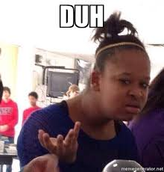
Answer Revealed
OBVIOUS NO RIGHT?
Q4

Slide 18
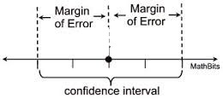
Answer Revealed
BEFORE:
49%
52%
55%
Q4
AFTER:
48%
51%
54%

Slide 19
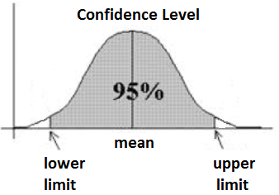
Confidence Interval
Basically how confident you are. 90%? 10%?

Slide 20
Answer Revealed
Q5
Hahahaha. Nice try!!!

Slide 21
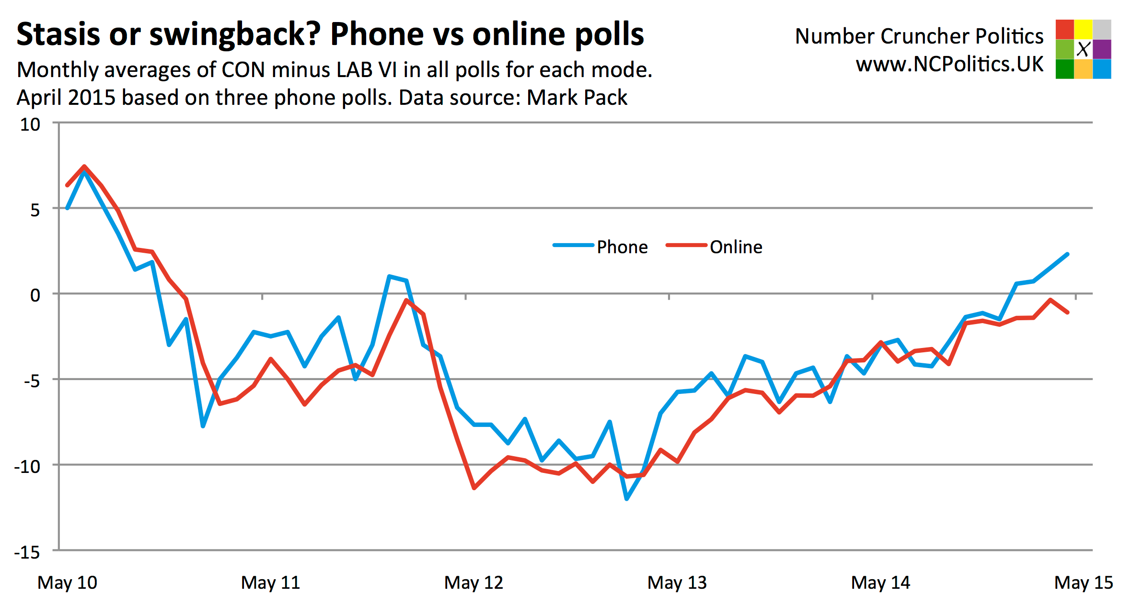
Comparing Polls

Slide 22
Comparing Polls
Even when individual polls do not show clear results, consensus of all polls may do so
Vested interest (BIAS!) of newspapers/networks to report only on polls they have sponsored

Slide 23
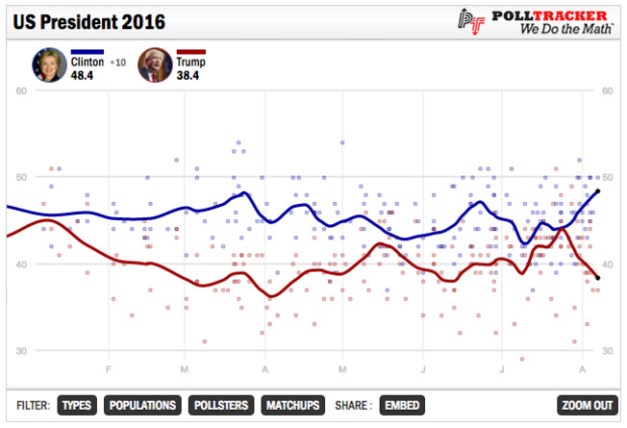
Comparing Polls
If one poll varies from others by more than *MoE
=> probably unreliable
If one poll’s results within MoE of other polls
=> probably reliable
*Margin of Error

Slide 24
Checklist of questions
Scientific or self- selected?
Poll’s MoE?
Other polls on same issue

Slide 25
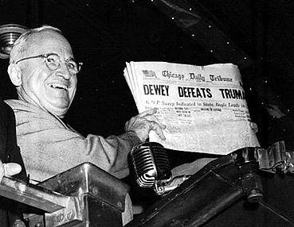
The infamous picture (1948 US elections)
Who is that?
What happened?
The link???
Notes:
"Dewey Defeats Truman"
incorrect headline on the front page of the Chicago Daily Tribune
the day after incumbent US President, Harry S. Truman, won an upset victory over Republican challenger Thomas E. Dewey, in the 1948 presidential election.
famously held up by Truman at a public appearance following his successful election, smiling triumphantly at the error.
THE LINK: online polls can be misleading

Slide 26
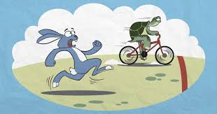
SO BASICALLY,
THE LOSER CAN LOOK LIKE THEY ARE THE WINNER.

Slide 27
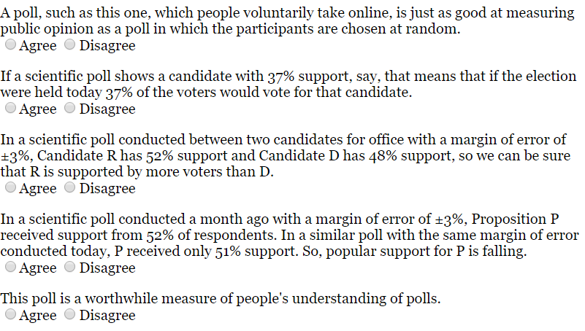
RETEST
DISAGREE
DISAGREE
DISAGREE
DISAGREE
DISAGREE

Slide 28
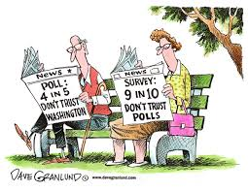
TAKE HOME MESSAGE
Do not believe everything you hear or see when it comes to polls!

