Slide 1
Keeping young and beautiful: evidence for an “anti-aging” product?
Topic: Hypothesis Testing
Group 4: Bernetta, Yong Ming and Timothy
Presenter: Timothy

Slide 2
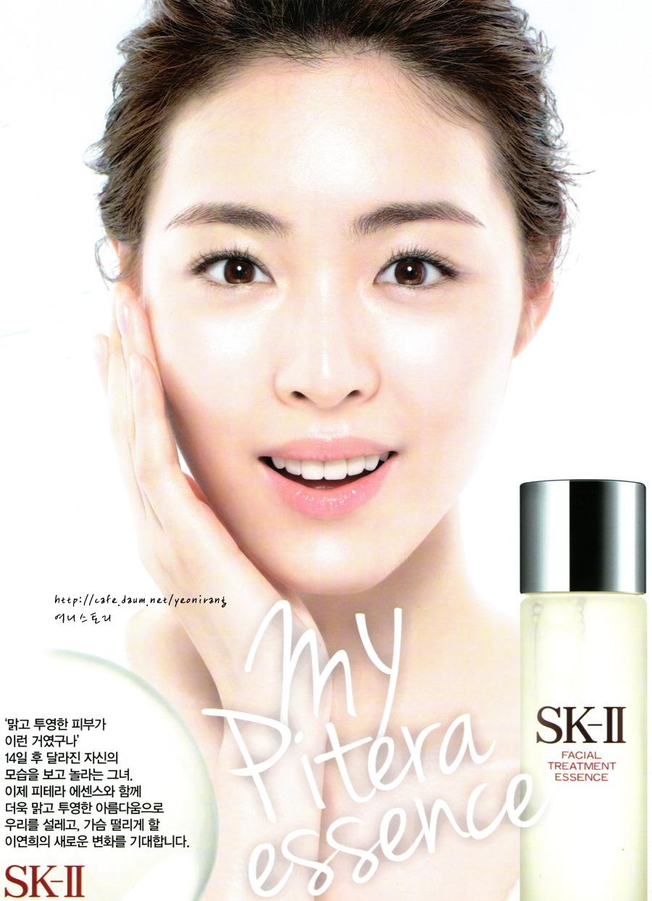
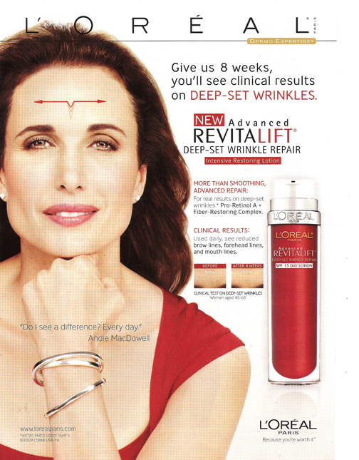
ARE THEY REALLY
ANTI-AGEING?
http://image.elevenia.co.id/ex_t/R/940/1/85/1/src/editorImg/2014/10/02/26213148/2014100220360209398.jpg
http://i.kinja-img.com/gawker-media/image/upload/s--zF8ci-iQ--/18erv9o5h2nv7jpg.jpg

Slide 3
Assigned reading
Bland, M. (2009). Keep young and beautiful: evidence for an"anti-aging" product? Significance, 6(4), pp. 182-183

Slide 4
Outline of presentation
Background of the trial
Discrepancies
Improvements
Take home message

Slide 5
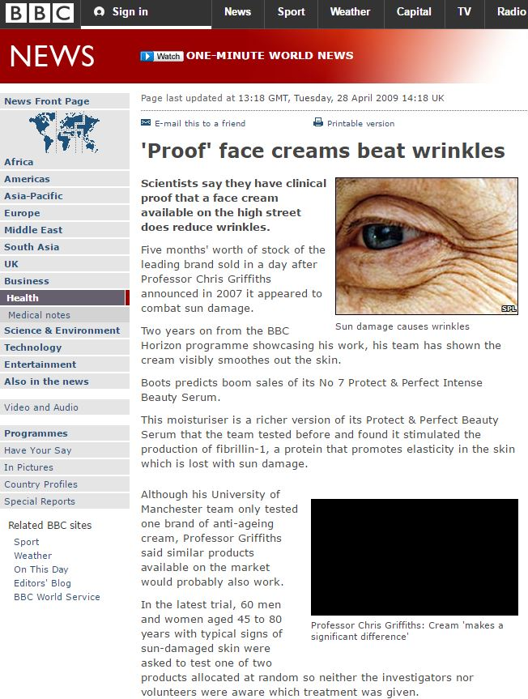
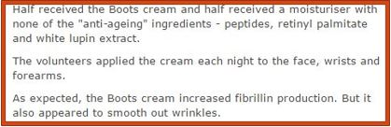
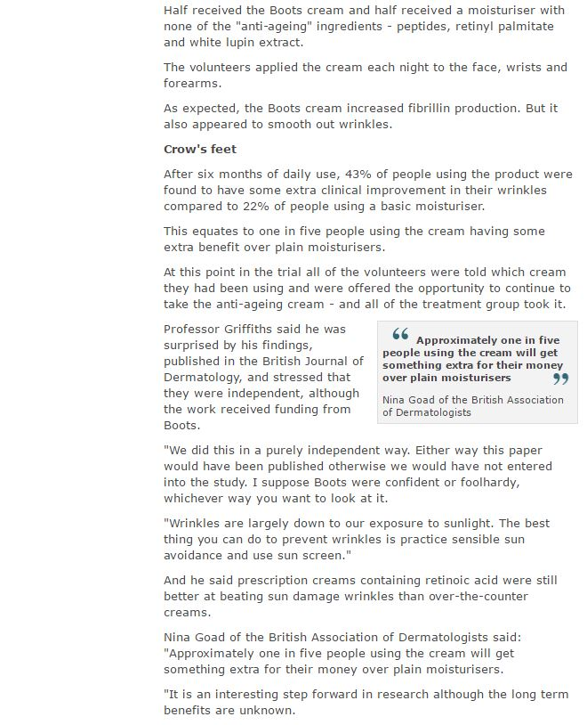
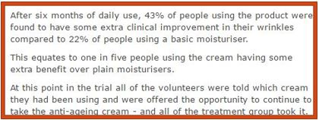

http://news.bbc.co.uk/2/hi/health/8022644.stm

Slide 6
Time frame
Patch test
12 Days
10 participants
Forearm
Double Blind Randomised Control Trial
6 months
60 participants
Face and hands once daily
Open Phase
12 months
28 participant
Skin Biopsies (Dorsal Wrist)
Assessed every 1, 3 and 6 months

Slide 7
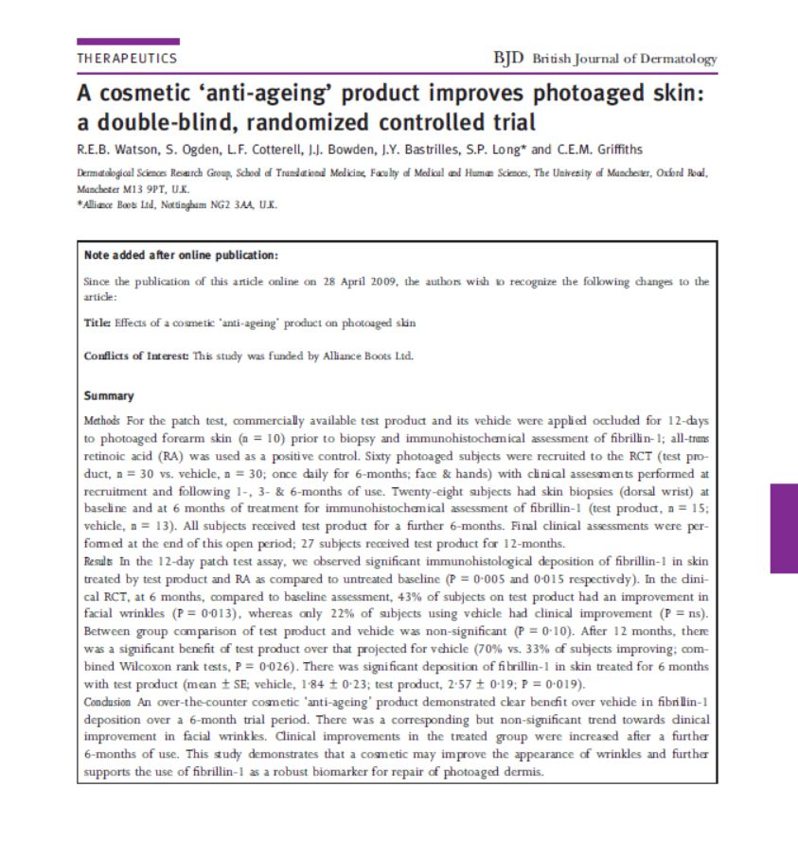
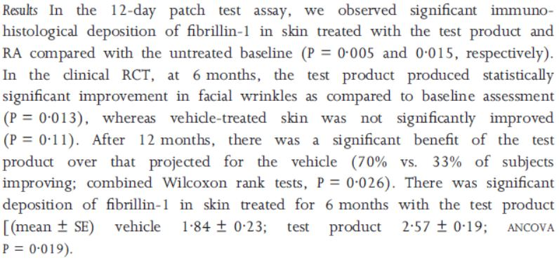
What does this mean?
Watson, R., Ogden, S., Cotterell, L., Bowden, J., Bastrilles, J., Long, S., & Griffiths, C. (2009). A cosmetic “anti-ageing” product improves photoaged skin: a double-blind, randomized controlled trial. The British Journal of Dermatology, 161(2), 419–426. http://doi.org/10.1111/j.1365-2133.2009.09216.x

Slide 8
Findings of trial results
Confidence level: 95% = 5% significance level (0.05)
Control | Serum
Hypothesis Control prove that serum either: Helps in anti ageing Do not help in anti ageing | Hypothesis Serum eithers: Helps in anti ageing Do not help in anti ageing
P-value: 0.11 Observed p-value value > significance value (0.05) Cannot conclude that results are significant! | P-value: 0.013 Observed p-value < significant value (0.05) Results can be concluded to be significant!
Serum helps!

Slide 9
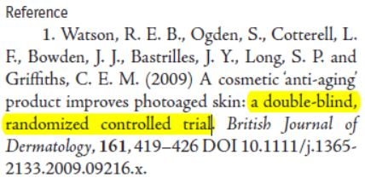
What could have gone wrong?

Slide 10
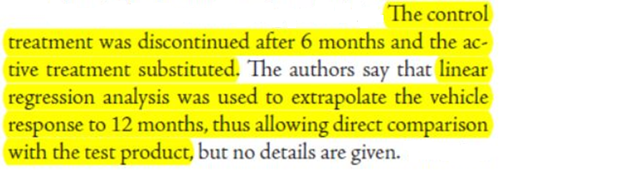
Discrepancy 1

Slide 11
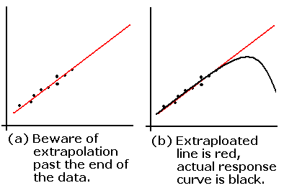
Extrapolation
Can be inappropriate
Often leads to answers out of the norm
Not a good method to predict values
http://condor.depaul.edu/sjost/it223/documents/extrap.gif

Slide 12
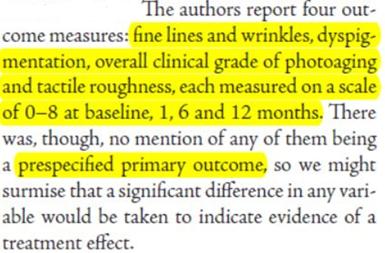
Discrepancy 2

Slide 13
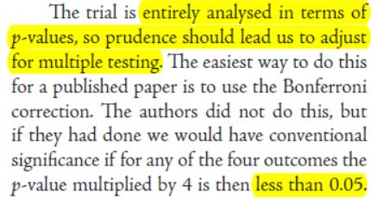
Discrepancy 3

Slide 14
Bonferroni Correction
Multiple testing
Adjusting significance level to α/n, where n = number of hypothesis made
Decreases the possibility of obtaining Type 1 error

Slide 15
Findings of trial results
Confidence level: 95% = 5%/4 significance level (0.05/4= 0.0125)
Control | Serum
Hypothesis Control prove that serum either: Helps in anti ageing Do not help in anti ageing | Hypothesis Serum eithers: Helps in anti ageing Do not help in anti ageing
P-value: 0.11 Observed p-value > significance value (0.0125) Cannot conclude that results are significant! | P-value: 0.013 Observed p-value > significant value (0.0125) Cannot conclude results are significant!
Serum does not help!

Slide 16
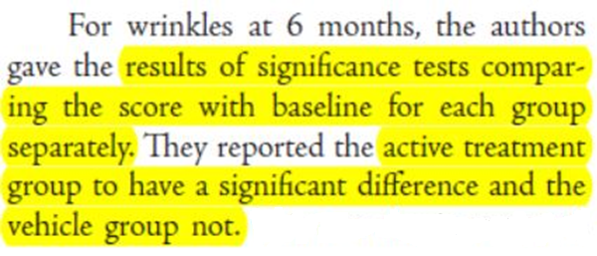
Discrepancy 4
Does not imply no difference or the magnitude of the difference

Slide 17
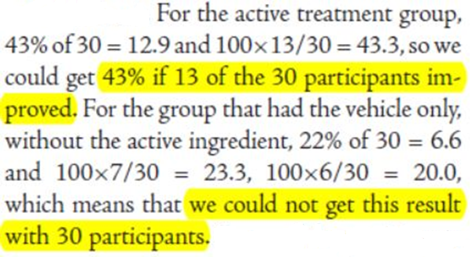
Discrepancy 5
Participants must have dropped out halfway!

Slide 18
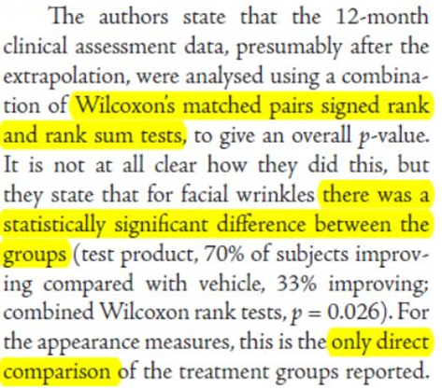
Discrepancy 6
Not enough testing methods?

Slide 19
Improvements
No extrapolation of data
Primary outcome should be specified clearly
Comparison of 2 groups should be done directly
Account for changes in data
More methods to test hypothesis

Slide 20

Take-home message
Within the trial, methods chosen might lead to inaccuracy of what is actually true
The media usually exaggerates the actual findings of a trial
HENCE…
http://pix.iemoji.com/images/emoji/apple/ios-9/256/thinking-face.png

Slide 21




GO NATURAL,
YOU DETERMINE YOUR AGE
http://onelifelivewell.com.au/wp-content/uploads/2015/06/Healthy-Foods10.jpg
http://www.thegeneralpost.com/wp-content/uploads/2016/09/healthy-lifestyle.jpg
http://www.eattoperform.com/wp-content/uploads/2012/01/sleepbaby.jpg
http://assets.yourtailorednews.com/wp-content/uploads/2016/08/happiness_in_the_classroom-e1460739237819_msvze4-1.jpg

Slide 22
Thank you!

Slide 23
REferences
http://www.stat.yale.edu/Courses/1997-98/101/linreg.htm
http://www.stat.berkeley.edu/~mgoldman/Section0402.pdf
http://www.aaos.org/AAOSNow/2012/Apr/research/research7/?ssopc=1

