Slide 1
Importance of sampling for hypothesis testing
Article: Do left-handers die earlier?
Group 3: Annabella Fong, Bok Wen Xuan, Goh Jie Sheng

Slide 2
Outline
Correlation of left-handers with age
Hypothesis testing using sample of Baseball players
Hypothesis testing using sample of recently deceased subjects
Hypothesis testing using sample of cricketers
Hypothesis testing comparing accidental death VS death in action
Emphasising the importance of sampling

Slide 3
Correlation of left-handedness with age

Slide 4
Correlation of left-handedness with age
Left handers die young
Cohort effect : people born many years ago had been encouraged to be right-handed in childhood, whereas those born more recently had been allowed to remain left-handed

Slide 5
Hypothesis testing using sample of deceased baseball players
Only players who have died were used
Lifespan of left-handers slightly shorter than right-handers

Slide 6
Hypothesis testing using sample of deceased baseball players
Wald–Wolfowitz test:
H₀ - distributions from which the samples come are identical in every respect
H₁ - different in some way.
A significant difference may indicate a difference in location, variability, skewness, kurtosis, grouping, etc. but does not show that the longevity of the right-handed population > left-handed
Notes:
To prove whether the left-handers really die younger, they did an experiment…..

Slide 7
Problems of sampling deceased baseball players
Over-representation of left-handers (14% left-handers amongst baseball players VS <9% in population)
Deceased baseball players consists of people who died young (born recently or long ago) and old
affected by other factors along their life e.g.education

Slide 8
Hypothesis testing using recently deceased people of the general population
Mean lifespan was 75.00 years for the right-handed decedents and 66.03 years for the left-handed.
Significantly more left-handers died in accidents; especially the younger people
2875 recent death certificates; 987 usable cases

Slide 9
Hypothesis testing using recently deceased people of the general population
Deaths were very close in time, so young deaths are recorded only among those born recently.
Due to Cohort effect (L.H increased over the years), sampling recently deceased as subjects would increase the apparent difference in mean lifespan between left- and right-handers.”

Slide 10
Hypothesis testing using sample of cricketers
Obtained data of 5960 cricketers - 2573 alive and 3387 dead.
Of these, 1102 (18.5%) were left-handed.
Martin then carried out a survival analysis (taking into consideration the alive and deceased) on the data, using total mortality as the outcome variable and controlling for birth year.
No significant effect of left-handedness on survival (P = 0.3), although risk of death increased slightly for left-handed subjects.
Notes:
Survival analysis i

Slide 11
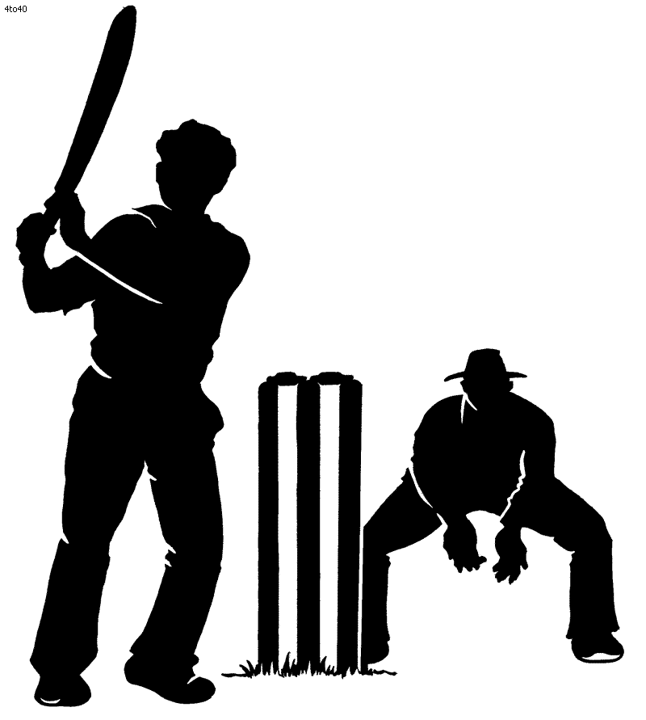
Hypothesis testing for risk of accidental deaths VS deaths in action
For left-handed cricketers, the risk of accidental death at any time is increased significantly by a factor estimated 1.45 (P = 0.03).
Death in action - Cox regression of survival on left-handedness, controlling for birth year, shows a significant relationship (P = 0.009).
Notes:
However there were problems of over-representing the left-handers in cricketers as ive mentioned earlier, hence we still need to be careful in generalizing the data even if there was a significant effect amg the cricketers

Slide 12
Importance of sampling
Cricketers example : over-representation of left-handers
Sample of recently deceased: cohort effect
There is little evidence for an effect of left-handedness on total mortality
Left-handed cricketers higher risk of death in action

Slide 13
Conclusion
It is always important to get an accurate sample for hypothesis testing.

